Slide 1
TRAVELL BROADENS THE MIND

Slide 2
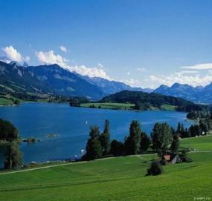
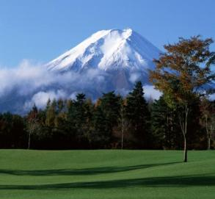
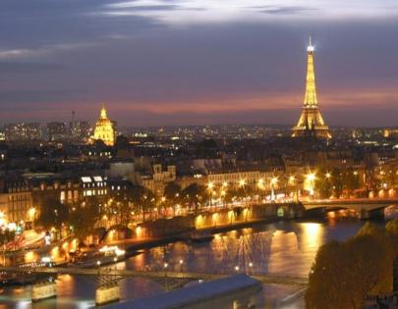
IT IS WORTH SEEING!!!!!

Slide 3
GREAT CHINA WALL

Slide 4
EGYPT PYRAMIDS

Slide 5
JAPANESE GARDENS

