Slide 1
Путешествие в страну знаний…
SCHOOL

Slide 2
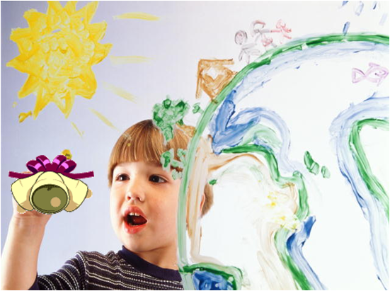
OUR MOTTO
“Tick-tock, tick-tock”,
Says the clock.
“Tock-tick, tock-tick”,
Be quick!”

Slide 3
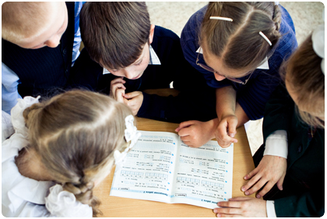
Write down as many words as possible
School
days of the week
activities
subjects

Slide 4
Listen and fill in.
Monday is the …….. day of the week.
Tuesday is the .…….day of the week.
Wednesday is the ……. day of the week.
Thursday is the ……. day of the week.
Friday is the …….. day of the week.
Saturday is the …….. day of the week.
Sunday is the …….. day of the week.

Slide 5
Days of the week
Monday is the first day of the week.
Tuesday is the second day of the week.
Wednesday is the third day of the week.
Thursday is the fourth day of the week.
Friday is the fifth day of the week.
Saturday is the sixth day of the week.
Sunday is the seventh day of the week.

Slide 6
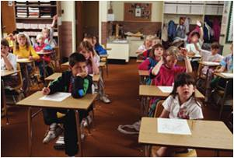
OUR TIMETABLE
School starts at … … .
We go to school … days a week.
We have 5… a day.
We have main … : Russian, Literature, Mathematics, History, Biology and English.
We also … Music, Art, Information Technology, Physical Education
and Technology.
We don’t have lessons on … .

Slide 7
OUR TIMETABLE
School starts at 8 o’clock .
We go to school six days a week.
We have 5 lessons a day.
We have main subjects : Russian, Literature, Mathematics, History, Biology and English.
We also have Music, Art, Information Technology, Physical Education and Technology.
We don’t have lessons on Sunday.

Slide 8
CORRECT THE MISTAKES WE don’t have Literature on Monday. Instead we have History.
MONDAY | TUESDAY | WEDNESDAY | THURSDAY | FRIDAY | SATURDAY
SPE | Technology | Russian | Russian | English | English
Mathematics | Information Technology | Art | Biology | Russian | Biology
Russian | Mathematics | Social Science | History | Music | Literature
English | Physical Education | Technology | English | Physical Education | Mathematics
Literature | Mathematics | Technology | Literature | Biology
Art

Slide 9
OUR SCHOOL TIMETABLE On Monday we have History.
MONDAY | TUESDAY | WEDNESDAY | THURSDAY | FRIDAY | SATURDAY
SPE | Russian | Russian | Russian | English | Music
Mathematics | Information Technology | Mathematics | Mathematics | Russian | Biology
Russian | Mathematics | Social Science | History | Russian | Literature
English | Physical Education | Technology | English | Physical Education | Mathematics
History | Mathematics | Technology | Literature | Biology
Art

Slide 10
Let’s relax
It’s raining, it’s pouring.
The old man is snoring.
He went to bed,
And bumped his head,
And couldn’t get up in the morning.
движения пальчиками, имитирующие капли дождя
сложить руки за голову, изобразив подушку
ладошки под щекой, как будто спим
хлопнуть ладошкой по голове
покачать головой, изображая сожаление

Slide 11
MATCH!
1 History A We read books, speak about them.
2 Maths B I like to read about old times.
3 English C We learn about computers.
4 Literature D It is the language of the world.
5 PE E We learn to write and to speak well.
6 IT F It is great! I like to play football.
7 Russian G The teacher is very good.
8 Art H We learn about nature.
9 Biology I It is OK! I like to sing.
10 Music J I like to draw.

Slide 12
MY FAVOURITE SUBJECTS
I like … . It teaches me to think.
I like … . We read books, speak about them.
I like … . I like to read about old times.
I like … . We learn about computers.
I like … . It is the language of the world.
I like … . We learn to write and to speak well.
I like … . It is great! I like to play football.
I like … . The teacher is very good.
I like … . We learn about nature, trees, flowers.
I like … . It is OK! I like to sing.
I like … . I like to draw.

Slide 13
Составьте небольшое сообщение о школьных предметах. Воспользуйтесь выражениями:
… is great. We speak about interesting people. We read books.
…is very easy. It teaches me to think. I like to read about old times.
… is (not) difficult. It is the language of the world. It helps to find friends.
… is OK! I like to play football (to sing, draw).
… is interesting. We learn about nature, trees, flowers.

Slide 14
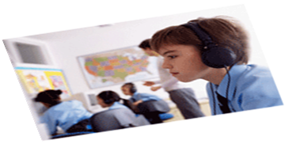
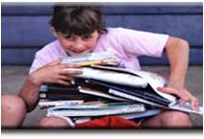
Is it easy to learn on …?
I think Wednesday is great.
I think … is (is not) easy
nice
difficult
interesting
OK
great.
We have … lessons on … .
They are….

Slide 15
Project making
Group 1
Group 2
My favourite day of the week
Group 3
My favourite subject at school
My dream timetable

