Slide 1
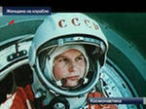
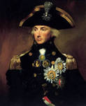
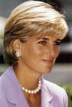
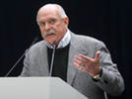
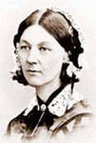
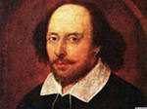
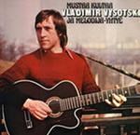
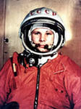
Famous people of Great Britain and Russia

Slide 2
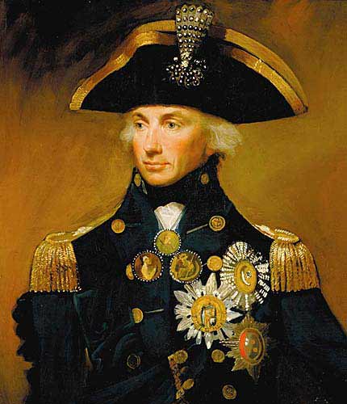
Horatio Nelson was born into a moderately prosperous Norfolk family on 29 September 1758. He joined the navy through the influence of his uncle, Maurice Suckling.

Slide 3
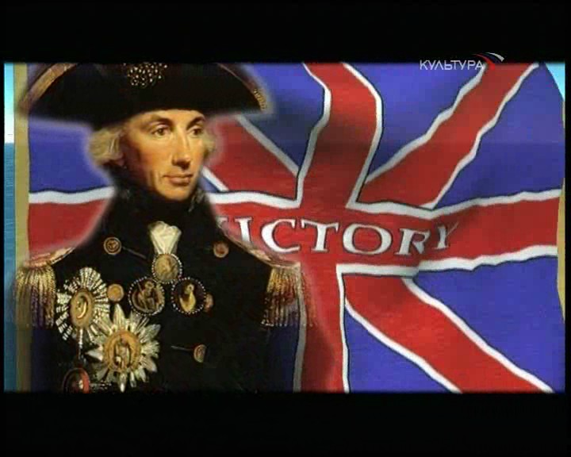
He rose rapidly through the ranks and served with leading naval commanders of the period before obtaining his own command in 1778.

Slide 4
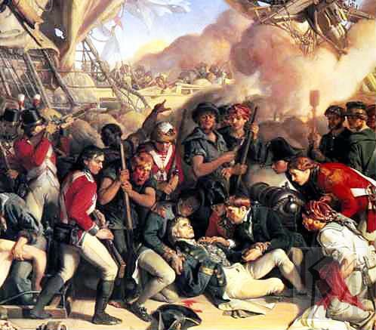
On 21 October 1805, the Franco-Spanish fleet came out of port, and Nelson's fleet engaged them at the Battle of Trafalgar. The battle was Britain's greatest naval victory, but during the action Nelson was fatally wounded by a French sniper. His body was brought back to England where he was accorded a state funeral.

Slide 5
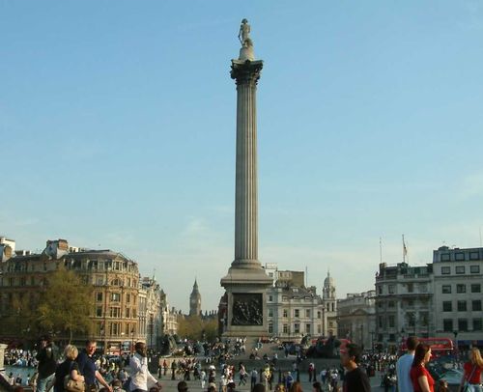
Nelson's death at Trafalgar secured his position as one of Britain's most heroic figures; numerous monuments, including Nelson's Column in Trafalgar Square, London, have been created in his memory and his legacy remains highly influential.

Slide 6
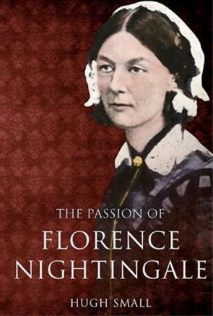
Florence Nightingale was born into a rich, upper-class, well-connected British family at the Villa Colombaia on 12 May 1820. Nightingale laid the foundation of professional nursing with the establishment, in 1860, of her nursing school at St Thomas' Hospital in London.

Slide 7
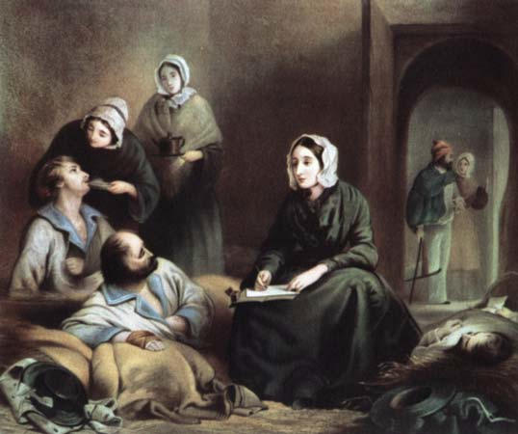
Florence Nightingale's most famous contribution came during the Crimean War, which became her central focus when reports began to filter back to Britain about the horrific conditions for the wounded.

Slide 8
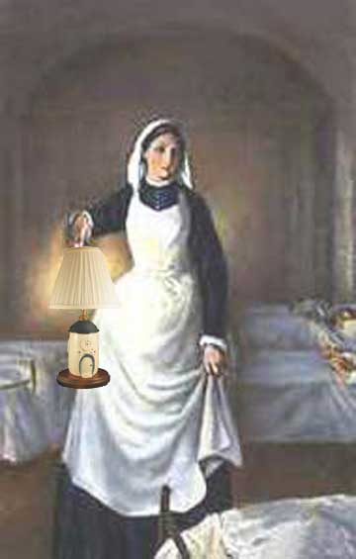
During the Crimean war, Florence Nightingale gained the nickname "The Lady with the Lamp", deriving from a phrase in a report in The Times: She is a ‘ministering angel’ without any exaggeration in these hospitals, and as her slender form glides quietly along each corridor, every poor fellow's face softens with gratitude at the sight of her.

