Slide 1
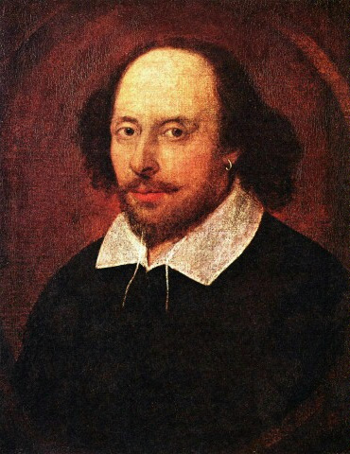
William Shakespeare was an English poet and playwright, widely regarded as the greatest writer in the English language and the world's pre-eminent dramatist.[1] He is often called England's national poet and the "Bard of Avon". He was born on 26 April 1564 and died on 23 April 1616.

Slide 2
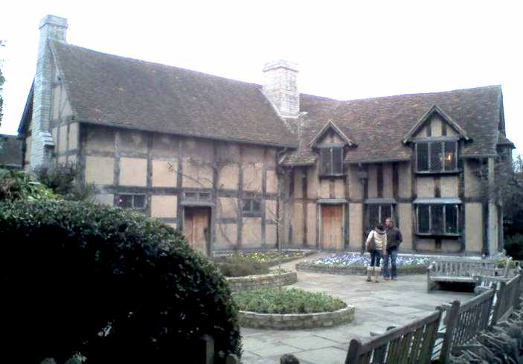
Shakespeare was born and raised in Stratford-upon-Avon between 1585 and 1592. He began a successful career in London as an actor, writer, and part owner of a playing company called the Lord Chamberlain's Men, later known as the King's Men. He appears to have retired to Stratford around 1613, where he died three years later.

Slide 3
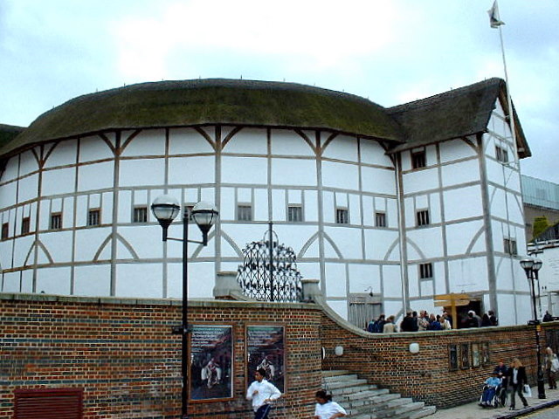
In 1599, a partnership of company members built their own theatre on the south bank of the River Thames, which they called the Globe.

Slide 4
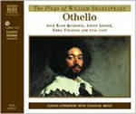
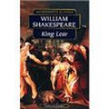
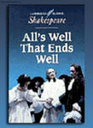
Shakespeare produced most of his known work between 1589 and 1613. His early plays were mainly comedies and histories. He then wrote mainly tragedies until about 1608. In his last phase, he wrote tragicomedies, also known as romances, and collaborated with other playwrights.

Slide 5
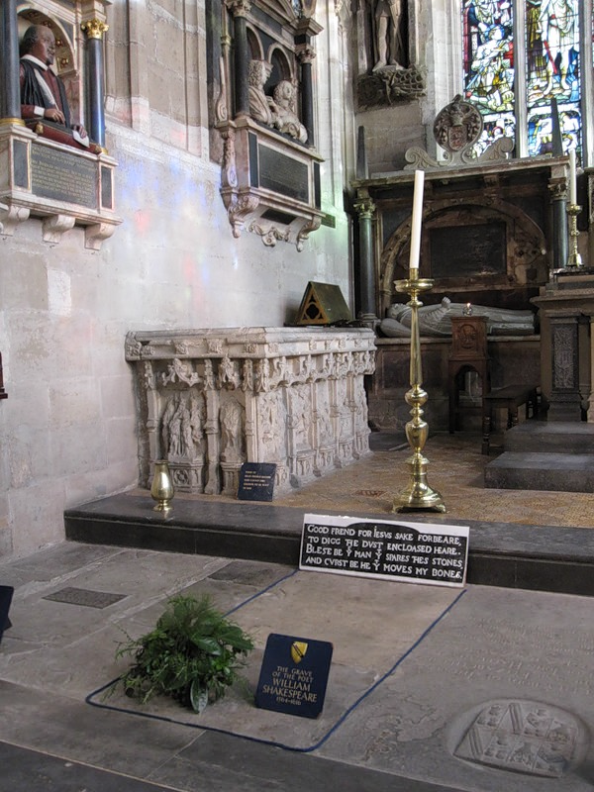
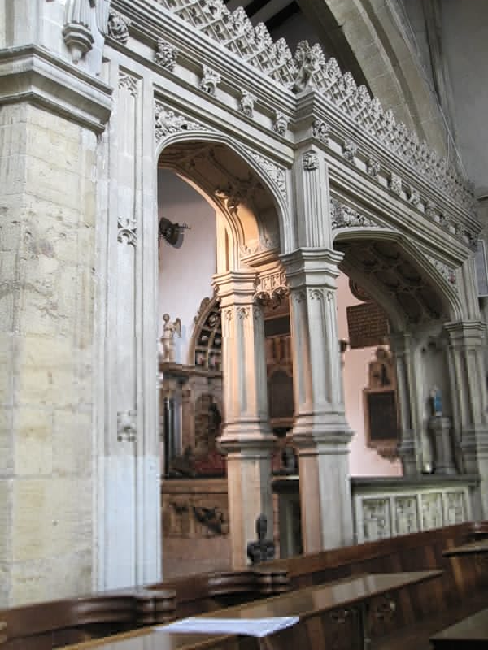
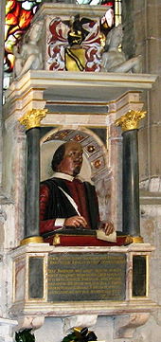
Shakespeare was buried in the chancel of the Holy Trinity Church two days after his death. The epitaph carved into the stone slab covering his grave includes a curse against moving his bones, which was carefully avoided during restoration of the church in 2008: "Good friend, for Jesus' sake forbear," "To dig the dust enclosed here." "Blessed be the man that spares these stones," "And cursed be he who moves my bones.

