Slide 1
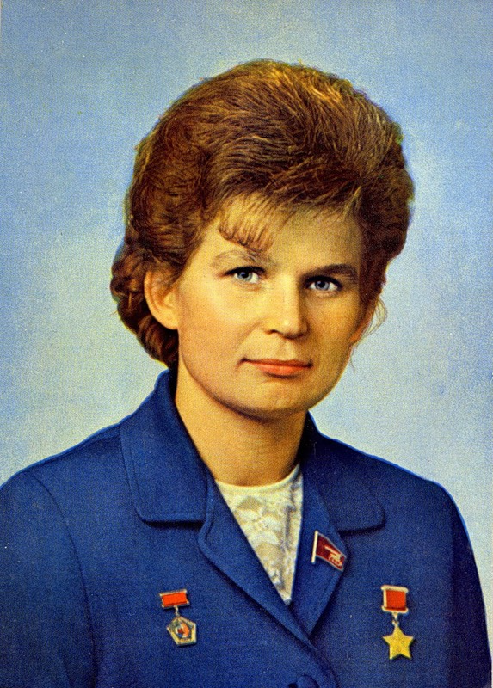
Valentina Vladimirovna Tereshkova (born March 6, 1937) is a retired Soviet cosmonaut, and was the first woman in space. She was selected out of more than four hundred applicants, and then out of five finalists, to pilot Vostok 6 on the 16 June.

Slide 2
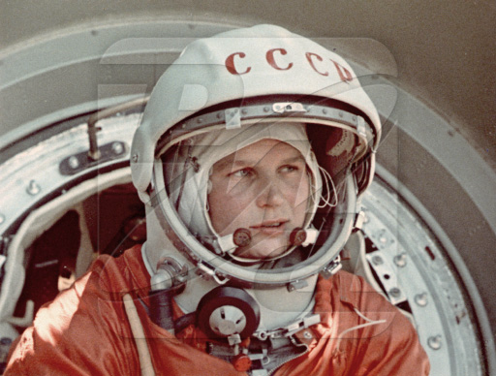
After the flight of Yuri Gagarin in 1961, Sergey Korolyov, the chief Soviet rocket engineer, came up with the idea of putting a woman in space. On February 16, 1962, Valentina Tereshkova was selected to join the female cosmonaut corps. Out of more than four hundred applicants, five were selected. Tereshkova was considered a particularly worthy candidate.

Slide 3
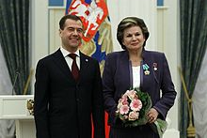
Tereshkova receives the Order of Friendship from Russian President Dmitry Medvedev on 12 April 2011 at the Moscow Kremlin.

Slide 4
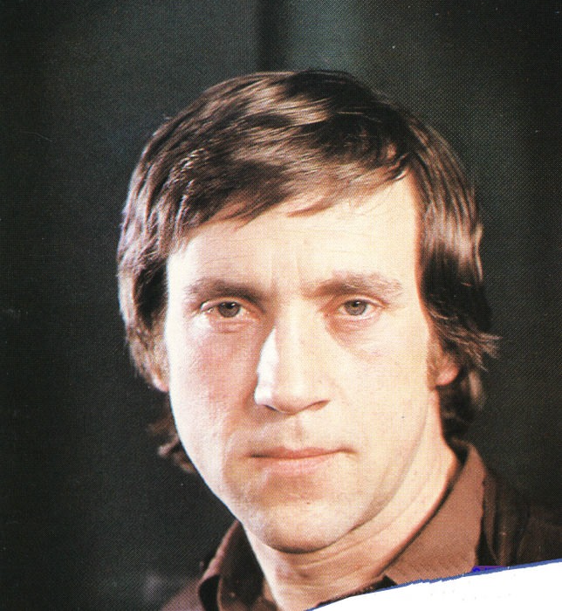
Vladimir Semyonovich Vysotsky (25 January 1938 – 25 July 1980) was an iconic Soviet-Russian singer, songwriter, poet, and actor whose career had an immense and enduring effect on Russian culture.

Slide 5
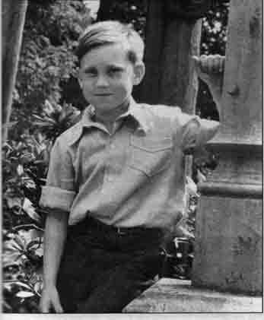
Vladimir's extraordinary theatrical inclinations became obvious at a very early age, his mother Nina, a theater fan, being an obvious influence. The boy used to recite poems, standing on a chair and "flinging hair backwards, like a real poet", often using in his public speeches expressions he could hardly have heard at home.

Slide 6
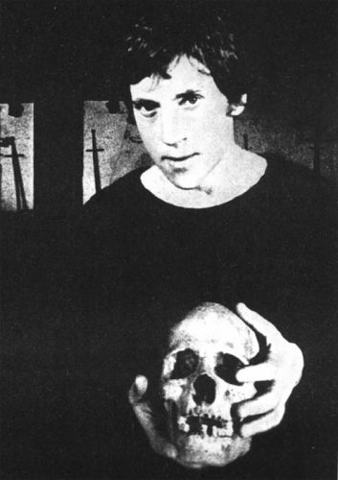
In June 1956 he joined Boris Vershilov's class at the Moscow Art Theatre Studio-Institute. In 1958 Vysotsky's got his first MAT role: that of Porfiry Petrovich in Dostoyevsky's Crime and Punishment. In 1964, director Yuri Lyubimov invited Vysotsky to join the newly created Moscow Theatre of Drama and Comedy on the Taganka. 1971 started promisingly: Lyubimov gave Vysotsky the long sought-after leading role in his groundbreaking Hamlet play.

Slide 7
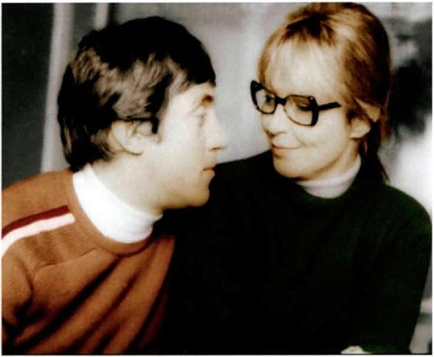
In 1967 fell in love with Marina Vlady, a French actress of Russian descent, who was working at Mosfilm on a joint Soviet-French production at that time. They were married in 1969.

Slide 8
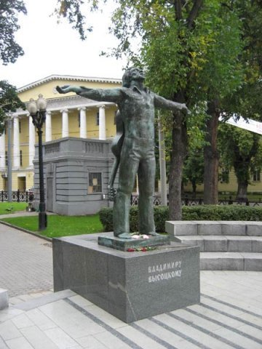
Vladimir Vysotsky’s monument

