Slide 1
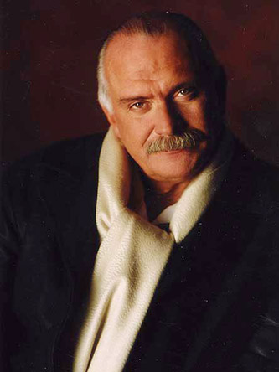
Nikita Sergeyevich Mikhalkov ( born October 21, 1945) is a Soviet and Russian filmmaker, actor, and head of the Russian Cinematographers' Union. Mikhalkov was born in Moscow into the distinguished, artistic Mikhalkov family.

Slide 2
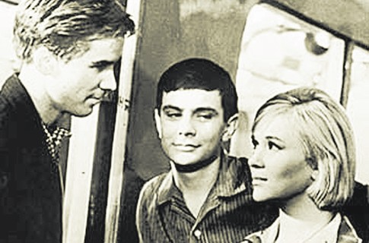
Mikhalkov studied acting at the children's studio of the Moscow Art Theatre and later at the Shchukin School of the Vakhtangov Theatre. While still a student, he appeared in Georgi Daneliya's film I Step Through Moscow (1964) and his brother Andrei Konchalovsky's film Home of the Gentry (1969). He was soon on his way to becoming a star of the Soviet stage and cinema.

Slide 3
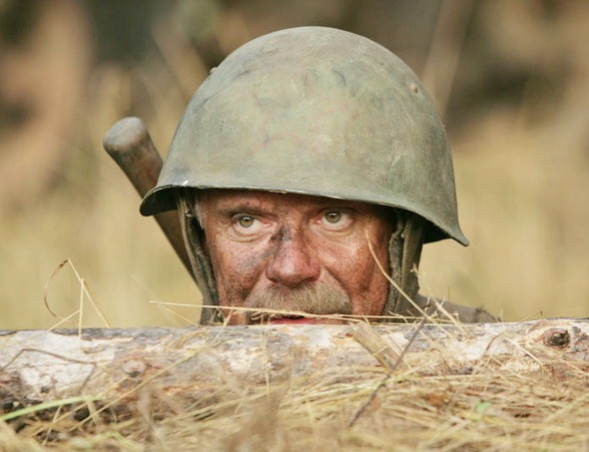
While continuing to pursue his acting career, he entered VGIK, the state film school in Moscow, where he studied directing under filmmaker Mikhail Romm, teacher to his brother and Andrei Tarkovsky. He directed his first short film in 1968, I'm Coming Home, and another for his graduation, A Quiet Day at the End of the War in 1970.

Slide 4
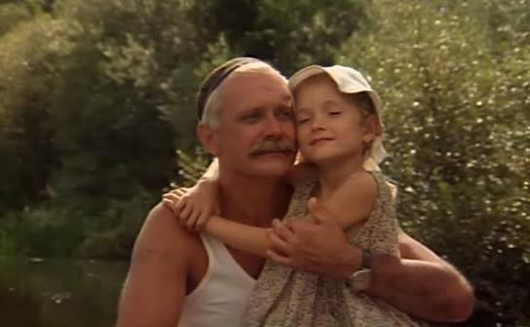
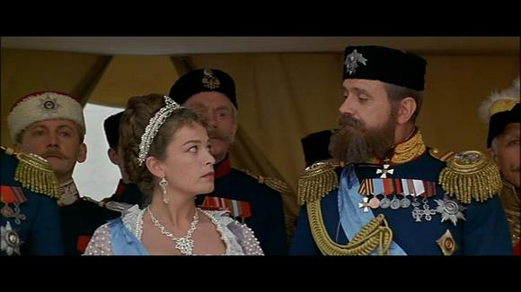
Mikhalkov used the critical and financial triumph of Burnt by the Sun to raise $25,000,000 for his most epic venture to date, The Barber of Siberia (1998). The film, which was screened out of competition at the 1999 Cannes Film Festival

Slide 5
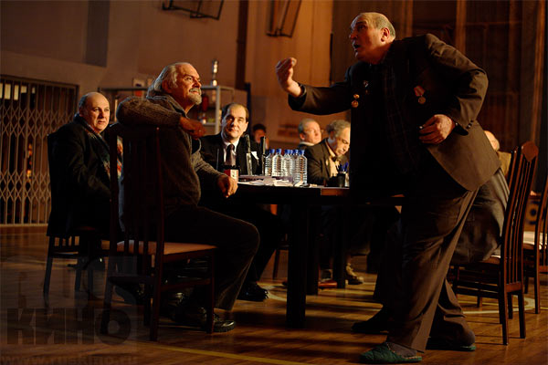
On January 22, 2008, Mikhalkov's film 12 was named as a nominee for the 2008 Academy Awards. Commenting on the nomination, Mikhalkov said, "I am overjoyed that the movie has been noticed in the United States and, what's more, was included in the shortlist of five nominees. This is a significant event for me."

