Slide 1
FIREWORKS OF FOOD

Slide 2
The Healthy
Eating Pyramid

Slide 3
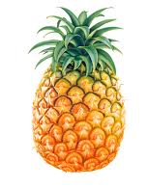
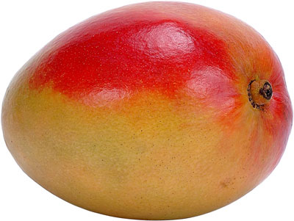
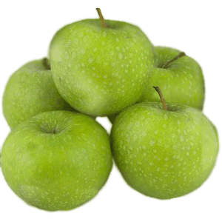
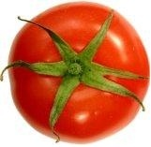
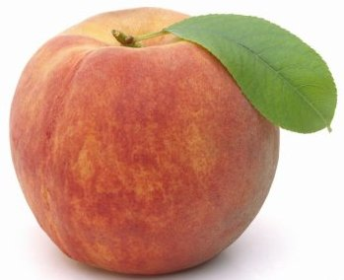
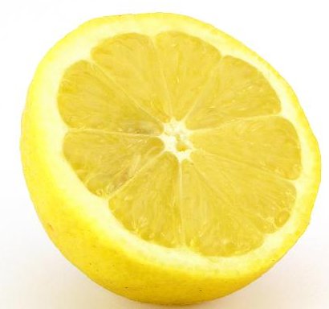
Questions:
What is your favourite food?

Slide 4
Questions:
What is your favourite food?
2. Do you like to have pineapples and apples for breakfast?

Slide 5
Questions:
What is your favourite food?
2. Do you like to have pineapples and apples for breakfast?
3. Do you like bananas or lemons?

Slide 6
Questions:
What is your favourite food?
2. Do you like to have pineapples and apples for breakfast?
3. Do you like bananas or lemons?
4. What do you usually have for breakfast?

Slide 7
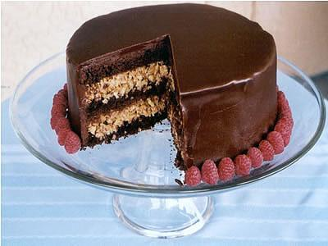
Listening:
It’s my Birthday!
In … , we have a party to celebrate our birthdays.
a) Britain b) China c) Russia
2. Everyone brings a … gift.
a) small b) medium c) large
3. My mum always makes me a birthday … .
a) fish b) cake c) ice-cream
4. We decorate the house with … .
a) red paper b) biscuits c) balloons

Slide 8
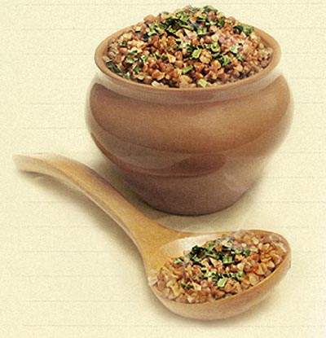
Reading:
Meals and Mealtimes in England
Breakfast. A typical English breakfast consists of 1) ……………… bowl of cereal, a slice of toast, orange juice and a cup of coffee. A 2) ………………. of children have a bowl of cereal.
Lunch. Most children at school and people at work have a packed lunch. 3) …………….. consists of a sandwich, a packet of crisps, fruit and a drink.
Dinner. A typical English meal for dinner is meat with vegetables. Vegetables like potatoes, carrots, peas, cabbages 4) ……………. onions are very popular 5) ……………… England.
A some B a C an
A much B many C lot
A It B These C Those
A and B or C but
A at B on C in

Slide 9
Reading:
KEYS: 1 B, 2 C, 3 A, 4 A, 5 C
Meals and Mealtimes in England
Breakfast. A typical English breakfast consists of 1) ……………… bowl of cereal, a slice of toast, orange juice and a cup of coffee. A 2) ………………. of children have a bowl of cereal.
Lunch. Most children at school and people at work have a packed lunch. 3) …………….. consists of a sandwich, a packet of crisps, fruit and a drink.
Dinner. A typical English meal for dinner is meat with vegetables. Vegetables like potatoes, carrots, peas, cabbages 4) ……………. onions are very popular 5) ……………… England.
A some B a C an
A much B many C lot
A It B These C those
A and B or C but
A at B on C in

Slide 10
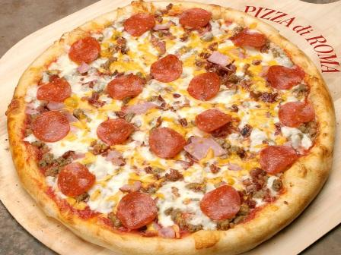
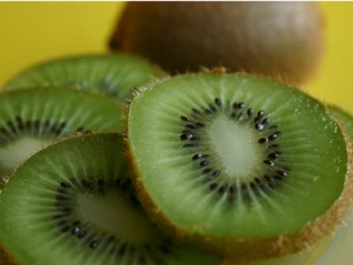
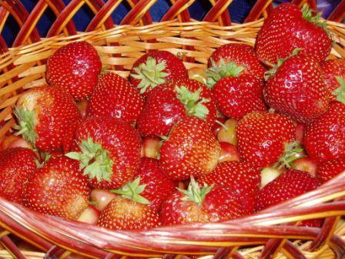
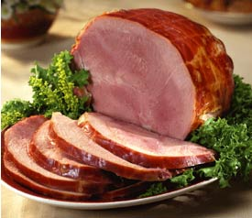
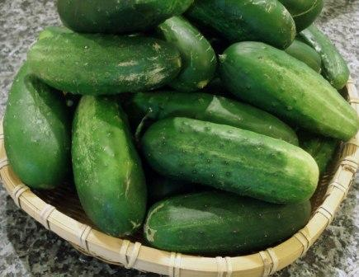
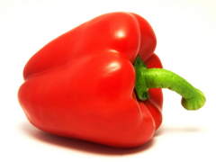
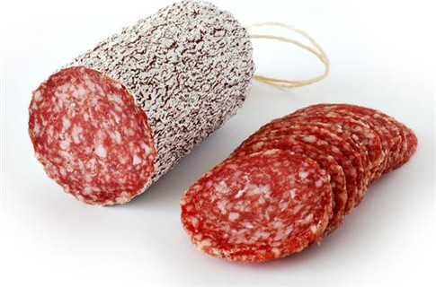
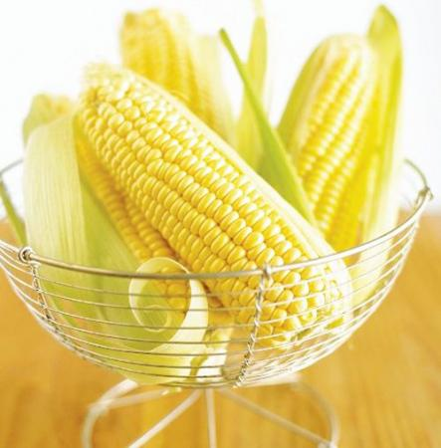
Speaking:
Pizza
tomato
strawberries
pepper
sausages
cucumber
corn
ham
cheese
onion
kiwi

Slide 11
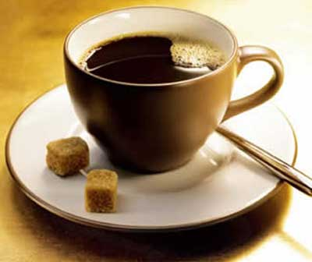
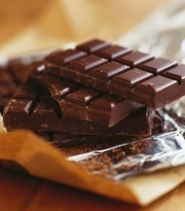
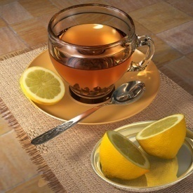
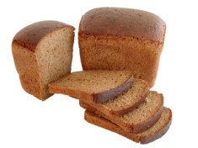
Writing:
Countable & Uncountable Nouns:
a
an
some
bread
eggs
peppers
cake
milk
sugar
biscuit
water
tea
pumpkin
cheeseburger
orange
cheese
coffee
lemon
apple
rice
orange juice
turkey
tomatoes

Slide 12
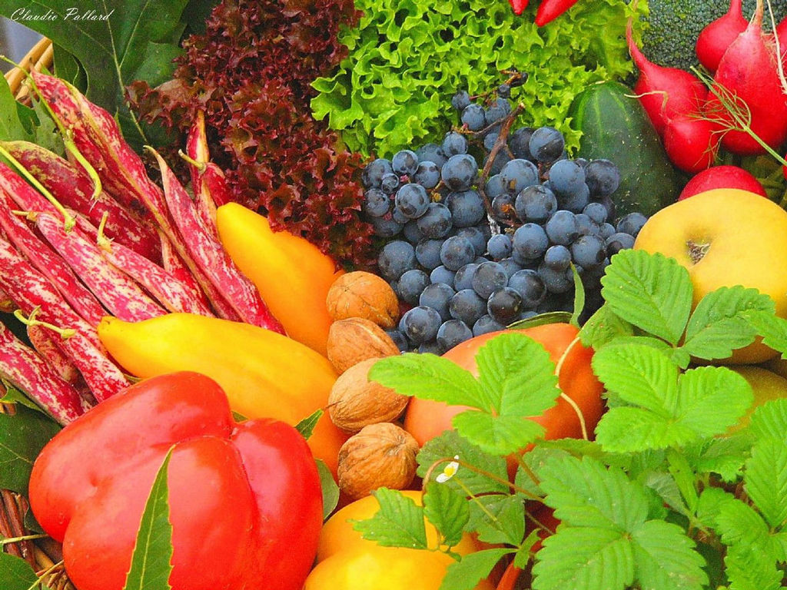
Pineapple
Meat
Cabbage
Milk
Burger
Pasta
Rice
Chicken
Pies
Butter
Crossword:

Slide 14
Riddles:

Slide 15
Riddles:

Slide 16
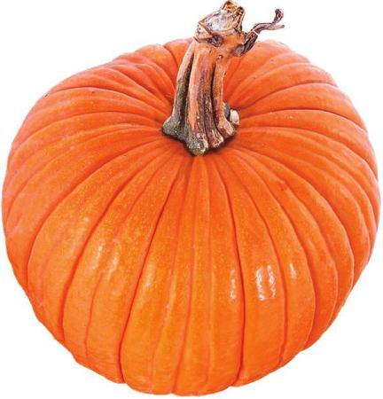
Riddles:

Slide 17
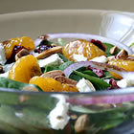
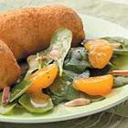
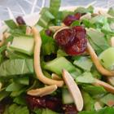
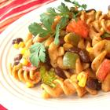
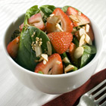
Homework:
Project: a recipe of cake or salad.

Slide 18
Beautiful Salad
Ingredients:
8 cups baby spinach leaves
1/2 medium red onion, sliced and separated into rings
1 (11 ounce) can mandarin oranges, drained
1 1/2 cups sweetened dried cranberries
1 cup honey-roasted sliced almonds
1 cup crumbled feta cheese
1 cup balsamic vinaigrette salad dressing, or to taste
Directions
Place servings of spinach onto salad plates. Top with red onion, mandarin oranges,
cranberries, sliced almonds and feta cheese in that order. Drizzle dressing over each salad.

Slide 19
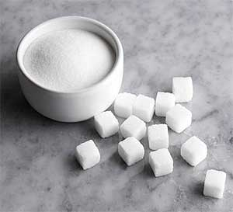
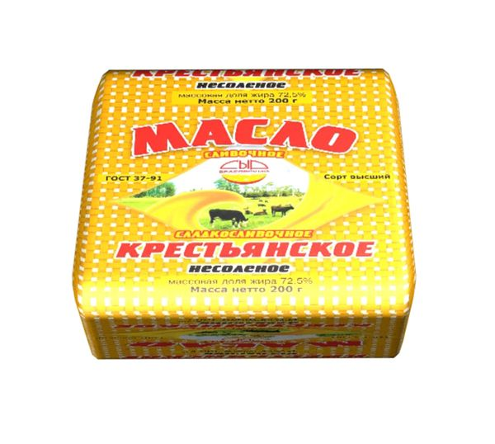
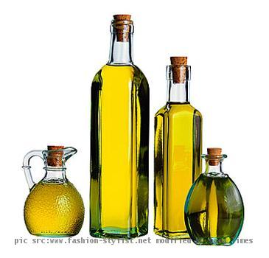
A recipe of chocolate cake
You need …

Slide 20
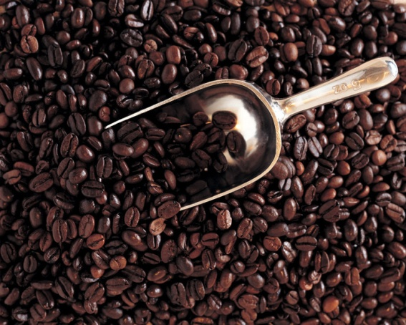
Now I can …
talk and write
talk about and order food / drinks
write a birthday party plan
make suggestions about food for a party
write a magazine entry about how we celebrate birthdays in my country
talk and write about kitchen safety
… in English

