Slide 1
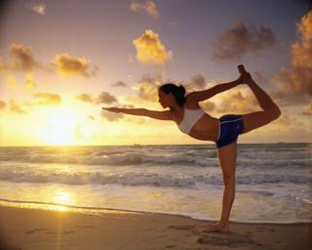
SPORTS AND GAMES
Sport is the best and the shortest way to health and fitness. Today increasing number of people are involved in activities that help them keep fit and enjoy life. We are sure you are all interested in sport. And there are so many kinds of sports in which you can take an active part or just be a devoted fan.

Slide 2
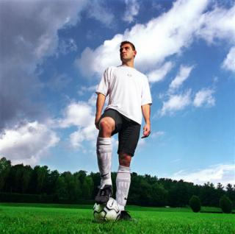
Topic Preview.
In your notebooks give brief answers to the following questions.
Do you like sports?
What kind of sports do you prefer? Why?
How can you prove that sports play an important role in our life?
Explain how sports influence on our health.

Slide 3

Vocabulary Preview. Part I.
These are some words and phrases you with hear in the lecture. Read the list,
look up the unknown words in a dictionary.
SPORTS
winter sports
shooting
hunting
skating
skiing
tobogganing
figure-skating
ski-jumping
swimming
boating
yachting
cycling
gliding
wrestling
athletics
gymnastics
GAMES
hockey
football
basketball
lawn-tennis
cricket
volleyball
soccer
badminton
billiards
table tennis
chess
golf
rugger

Slide 4


Vocabulary Preview. Part 2.
The most popular games in England are cricket in summer and football in winter.
Basketball is a very fun y game which can be played formally, in a league, or casually, just for enjoyment.
There is professional league called the NBA.
Soccer is my favorite sport, and I have been playing for nine years.
My sister was naturally good and she scored a lot for her team.
Tennis and golf are also very popular; so are running, jumping and swimming and boating.
When they get a really hard winter, they skate, ski and toboggan.
Cricket, soccer, rugby, tennis, squash, table tennis, badminton and snooker were all invented in Britain.
The first rules for such sports are boxing, golf, hockey, yachting and horse-racing also originated from Britain.
Rugby and football become two separate sports when rules laid down by the Football Association said that only the goalkeeper could handle the ball.

Slide 5
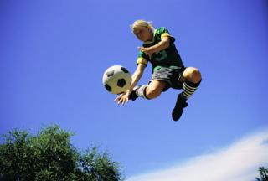

Listening .Part I.
Listen to the first text. In your notebooks
write T (true) or F (false) for every sentence
below.
The most popular outdoor winter sports are shooting, hunting and hockey.
A lot of people hate figure-skating and ski-jumping.
The most popular indoor games billiards, draughts able tennis.
Listen to the second text.
Horse-racing is one of the most popular sports in Great Britain.
Walking-races, running, swimming are not popular in England.
English winter is very severe and people often have the chance of skiing,
skating or tobogganing.

Slide 6
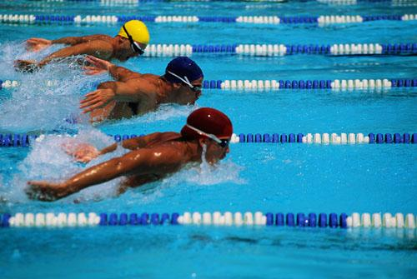
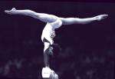
Listening. Part II.
Choose the correct answer. Click on a), b) or c) to check.
Text A.
This is one thing in which people of every nationality and class are united.
a) games;
b) soccer;
c) sports and games ;
2. Summer affords excellent opportunities for …
a) swimming, bathing, yachting, cycling and gliding;
b) boxing, wrestling, athletics and gymnastics;
c) billiards, table tennis and draughts;
3. Is football popular among outdoor games?
a) yes;
b) no;

Slide 7



Text B
Winter is the great time for …
a) hunting;
b) swimming;
c) horse-racing;
2. Indoor games include
a) football;
b) cricket;
c) billiards;
3. Why are there no winter sports in Great Britain?
a) because Englishmen do not like winter sports;
b) because in Great Britain winter is not very severe;
c) because in Great Britain there is no winter at all.

Slide 8
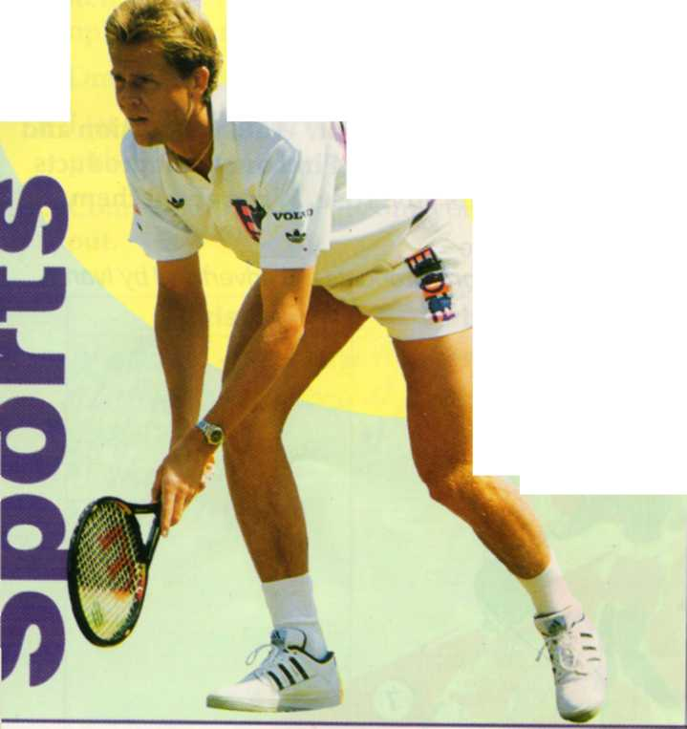
READ THE TEXT.
When the athlete, Ben Johnson, was disqualified from the Seoul Olympic games for taking drugs, he lost more than his gold medal and his good name. He said goodbye to $5 million in possible sponsorship money. Sport is big business. Today's sports stars can earn as much on television as they can on the tennis court, golf course or football pitch.
Ivan Lendl earns £1.3 million a year for wearing Adidas clothes and Ray-Ban sunglasses. He is the world's richest tennis player. The richest sports star of all is the boxer, Muhammed Ali. He has earned £39 million in and out of the boxing ring. Most of the money in boxing comes from prize money. Sponsors like sports which have a cleaner, more glamorous image than boxing — sports like tennis, golf, motor racing and skiing.
Most of the money comes from advertising clothes, sports equipment, drinks and other products.
Sports can change their image. At one time snooker was only a game that was played in clubs. But since colour television arrived, it has become the most popular sport on British television. Top snooker player, Steve Davis, earns over £1 million a year in prize money, sponsorship and fees for appearing on television

Slide 9
On the other hand, some sports, like athletics and football, are less popular with sponsors because of bad publicity about drugs and fighting by fans.
Sponsors want the best image for their products. They want stars who are the best on the athletics track or the motor racing circuit. But they also ¹ want stars who are good-looking and who have an interesting personality - stars like Argentina's young tennis player, Gabriela Sabatini, Spanish golfer, Severano Ballesteros, French motor racing driver, Alain Prost, America's running star, 'Flo Jo' Johnson or Switzerland's champion skier, Pirmin Zubriggen.
DO THE EXERCISE.
Right, Wrong or Don't know?
a Ben Johnson was disqualified for taking drugs.
b The gold medal was taken away from him.
с Ben Johnson earns $5 million a year.
d Sports stars earn more money from prize money than from sponsorship.
e Muhammed Ali has earned more than any other sports star.
f Sponsors think that skiing is a glamorous sport.
g Snooker is the most popular sport in Britain.
h Sponsors are worried about footballers who fight.
i Alain Prost advertises cars.

Slide 10
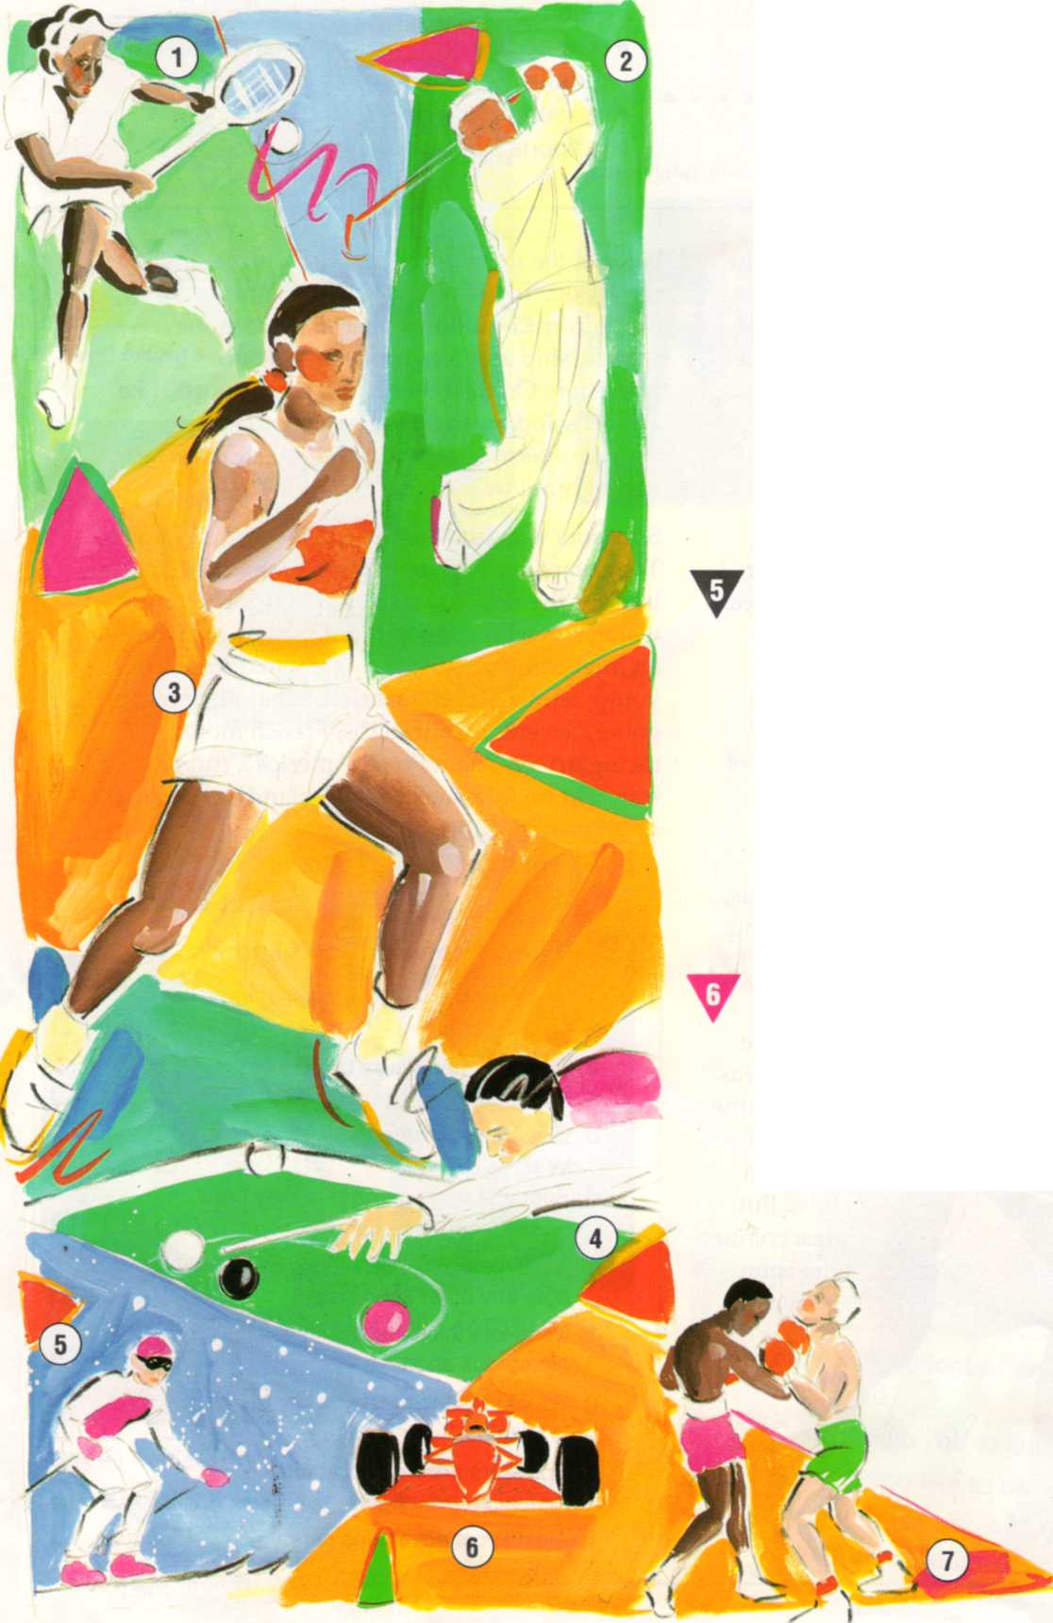
EXTENSION
LABEL THESE SPORTS

Slide 11
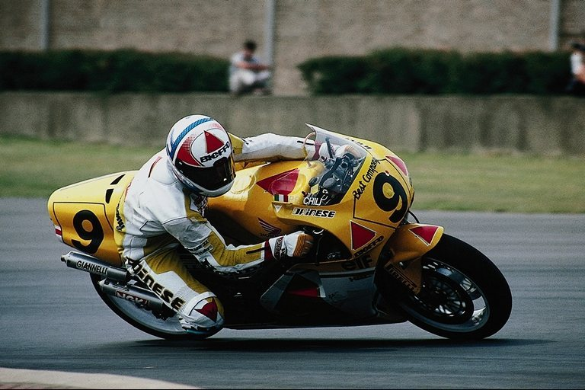
UNIT COMPLETED.
THANK YOU FOR YOUR COOPERATION!

Slide 12
a game played by two teams of eleven players on a field with a wicket at either end of a 22-yard pitch, the object being for one side to score runs by hitting a hard leather-covered ball with a bat while the other side tries to dismiss them by bowling, catching, running them out, etc
any of various games played with a round or oval ball and usually based on two teams competing to kick, head, carry, or otherwise propel the ball into each other's goal, territory, etc

Slide 13
an association of sporting clubs that organizes matches between member teams of a similar standard

Slide 14
National Basketball Association

Slide 15
a game in which two teams of eleven players try to kick or head a ball into their opponent's goal, only the goalkeeper on either side being allowed to touch the ball with his hands and arms except in the case of throw-ins

Slide 16
to gain (a point or points) in a game or contest

Slide 17
the practice of rowing, sailing, or cruising in boats as a form of recreation

Slide 18
the steel blade or runner of an ice skate
one of a pair of wood, metal, or plastic runners that are used for gliding over snow. Skis are commonly attached to shoes for sport, but may also be used as landing gear for aircraft, etc
a light wooden frame on runners used for sliding over snow and ice

Slide 19
a game for two or four players played in an enclosed court with a small rubber ball and light long-handled rackets. The ball may be hit against any of the walls but must hit the facing wall at a point above a horizontal line
a game played on a billiard table with 15 red balls, six balls of other colours, and a white cue ball. The object is to pot the balls in a certain order

Slide 20
a the sport or practice of navigating a yacht
an organized sport, closely associated with gambling, in which riders race horses over dedicated courses, often incorporating hurdles.

Slide 21
a player in the goal whose duty is to prevent the ball, puck, etc., from entering or crossing it

Slide 22
WRONG!
TRY AGAIN

Slide 23
Right!!!

Slide 24
WRONG!
TRY AGAIN

Slide 25
RIGHT!!!

