Slide 1
Famous Academicians and Scientists
Famous Russian, American and English people
Created by Gukasova T. V.
School №80
Saint-Petersburg
2011

Slide 2
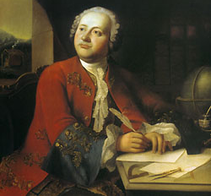
M. V.Lomonosov (1711-1765)
Was born in Kholmogory settlement near the city of Arkhangelsk
Father was a seaman
Started to study at the age of 19
Became the first Russian Academician at the age of 33
Founded Moscow University in 1765
Made a lot of discoveries in different fields of science
A monument to M. Lomonosov is in Moscow

Slide 3
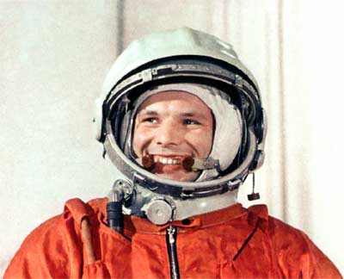
Y.A.Gagarin (1934-1968)
Was born in a small village near the city of Smolensk
Was interested in planes, spaceships, rockets
Became the first world cosmonaut at the age of 27
Flew into space on the 12th of April, 1961 on board the spaceship ”Vostok”
The monument to Y. Gagarin is in Moscow

Slide 4
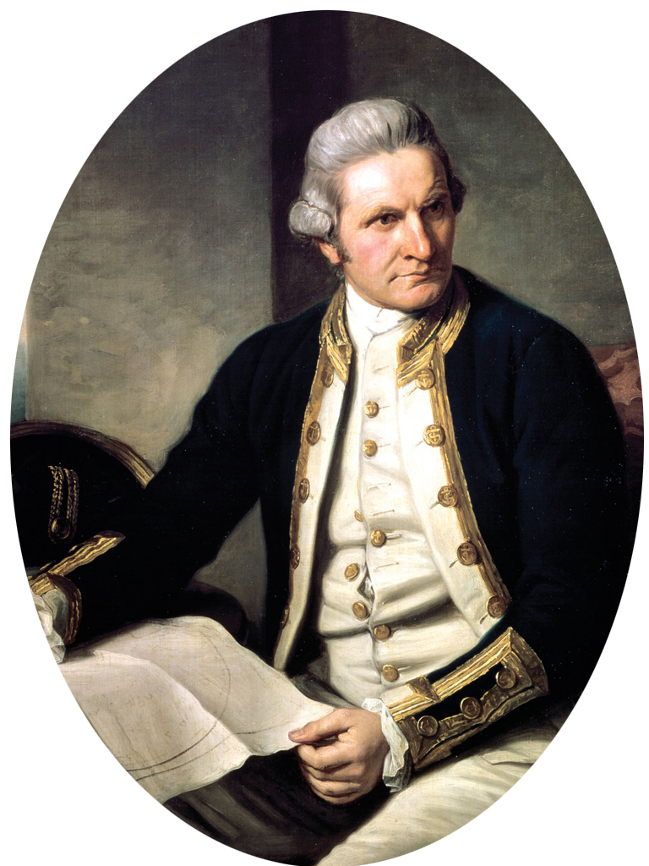
James Cook (1728-1779)
Was born in an English village
His father was a poor farmer
Became a seaman, traveller and discoverer
Made three voyages around the world
Discovered a lot of islands in the Pacific Ocean, explored the eastern coast of Australia

Slide 5
George Washington (1732-1799)
Was born in America, state of Virginia
A son of a rich plantator
Became an American general at the age of 43
Took part in the war of Independence (1775-1783) against Britain
Fought many battles
Won a lot of battles in the war of Independence
The first US President (1789-1797)

Slide 6
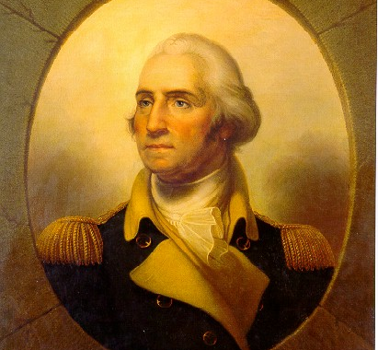
George Washington

