Slide 1
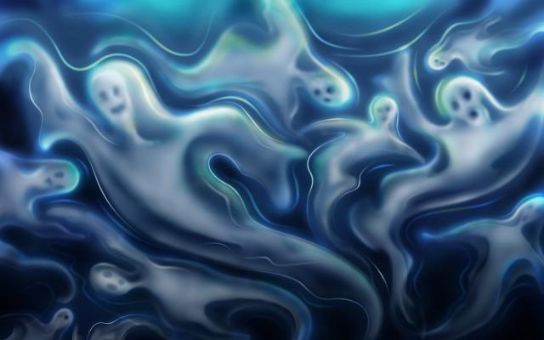
HALLOWE’EN
ГОУ СОШ №80
Санкт-Петербург
2008
Гукасова Т. В.,
учитель английского языка

Slide 2
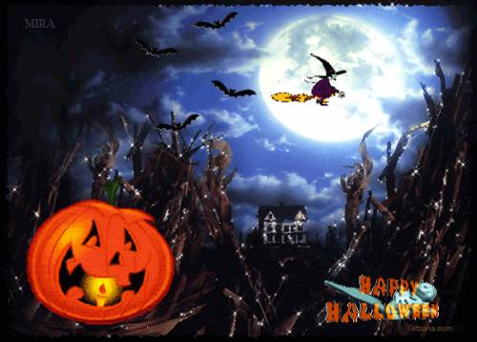
On the 31st of October in Great Britain and the USA there is a nice holiday for children-Hallowe’en. Many centuries ago people thought that Hallowe’en was the night when witches came out.

Slide 3
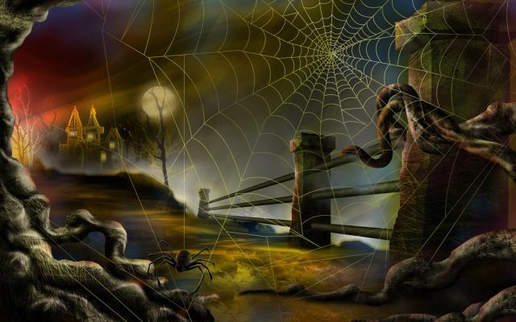
As people were afraid of the witches they put on different clothes and painted their faces to deceive the evil spirits.

Slide 4
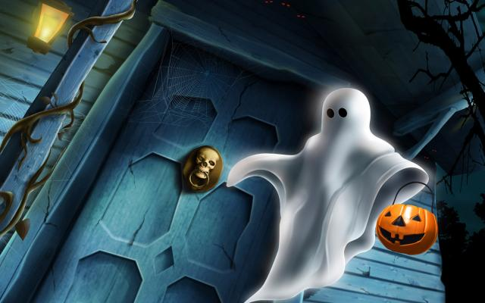

Slide 5
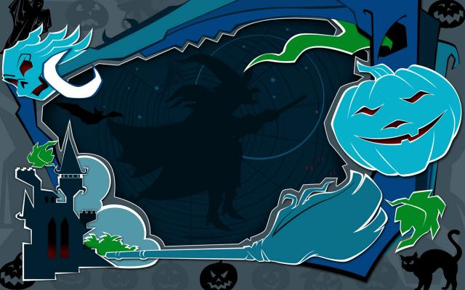
Nowadays young and old take part in Hallowe’en Parade. On the 31st of October agreat number of people get together. They are dressed as witches, Demons, Fairies, Ghosts, Zombie, Vampires, Frankenstein.

Slide 6
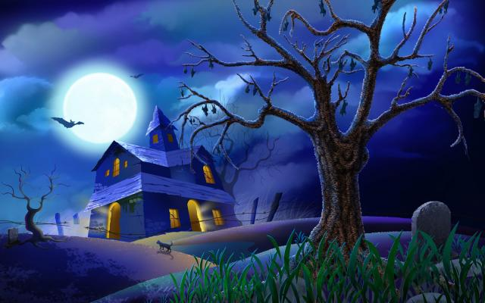
Children go from house to house and say “Trick or Treat”.

Slide 7
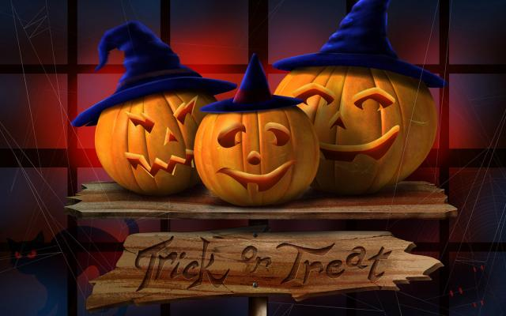
On that day people put pumpkins on the window-sills. They draw eyes, noses and mouths on the pumpkins and put candles (lanterns) into them.

Slide 8
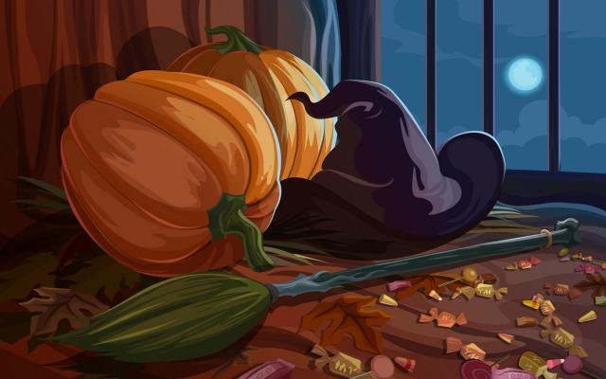

Slide 9
Hallowe’en is a nice, funny holiday!

