Slide 1
Our school drama club

Slide 2
The curtain goes up……

Slide 3
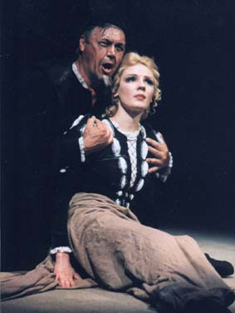
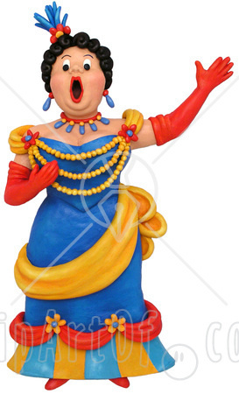
OPERA

Slide 4
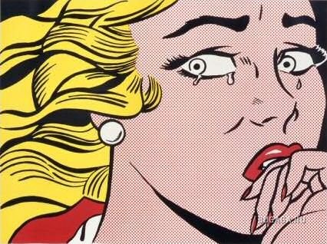
DRAMA

Slide 5
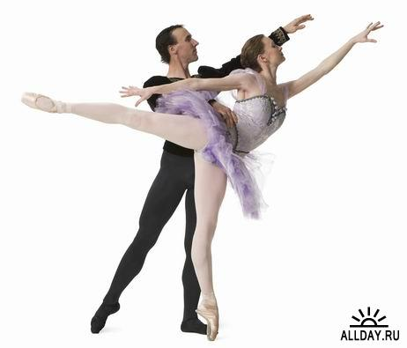
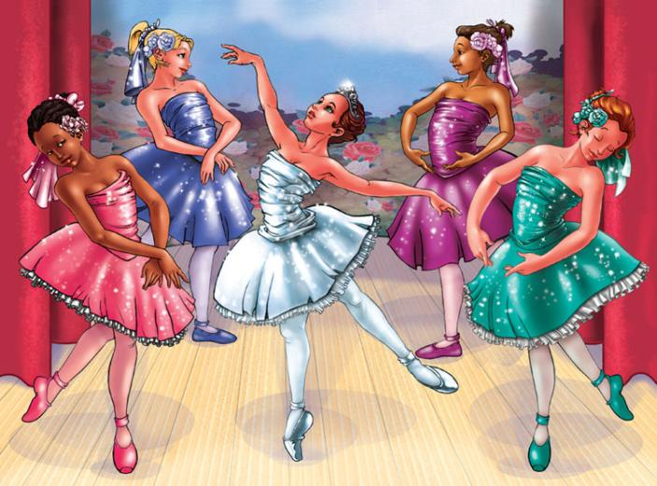
BALLET

Slide 6
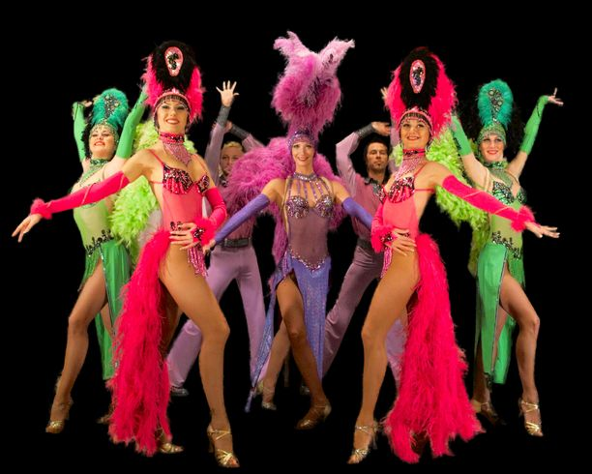
OPERETTA

Slide 7
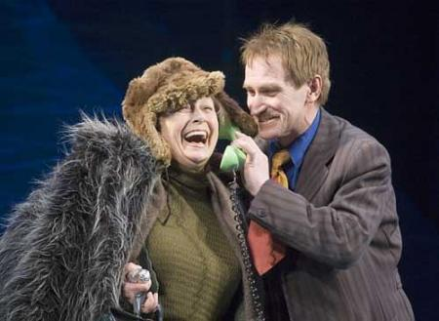
COMEDY

Slide 8
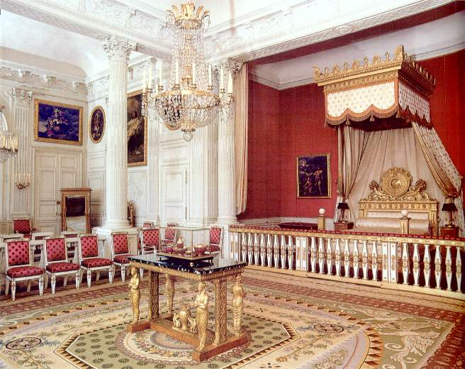
KING’S PALACE

Slide 9
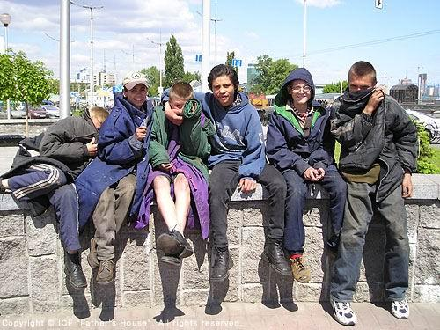
OFFAL COURT

Slide 10
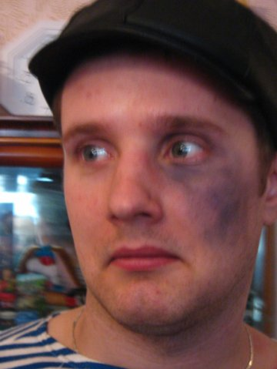
John Canty

Slide 11
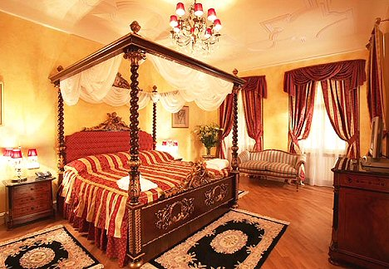
TOM MEETS THE KING

Slide 12
OUR SCHOOL DRAMA CLUB

