Slide 1
Презентация открытого урока в 8 «А» классе по теме« OUR ENVIRONMENT AND HEALTHY WAY OF LIFE»
Подготовила:
Учитель английского языка МБОУ СОШ №5
КОПЫЛОВА АНТОНИНА РОМАНОВНА
Тимашевск , 2012
Краснодарский край

Slide 2
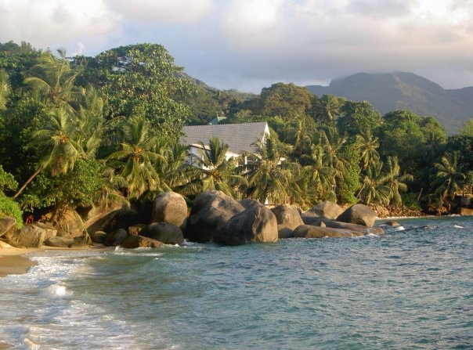
OUR ENVIRONMENT AND HEALTHY WAY OF LIFE.
LET’S PROTECT OUR ENVIRONMENT !!!

Slide 3
ЦЕЛИ И ЗАДАЧИ: 1)ПОКАЗАТЬ КРАСОТУ ПРИРОДЫ И ВЛИЯНИЕ НЕГАТИВНЫХ ФАКТОРОВ НА ПРИРОДУ И ЧЕЛОВЕКА ; 2) ПОМОЧЬ УЧАЩИМСЯ НАУЧИТЬСЯ ЗАЩИЩАТЬ ПРИРОДУ И ЖИВОТНЫХ; 3) РАЗВИВАТЬ У УЧАЩИХСЯ БЕРЕЖЛИВОЕ ОТНОШЕНИЕ К ПРИРОДЕ ; 4) РАЗВИВАТЬ НАВЫКИ УСТНОЙ РЕЧИ И АУДИРОВАНИЯ ПО ТЕМЕ; ОБОРУДОВАНИЕ: ФИЛЬМ ВВС «ПЛАНЕТА ЗЕМЛЯ», ПРЕЗЕНТАЦИЯ ПО ТЕМЕ, АУДИОЗАПИСЬ ТЕКСТА, РАЗДАТОЧНЫЙ МАТЕРИАЛ ПО ТЕМЕ.

Slide 4
1.Организационный момент (просмотр фрагментов фильма ВВС «Планета Земля) Ответить на вопросы: a) What is ENVIRONMENT? b) What does the word ENVIRONMENT mean?

Slide 5
2.Активизация лексических единиц по теме : а) сделать двуязычный перевод фраз (раздаточный материал) б) упр.7 стр.147 (перевести на английский язык)
TRANSLATE INTO RUSSIAN OR ENGLISH: TO CUT DOWN FORESTS --- БЕЗ EДЫ И ВОДЫ --- BEAUTIFUL NATURE --- ЗАГРЯЗНЯТЬ ВОДУ (ВОЗДУХ) --- WATER (AIR) POLUTION--- ЯДОВИТЫЕ ОТХОДЫ --- WASTE OF TIME --- ГОРОДСКАЯ СВАЛКА --- TO BE IN DANGER (TO BE OUT OF DANGER) --- ОПАСНОЕ ЖИВОТНОЕ (ОПАСНЫЙ СПОРТ) --- TO POUR TOXIC WASTE INTO RIVERS AND LAKES--- МОЩНАЯ ЭЛЕКТРИЧЕСКАЯ СТАНЦИЯ --- TO INFLUENCE THE ENVIRONMENT --- PROTECTED SPECIES --- TO BECOME EXTINCT--- TO DESTROY HABITAT OF PLANTS AND ANIMALS---

Slide 6
4. Развитие навыков устной монологической и диалогической речи по теме: Описание картинок учащимися: a) What is land without animals, trees, plants and flowers? b) No air to breathe? (Chernobyl power station) c) What is dangerous waters? d) What is toxic food?

Slide 7
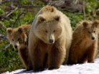
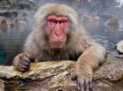
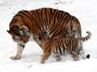
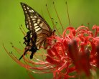
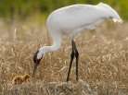
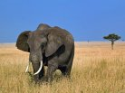
ANIMALS AND BIRDS
SOME ENDANGERED SPECIES

Slide 8
PROTECT OUR NATURE !!!
TREES AND FLOWERS

Slide 9
But at the same time we cut down forests, build farms, houses, roads and factories on the land. While doing that we pollute the environment.

Slide 10
POLLUTION OF ENVIRONMENT
CHERNOBYL ATOMIC POWERSTATION

Slide 11
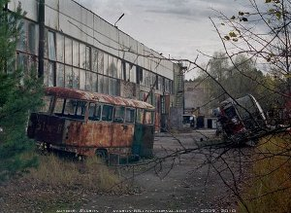
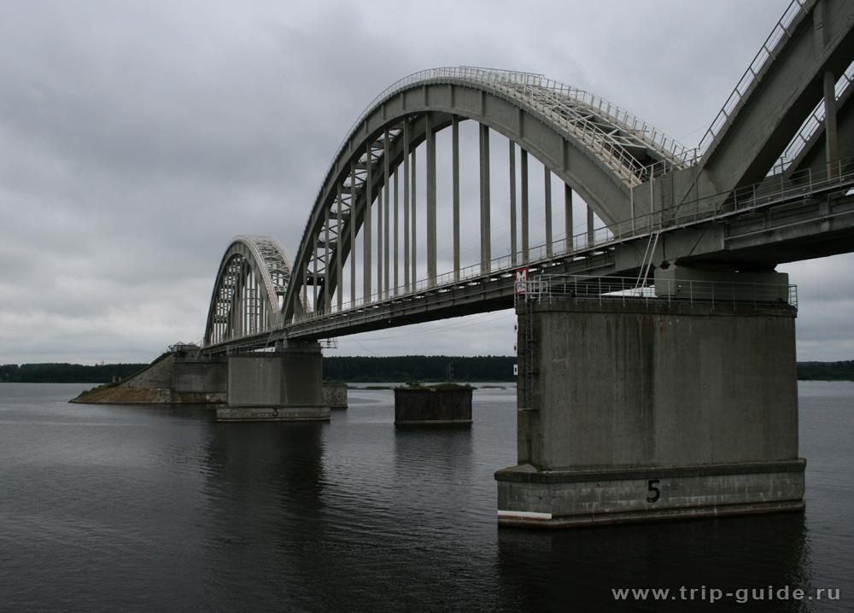
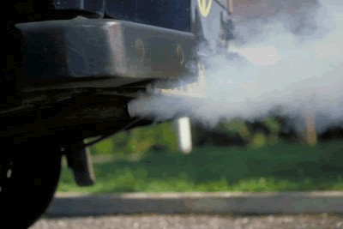
POLLUTION OF ENVIRONMENT

Slide 12
If people want to survive they have to think about all these ecological problems!!!!!

Slide 13
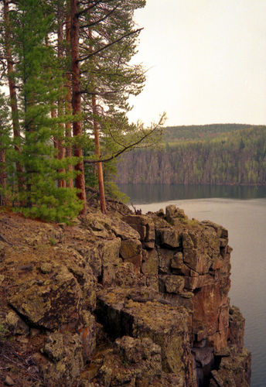
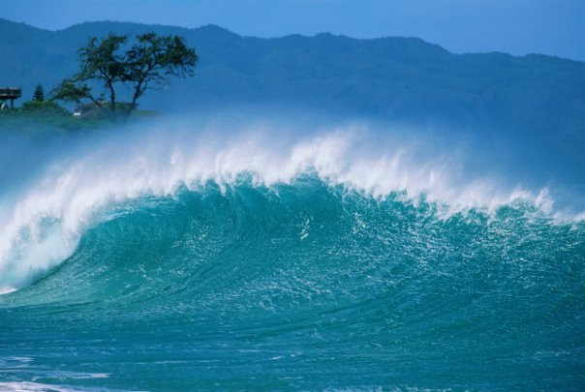
To live a happy and healthy life people need:

Slide 14
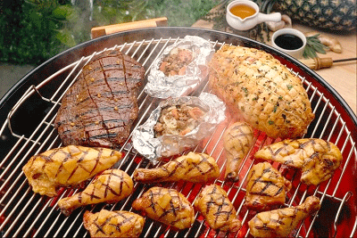
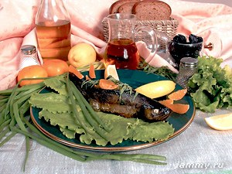
PEOPLE NEED: HEALTHY FOOD TO EAT

Slide 15
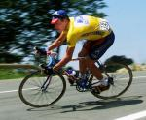
TO LIVE HEALTHY LIFE PEOPLE SHOULD DO SPORTS.

Slide 16
MATCH THE TWO COLUMNS :
THE PLACE IN WHICH PEOPLE LIVE | WASTE
A SCIENTIST WHO STUDIES THE ENVIRONMENT, PLANTS, ANIVALS, PEOPLE | POLLUTE
TO MAKE WATER, AIR AND SOIL DANGEROUS TO LIVE | NATURE
USELESS MATERIALS | ENVIRONMENT
A PLACE OUTSIDE A TOWN WHERE PEOPLE COLLECT WASTE | HEALTHY
THE WORLD WITH ALL LIVING THINGS , THE LAND AND THE SEAS | POWER STATION
A LARGE BUILDING WITH MACHINES THAT GIVE ELECTRICITY | ECOLOGIST
GOOD AND USEFUL FOR YOUR HEALTH | DUMP

Slide 17
IN HOW MANY WAYS CAN YOU COMPLETE THESE SENTENSES? PEOPLE CAN “T LIVE WITHOUT….. PEOPLE NEED TO MAKE OUT PLANET… WE WOULD LIKE TO SEE OUR RIVERS AND LAKES… IT IS DANGEROUS TO … WE POLLUTE THE ENVIRONMENT WHEN WE… THERE ARE A LOT OF THINGS WE CAN TAKE FROM NATURE:… LET”S MAKE OUR COUNTRY…

Slide 18
TO DO AT HOME : EX. 7 P.167 (TO READ AND RETELL THE TEXT) EX. 11 P. 169 (TRANSLATE INTO ENGLISH)

