Slide 1
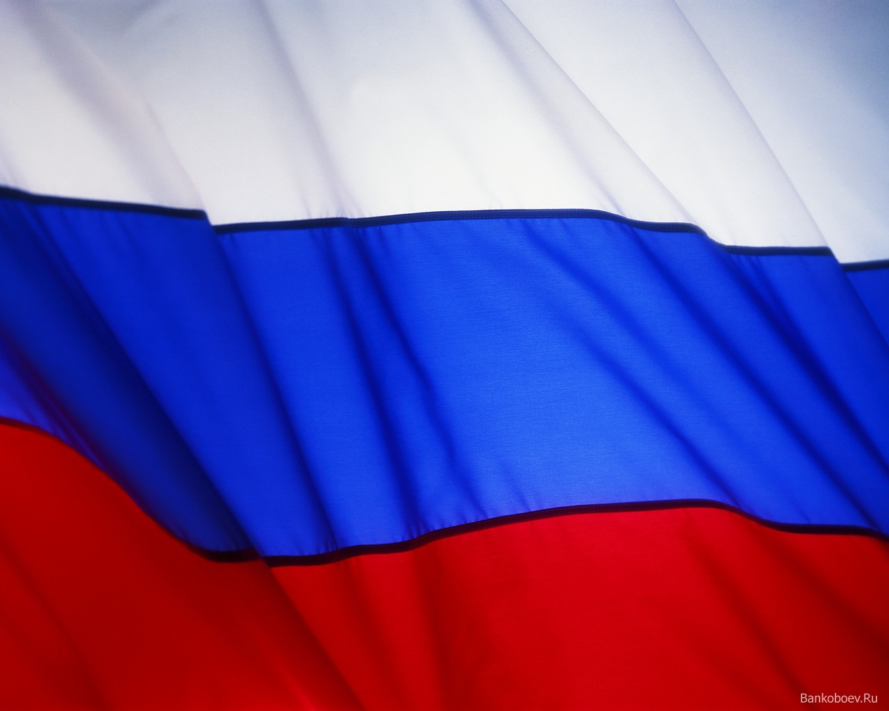
Russia is my country

Slide 2
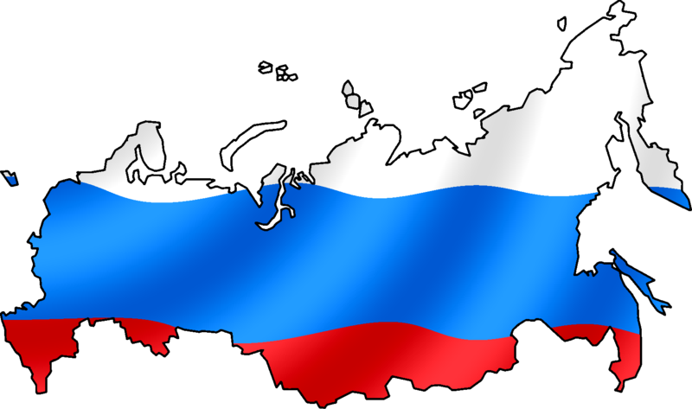
My country is the biggest in the world. It is 17 075 400 square kilometers. The population of
my country is
141 895 500
people.

Slide 3
Climate
Climate in Russia is very different. Mostly it is mild. In the South of the country it is subtropical. In winter average temperature is -15 - -20 degrees C. There are many rains in autumn in our country. Summer in my region is not very hot and often rainy.

Slide 4
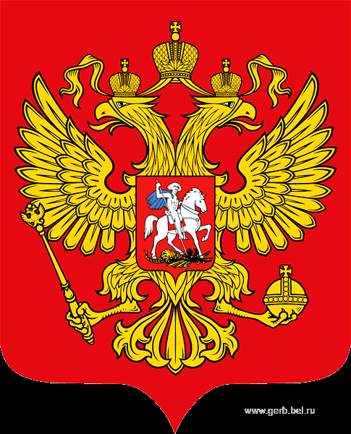
Coat of arms

Slide 5
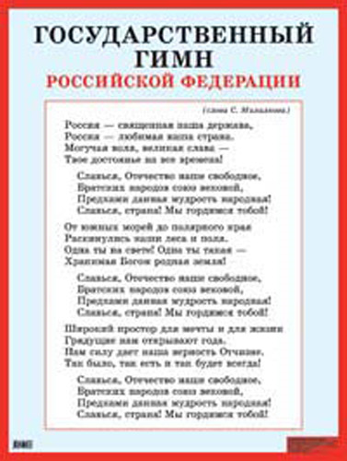
Hymn

Slide 6
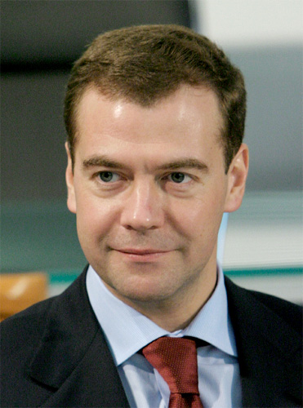
President of the Russian Federation
Dmitry Medvedev was born on the 14th of September 1965. He graduated from the Petersburg State University. He was a lawyer before he became a president. He as elected on the 7th of May 2008.
Dmitry Medvedev is married and he has a son.

Slide 7
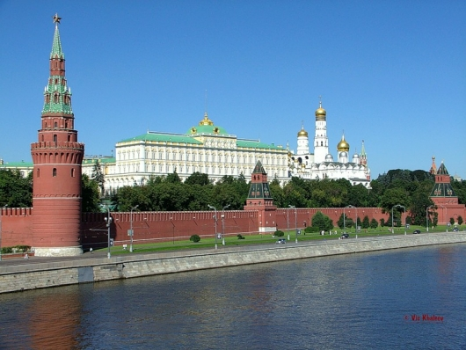
Moscow
The capital of my country is Moscow. 10 562 000 people live in Moscow. The Kremlin is the most important building in Moscow. Russian President works in the Kremlin.

Slide 8
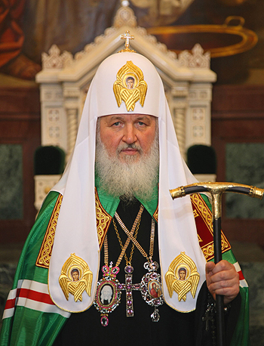
Religion
Russia is a country of many Religions. Most Russia people are Orthodox. The head of the Orthodox church is Patriarch Krill.

Slide 9
Thank You!

