Slide 1




The theme of our lesson is…
HOLIDAYS

Slide 2
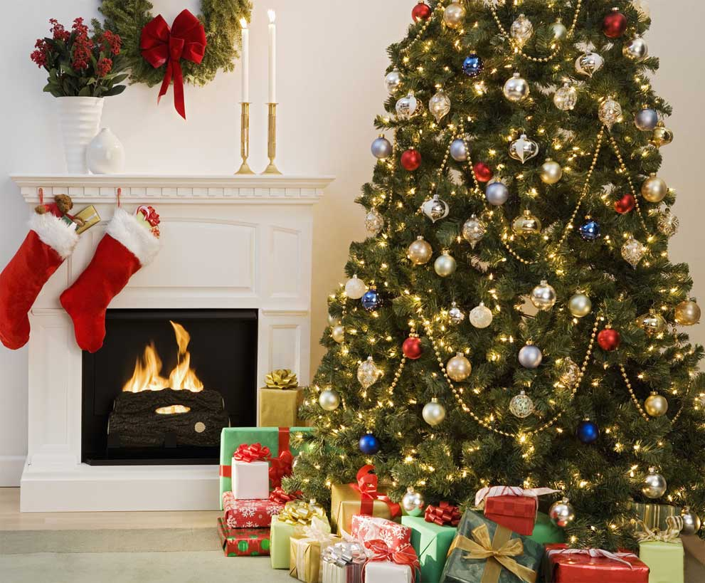
We are glad and very gay.
We all dance and sing and say:
“Merry, merry, ---------Day!”

Slide 3

Roses are red,
Violets are blue,
Sugar is sweet
And so are you

Slide 4
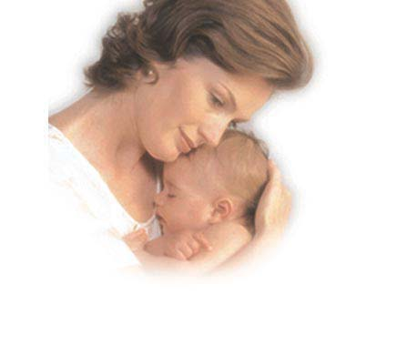
I give her flowers
White, yellow and red
Who loves ---------best

Slide 5
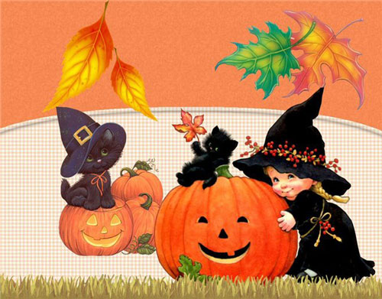
Five little pumpkins sitting on a gate.
The first one said: "It's getting late!"

Slide 6
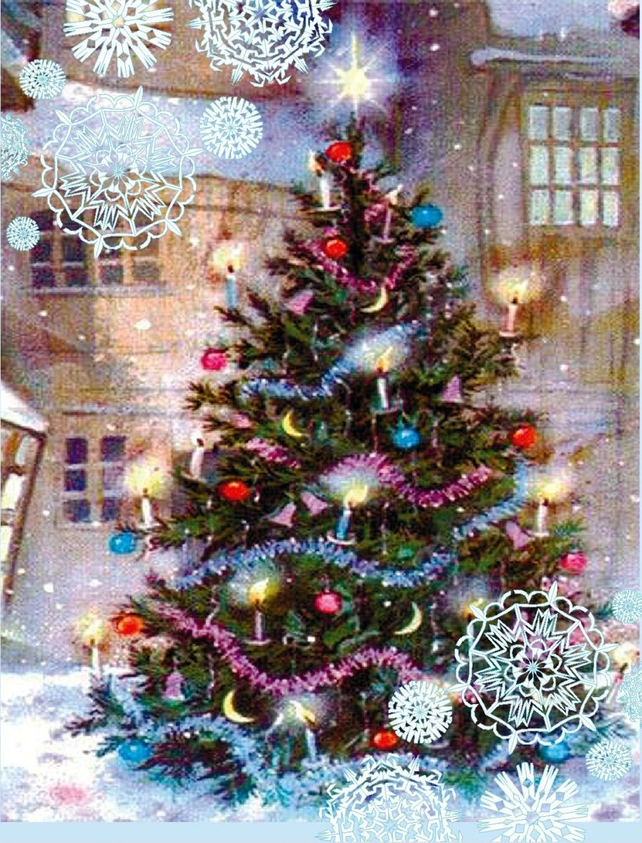
This is the season
When children ski,
And old Father Frost
Bring the --------Tree

Slide 7
Ordinal numerals
Which?
Какой? Четвертый.
Который по счету?
the 4th
the first
the second
the third
21 – the twenty first
30 – the thirtieth
19 – the nineteenth

Slide 8
When and where is … celebrated ?
Christmas | The 25th of December
St Valentines Day | The 14th of February
Australia Day | The 26th of February
Canada Day | The 1st of July
Independence Day | The 4th of July
Victory Day | The 9th of May
Independence Day | The 12th of June
Christmas | The 7th of January

Slide 9
Where do people celebrate these festivals and have these traditions?
People cook pancakes and eat them with honey, butter and caviar.
People colour eggs and present as a symbol of endless life.
People celebrate birthdays and sing “Happy Birthday to You”.
People send cards when they get a new house, People organize wedding parties.
People organize military parades when they celebrate Victory day.
People say “Good day” when they meet.
Men usually give flowers to women.
Decide where they have these traditions:( use numbers only)
1. In Russia: 2. In G.B: 3. In the USA: 4. In all the mentioned countries:

Slide 10
People say “Happy New Year” when they see the New Year in.
Children put their stockings near the bed and find presents in the morning.
People decorate the X-mas tree (New Year Tree).
People celebrate Mother’s Day.
People eat turkey and a pumpkin pie when they celebrate Thanksgiving day.
Decide where they have these traditions:( use numbers only)
1. In Russia: 2. In G.B: 3. In the USA: 4. In all the mentioned countries:

Slide 11
Holidays
Date The 9th of May January February | Guests Bring a lot of presents | Presents Flowers Books | Traditions Decorate houses Hang stockings Colour the eggs Congratulate old people with Khadak Sing songs, dance | Food Roast turkey Pumpkin pie Cakes Salads Boozy

Slide 12
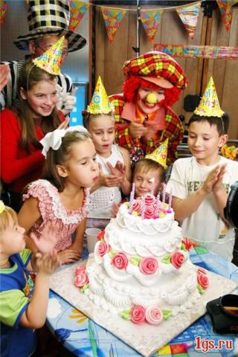

Slide 13

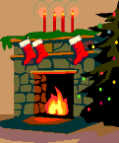
In Russia we have... (too). In Great Britain we have
Santa Claus
Father Frost
stockings
a reindeer
Snow Maiden
a Christmas Tree
Christmas cake
a New Year Tree
a turkey
a fireplace
Christmas pudding
presents

Slide 14

In Russia we have... In Great Britain we have
(too).
dyed eggs
a basket of eggs
Easter Bunny
Easter lily

Slide 15
In Russia we have...(too). In Great Britain we have
pancakes
the figure of the winter

Slide 16
In Russia we have...(too). In Great Britain we have
the 8th of March
Mother’s Day
cakes
a holiday dinner
flowers

Slide 17
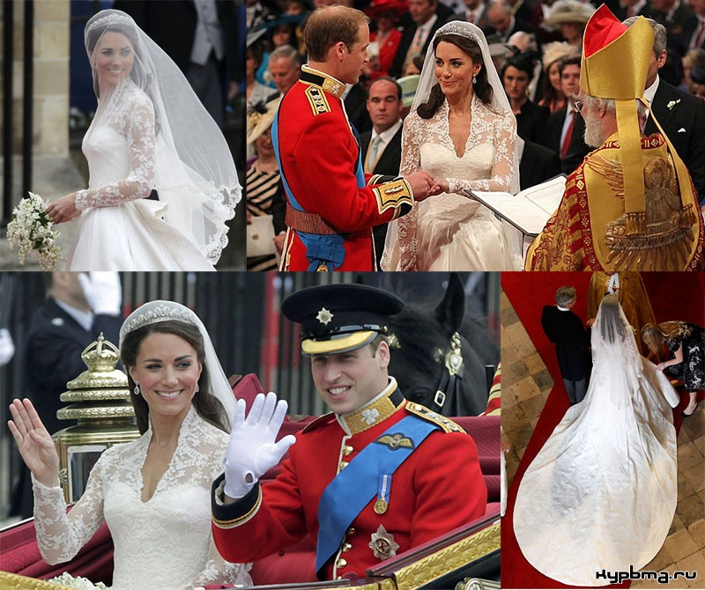

Slide 18
GRAMMAR.
TAG – QUESTIONS
Fill the gaps with don’t they, do they, does he, don’t we, aren’t there, are there, is it, isn’t it,
1. There are a lot of holidays in the world, ...?
2. We celebrate the New Year in Summer, ...?
3.We celebrate Easter in spring, ...?
4. May Day is not a winter holiday, ...?
5. People like holidays, ...?
6. Christmas is a winter holiday, ...?
7. Halloween is not a traditional Russian holiday, ...?
8. Every Englishman doesn’t like to miss his afternoon tea, ...?
9. People like to celebrate Christmas, New year and Easter, ...?

Slide 19


