Slide 1
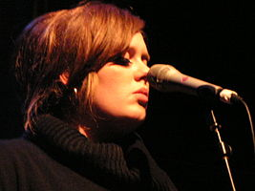
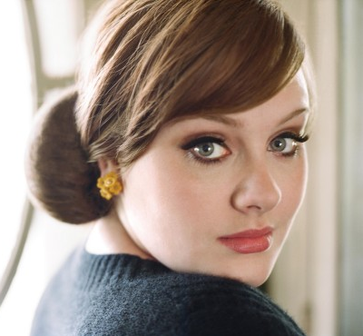
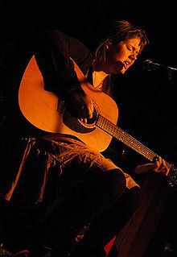
ADELE
“Someone like you”

Slide 2
Adele
Adele Laurie Blue Adkins (born 5 May 1988), known professionally as Adele, is an English singer-songwriter. She was the first recipient of the Brit Awards "Critics' Choice" and was named the number-one predicted breakthrough act of 2008 in an annual BBC poll of music critics, Sound of 2008. Since her debut album Adele has received much recognition both commercially and critically. The album debuted at number one and has been certified four times platinum in the UK. At the 2009 Grammy Awards, Adele won the awards for Best New Artist and Best Female Pop Vocal Performance. After being performed at the 2011 BRIT Awards, the album track "Someone Like You" reached number one in the United Kingdom, while the album also remained at number one. "Someone Like You" held the number one position for four consecutive weeks. The song has also spent 2 weeks at number one in New Zealand. 5 weeks at number one in Australia and following her performance at the 2011 MTV Video Music Awards it became Adele's second number one single on the Billboard Hot 100 in the US

Slide 3
to be settled down | не в твоих привычках
to be married | вместо
to come true | просить, молить
ain't like you | быть женатым, замужем
never mind | ничего
instead | обрести покой
to beg | осуществляться
can't fight it | быть сдержанным
hold back | не в силах устоять

Slide 4
I heard that you're settled down,
That you found a girl and you're married now,
I heard that your dreams came true,
Guess she gave you things I didn't give to you,
Old friend, why are you so shy?
Ain't like you to hold back or hide from the light
I hate to turn up out of the blue uninvited,
But I couldn't stay away, I couldn't fight it,
I had hoped you'd see my face,
And that you'd be reminded that for me it isn't over
[Chorus:]
Never mind, I'll find someone like you,
I wish nothing but the best for you, too,
Don't forget me, I beg,
I remember you said,
"Sometimes it lasts in love,
But sometimes it hurts instead,"
Sometimes it lasts in love,
But sometimes it hurts instead, yeah

Slide 5
Я слышала, ты обрёл душевное равновесие,
Что ты нашёл себе девушку и теперь женат,
Я слышала, твои мечты осуществились,
Думаю, она дала тебе то, что не смогла дать я.
Дружище, почему ты так застенчив?
Не в твоих привычках быть сдержанным или скрываться от света.
Я ненавижу появляться как гром среди ясного неба,
Но я не могла не прийти, я не смогла устоять.
Я надеялась, что ты увидишь моё лицо,
И это напомнит тебе, что для меня ещё не всё кончено.
[Припев:]
Ничего, я найду такого, как ты,
Я тоже желаю тебе только лучшего,
Не забывай меня, прошу,
Я помню, как ты сказал:
"Иногда любовь бесконечна,
Но иногда это вместо этого - только боль",
Иногда любовь бесконечна,
Но иногда это вместо этого - только боль

Slide 6
Find 5
nouns | verbs | adjectives | adverbs | pronouns

Slide 7
Write down 5 questions
Yes|No
Special
OR
Tag
Who|What

Slide 8
Find such sentences in the text of this song & write them in INDERECT SPEECH
Present Simple
Past Simple
Future Simple

