Slide 1






Countries and Continents
The earth is a garden,
It’s a beautiful place
For all living creatures,
For all the human race.

Slide 2
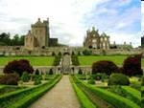
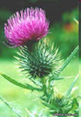

The National Symbol of Scotland
New words:
Scandinavians( the Norsemen) –скандинавские завоеватели
to plunder грабить
to settle поселяться
to defend защищать
еnemies враги
sharp pain острая боль

Slide 3
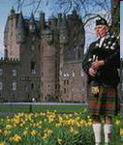
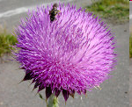
The National Symbol of Scotland
Ancient Scandinavians wanted to plunder
----------------and-----------------there.
When they decided to attack the Scots, they took-----------off not to make noise.
But one of them ------------ on a thistle and sudden and sharp pain made him scream.

Slide 4
Check up your answer!
Ancient Scandinavians wanted to plunder
the land of Scotland and settle there.
When they decided to attack the Scots, they took their shoes off not to make noise.
But one of them stepped on a thistle and sudden and sharp pain made him scream.

Slide 5
An interesting historical fact
No one knows for sure where the name “ Yankee” comes from.
Some think that the Indians who came to the village of New Plymouth called the Englishmen “Yankee”
Some think that it comes from the Dutch name Jan Kees or from a Dutch pirate named Yankey.
Whatever the origin is, still in colonial times the British soldiers used this word as a rude name for the Americans whom they disliked.

Slide 6
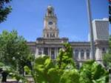
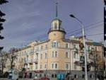
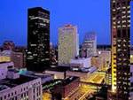
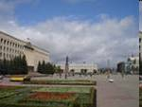

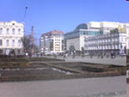
Des Moines – Stavropol
Twin - Cities

Slide 7

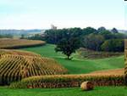
Iowa

Slide 8

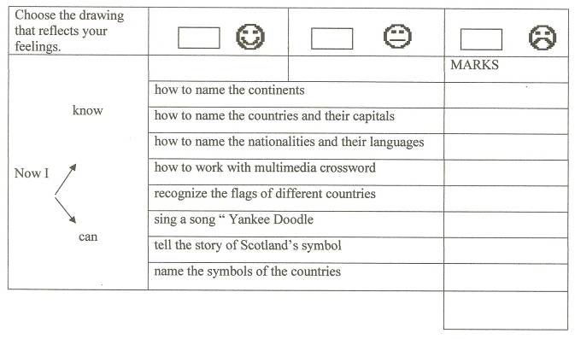

Slide 9


1.Tell about Alexandria.
2. Make a poster about English- Speaking countries.
3. Learn the poem by heart !

