Slide 1

My Dream House
My Dream Room
Журавлева И.Ю.
школа №596
Приморского района
Санкт-Петербург
2011

Slide 2

Task: Read and repeat.
[ w] - wall, wardrobe, window, what
[ ʧ ] - chair, armchair, picture, kitchen
[ t ] - table, carpet, curtain, poster
[ d ] - dream, desk, do, does
[ ð ] - this, that, there is, there are
[ θ ] - bath, bathroom, thank, things

Slide 3
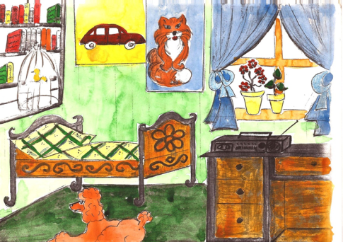
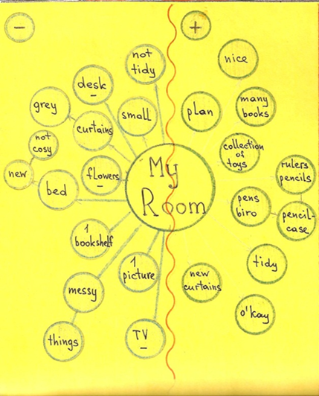
My
Project
Work:

Slide 4

Let’s sing a song
“Copy me”
Hands up!
Hands down!
Stamp your feet!
Nod your head!
Dance together!

Slide 5
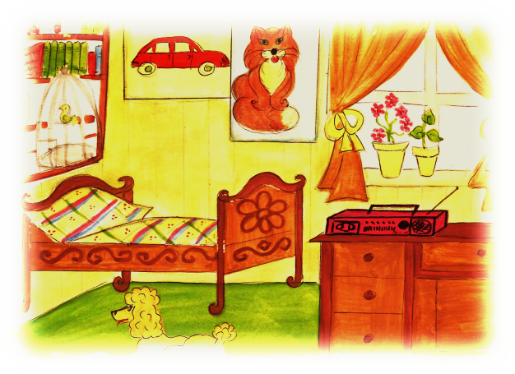

My Dream
House
My Dream
Room

Slide 6
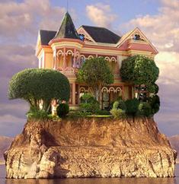
Task: Read as quickly as you can.
We are lucky
We are lucky to have a house
We are lucky to have a big house
We are lucky to have a big yellow house
We are lucky to have a big yellow house with a garden
We are lucky to have a big yellow house with a beautiful garden
We are lucky to have a big yellow house with a beautiful garden
on a small island
In my dream world we are lucky to have a big yellow house with
a beautiful garden on a small island.

Slide 7
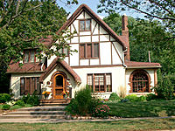
Task: Read and find the word in each
line which cannot be used.
Cross it out.
Great, ugly, interesting, good
Nice, clean, beautiful, messy
Dirty, light, fantastic, tidy
Cosy, pretty, dark, light

Slide 8
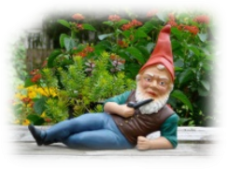
Task: write down the missing words
My name is Andy Johnson.
I’m from (1- the USA).
I like to (2- dream). In my dream
world I (3- live) on an island.
I live in a big (4- house).
There is a nice orange (5- garden) around the house with
a (6- swimming-pool) for children. Also there are a lot of animals in my garden.
There are (7 -ten) rooms in my dream house:
a (8- living room), two children’s rooms for my brother and me, four bedrooms for parents and guests, three
(9- bathrooms), a (10- kitchen) and a dining room .
Also there is a big room like
a cinema where children can watch films.
I think my (11- dreams) are fantastic.

Slide 9
Task: Put the words in right way.

Slide 10
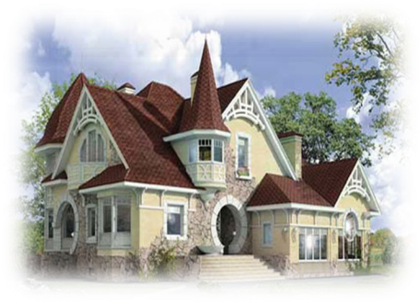
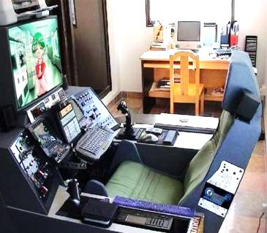
My Dream
Room
My Dream
House

Slide 11
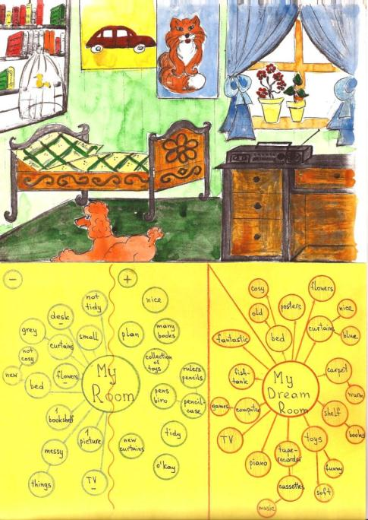
My
Project
Work:

Slide 12
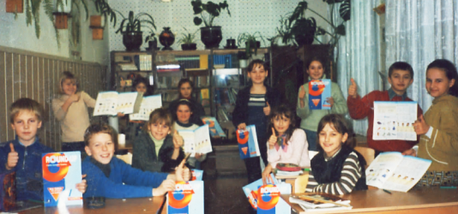
There is no place like home.
My home is my castle.
East or West, home is best.
Home, sweet home.

