Slide 1
1. What is the capital of Great Britain?
New York
Washington
London

Slide 2
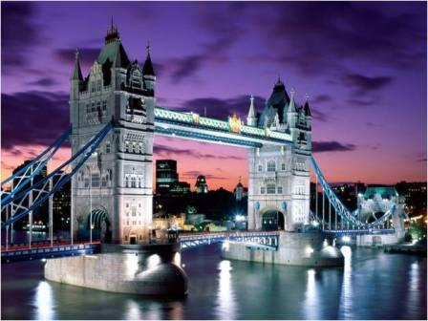
3. London

Slide 3
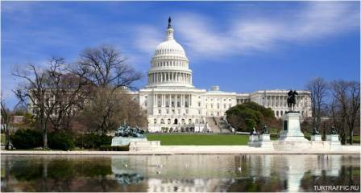
2. Who is the president of the USA?
Tony Blear
Barak Obama
Bill Clinton

Slide 4
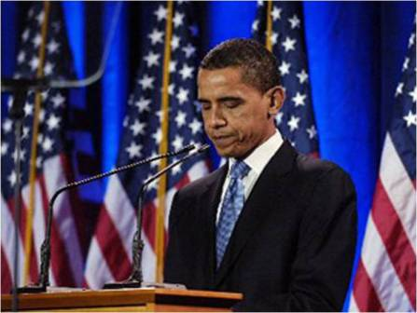
2. Barak Obama

Slide 5
3. What is the name of the British queen?
1. Elizabeth I
2. Elizabeth II
3. Princess Diana

Slide 6
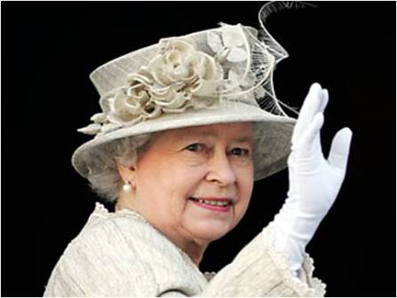
2. Elizabeth II

Slide 7
4. What country does this flag belong to?
New Zealand
Australia
Canada

Slide 8
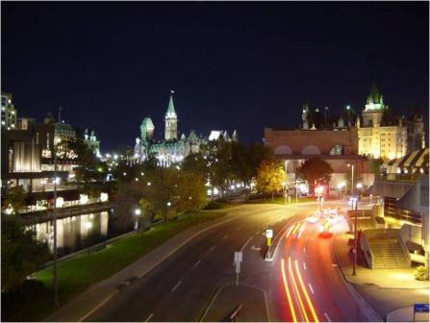
3.Canada

Slide 9
5. What is the capital city of the USA?
Washington
New York
Boston

Slide 10
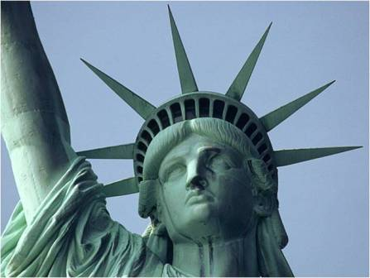
1. Washington

Slide 11
6. What did Christopher Columbus discover?
England
Europe
America

Slide 12
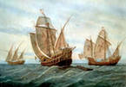
3. America

Slide 13
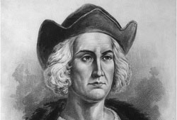
7. When did Columbus discover America?
1492
1429
1249

Slide 14
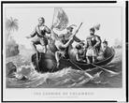
1. 1492

Slide 15
8. What weather is very TYPICAL in Great Britain?
Rainy
Snowy
Sunny

Slide 16
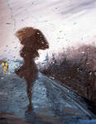
1. Rainy

Slide 17
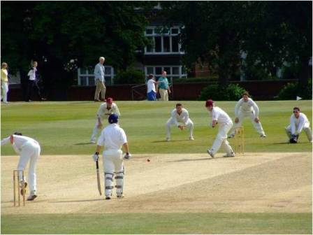
9. What is the name of this sport game?
Golf
Rugby
Cricket

Slide 18
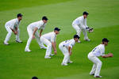
3. Cricket

Slide 19
10. What is the name of the book? It is a story about a mischievous boy who can fly and doesn’t want to grow up . He lives on the small island of Neverland as the leader of his gang of the Lost Boys.
Christopher Robin
Little Prince
Peter Pen

Slide 20
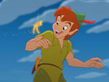
3. Peter Pen

Slide 21
11. Who is the American writer?
1. Mark Twain
2. Allan Alexander Milne
3. Louise Carol

Slide 22
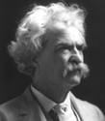
1. Mark Twain

Slide 23
12. What Country does this flag belong to?
England
Scotland
The USA
Australia

Slide 24
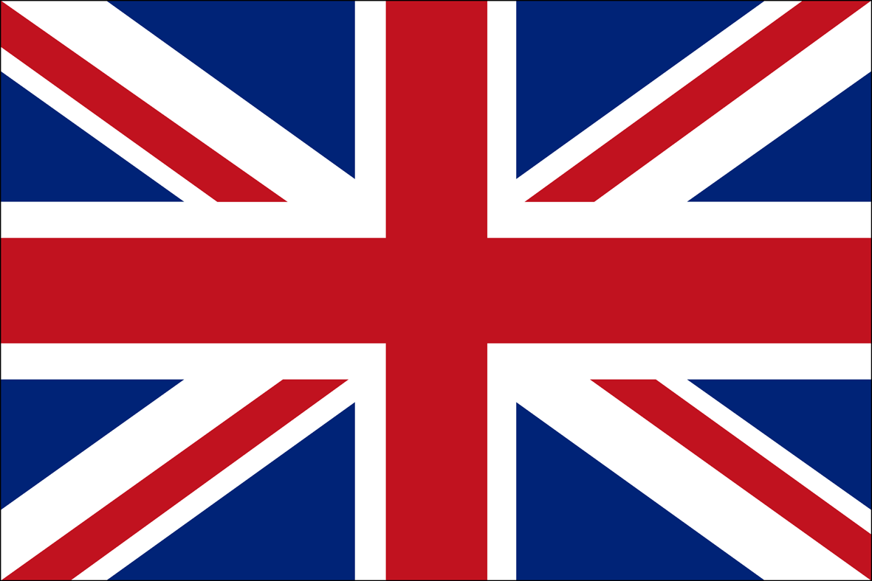
1. England

