Slide 1
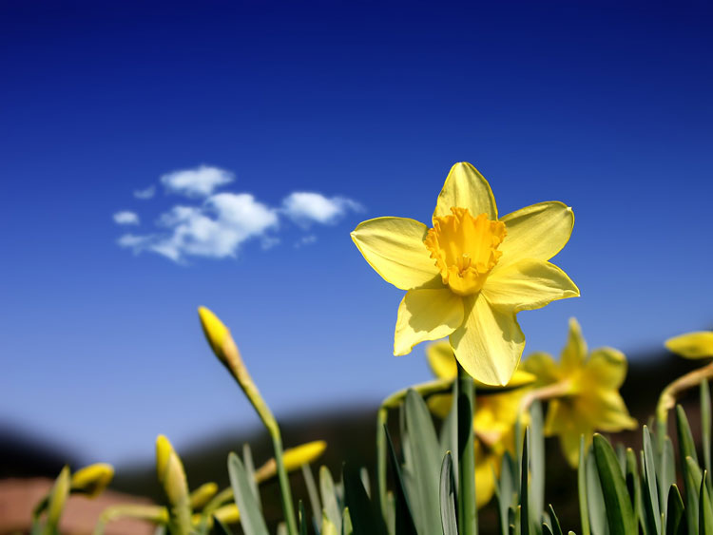
Ecology is one of the most important sciences nowadays.

Slide 2
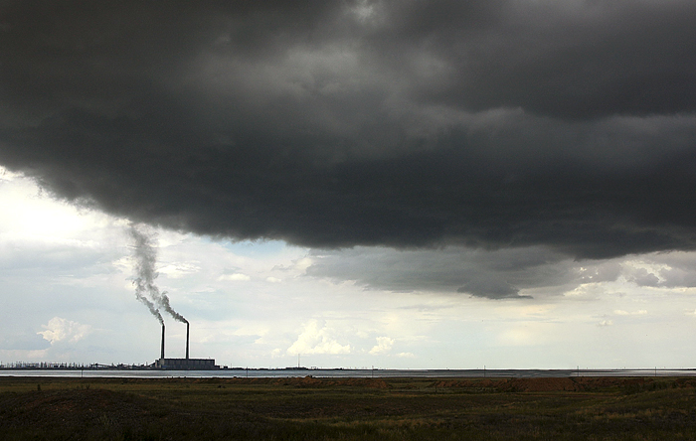
People have been polluting the planet on which they live for many years. The result is very sad.

Slide 3
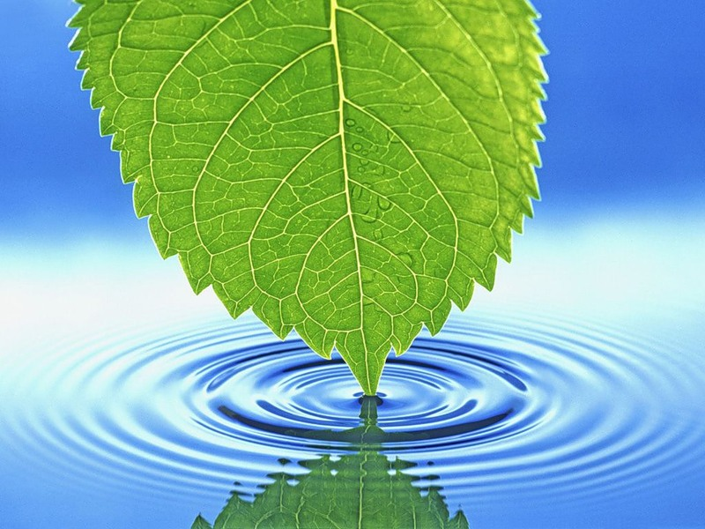
The world is our home and we want to see it clean and beautiful!
At the same time we take from nature as we can….

Slide 4
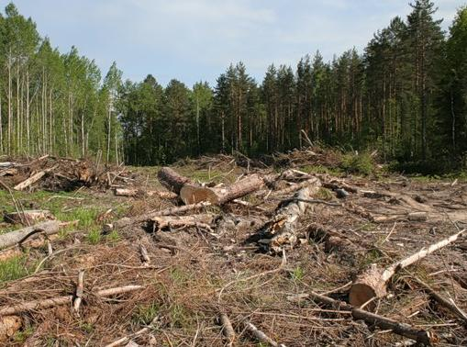
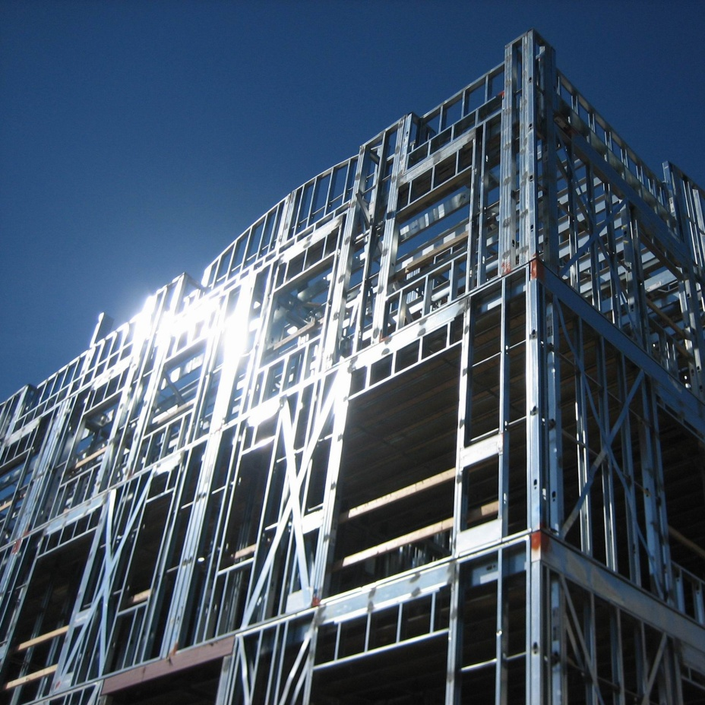
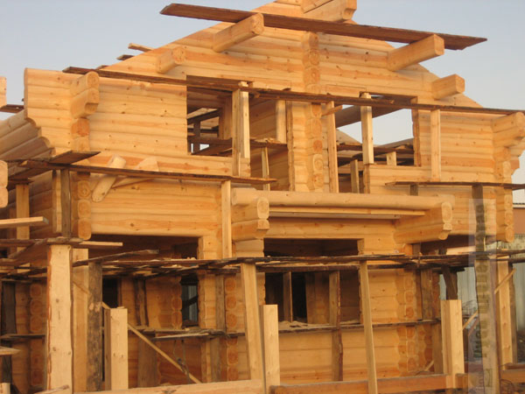
We cut down forests and build farms, houses, roads and factories on the land.

Slide 5
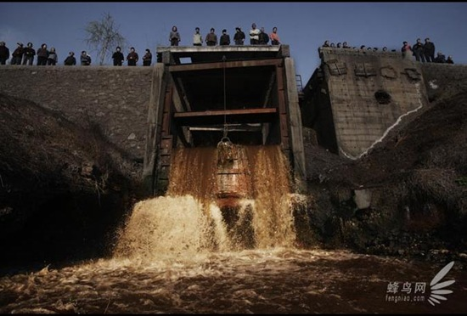
We make a lot of waste some of which is toxic.
We dump domestic and industrial waste in the country and pour toxic waste into our rivers, seas and oceans.

Slide 6
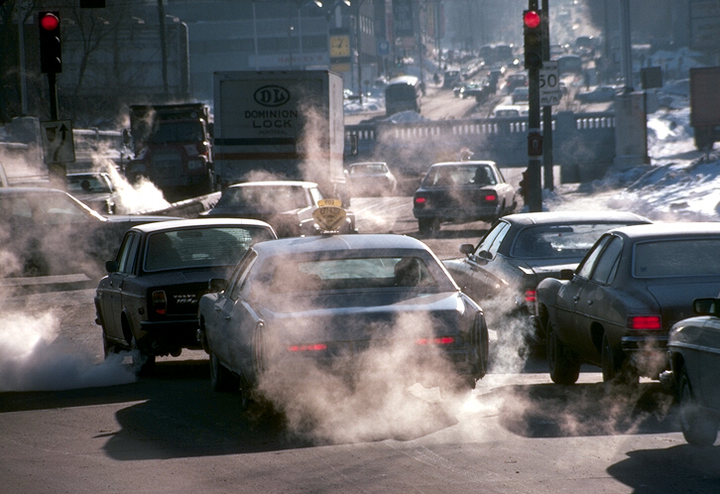
Cars and factories, plants and power stations pollute the air and make it dangerous to breathe…

Slide 7
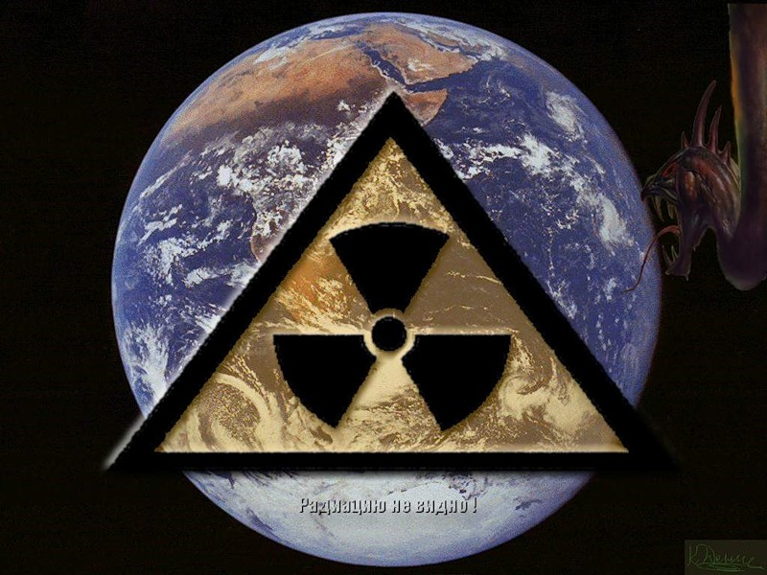
People have to think about all these ecological problems if they want to survive.

Slide 8
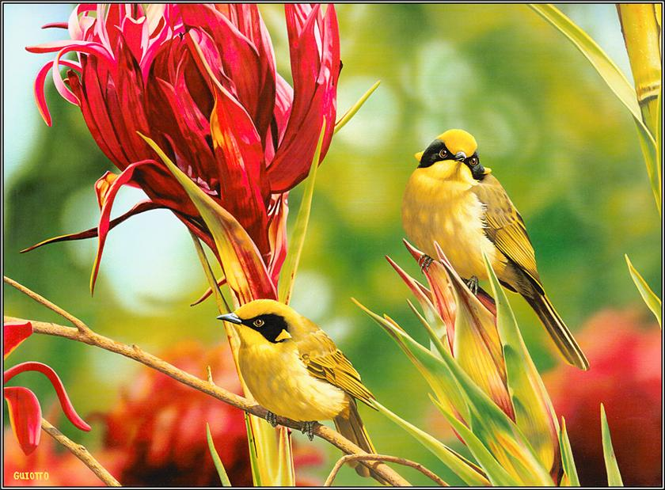
There are some ecological organizations nowadays.

Slide 9
WWF and Greenpeace-are some of such organizations.

Slide 10
They help endangered animals. For example, if the population of some species is very small, it means they can become extinct. Ecologists protect them and try to make their population larger…..

Slide 11
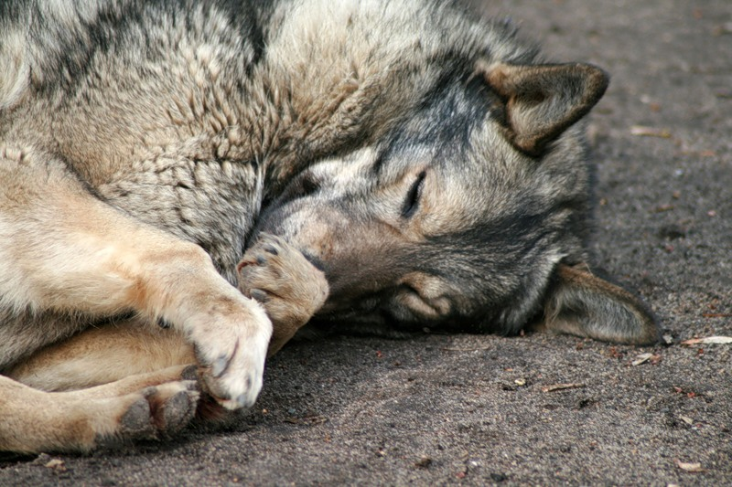
They stop those people who kill endangered animals and destroy their habitats.

Slide 12
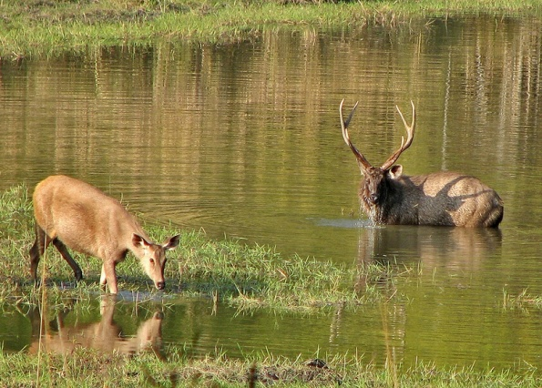
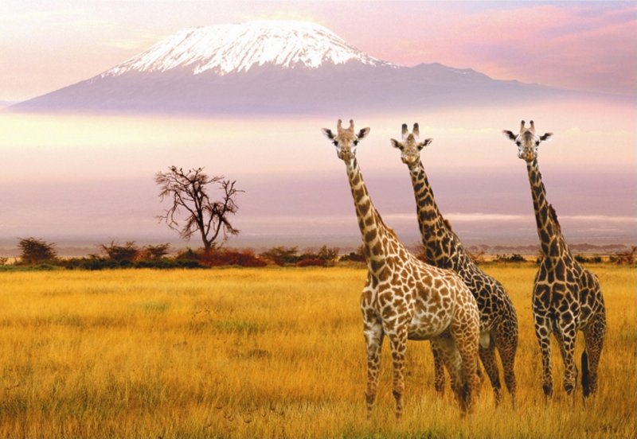
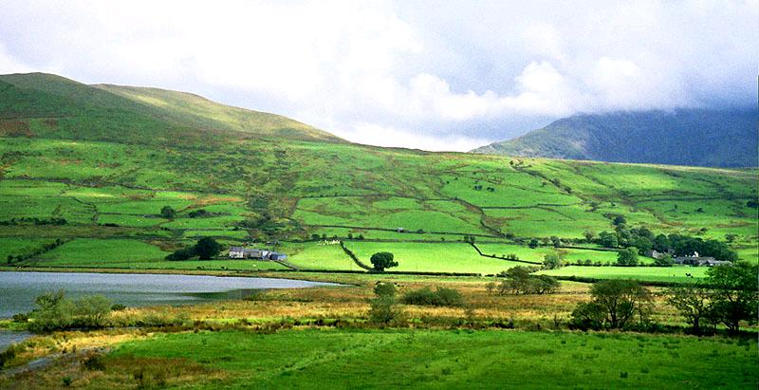
Сountries can open national parks. They are big and usually very beautiful places without buildings. They are homes for animals living freely and also for birds, trees and flowers.

Slide 13
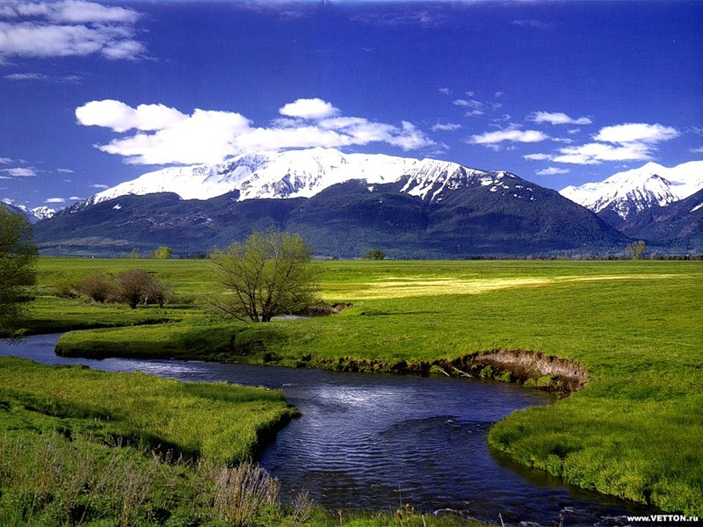
WE ALL MUST WORK TOGETHER TO MAKE OUR PLANET A SAFE AND BEAUTIFUL PLACE TO LIVE!!!

