Slide 1
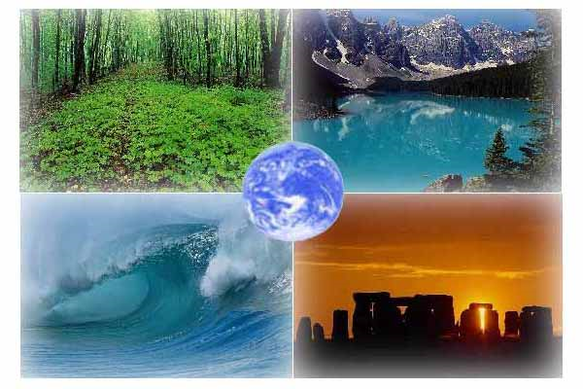
Ecological problems.

Slide 2
Ecological problems.
1. Water pollution.
2. Air pollution.
3. Soil pollution.

Slide 3
Water pollution.
We make a lot оf waste some of which is toxic. We dump domestic and industrial waste in the country and pour toxic waste into our rivers, seas and oceans.

Slide 4
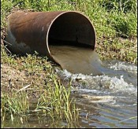
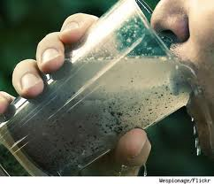
The water in the oceans, seas, and rivers has become polluted in many places. If people drink this water, they can get ill or even die. People use oceans and seas as big dumps and pour industrial and domestic waste into them. And so fish become toxic. It is very dangerous for people to eat such fish. Water birds leave places with toxic water. A lot of trees on the coast die, too.

Slide 5
Air pollution.
Nowadays people feel that it is more difficult to breathe: in big cities the air has become badly polluted. Cars and factories, plants and power stations pollute the air and make it dangerous to breathe. Old people and little children feel bad and get ill because of the polluted air.

Slide 6
What to do to survive?
First of all countries should have strong laws to control pollution, to protect animals and plants. Governments should be responsible for protecting nature. Countries can open national parks. Politicians can think of ways to stop hunting. Governments should also find ways to recycle things we have used: paper bags and plastic bags, plastic bottles and cans, glass and metal things. They should build recycling factories. Governments must control and if necessary, close dangerous plants and factories.

Slide 7
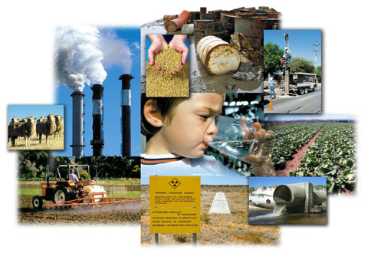
We all must work together to make our planet a safe and beautiful place to live.

