Slide 1
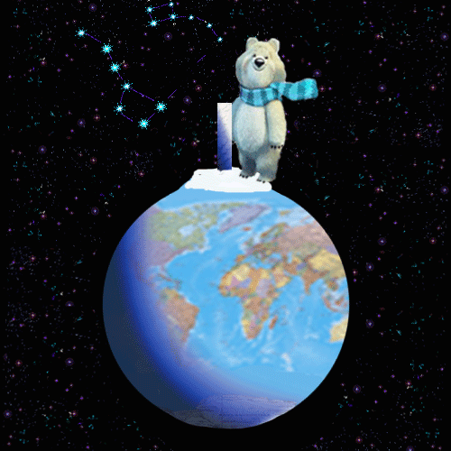
Animals in Danger part 2 (about tigers)
Презентация к уроку “Animals in Danger”. Учебник для 5 класса школ с углубленным изучением английского языка, лицеев гимназий, колледжей. И.Н.Верещагина, О.В.Афанасьева.
Учитель английского языка ГОУ СОШ № 180
Васильева Елена Васильевна

Slide 2
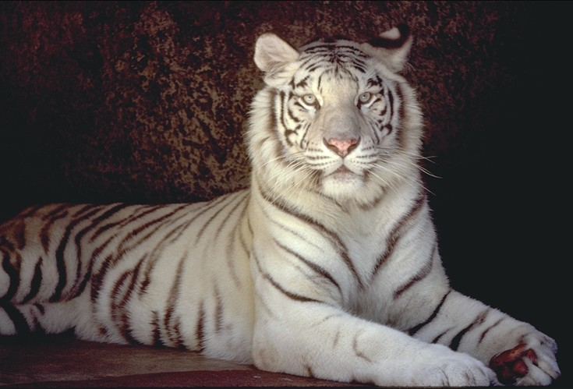
Another wonderful animal, which is disappearing nowadays, is an Indian tiger

Slide 3
Tigers are often dangerous animals. They can kill cows, sheep, other domestic animals and sometimes they can kill men. Some people are afraid of tigers and kill them to save their domestic animals and their lives.But some people have often hunted tigers for fun and for their beautiful skin. They can easily sell the skin and get a lot of money as the prices are high.

Slide 4
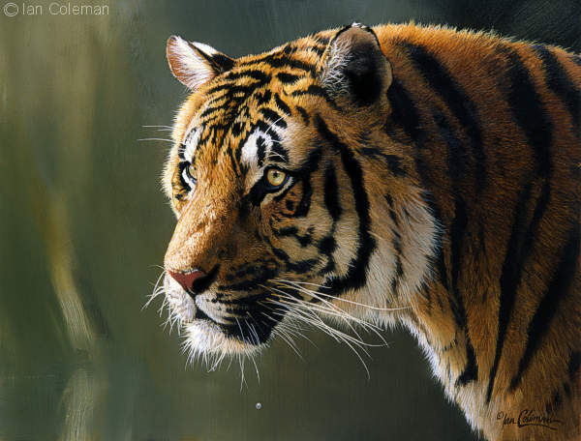
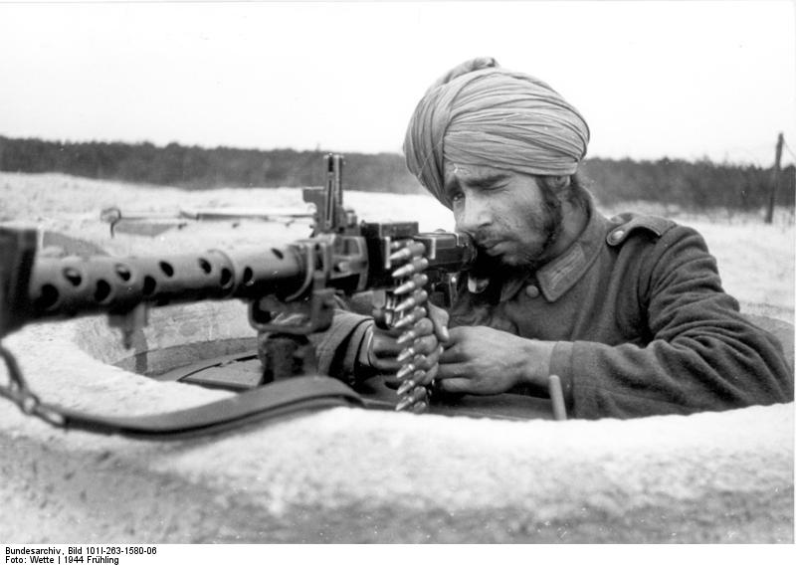
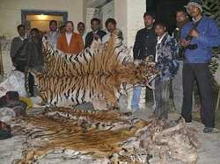

Slide 5
This is the sad story of Indian tigers and African elephants. But many other dangerous animals and birds are also disappearing from the Earth.

