Slide 1
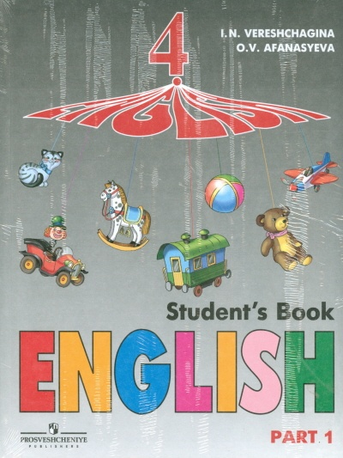
Презентация “The United States” для учащихся, изучающих английский язык по УМК авторов Верещагиной И.В. И Афанасьевой О.В (4-й год обучения) для школ с углублённым изучением английского языка, лицеев и гимназий.
Учитель английского языка
Васильева Елена Васильевна
ГОУ СОШ № 180
2011 год

Slide 2
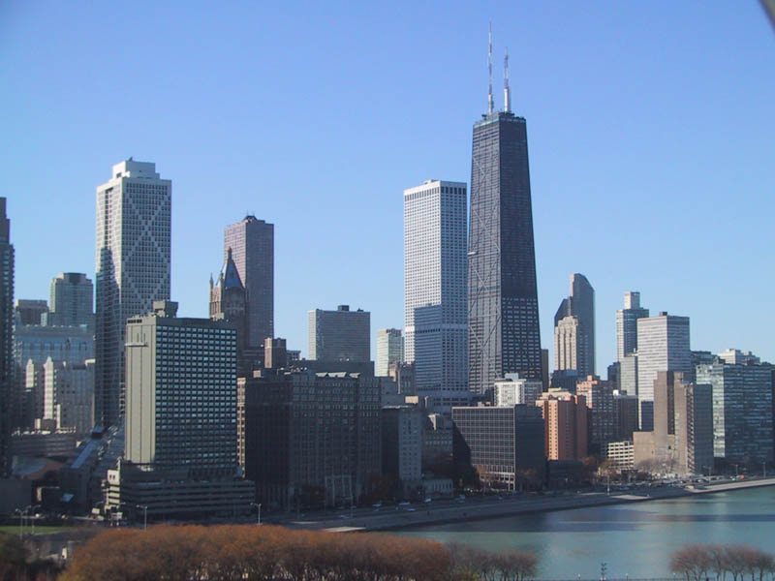
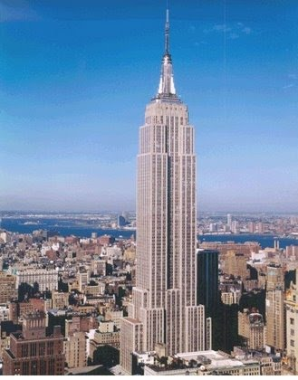
The United States is a young country. In fact
sometimes people call it “The New World”.
Americans like new ideas. They built the first
skyscrapes.

Slide 3
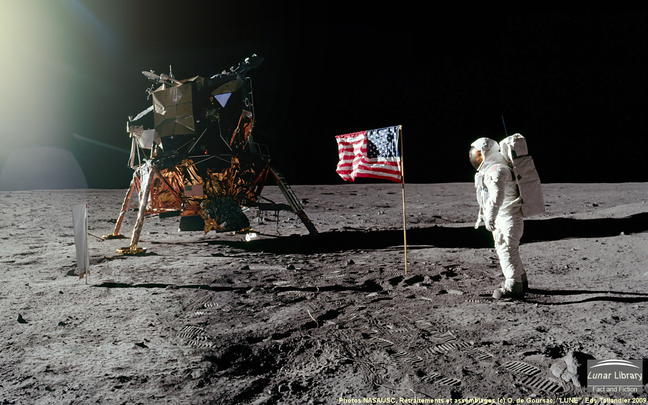
They put the first man on the Moon

Slide 4
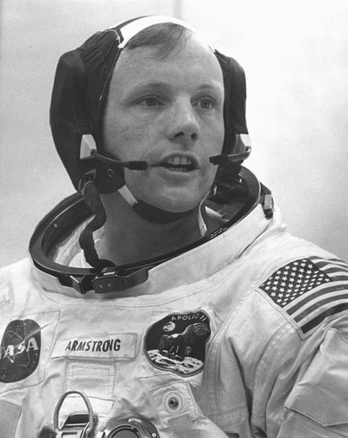
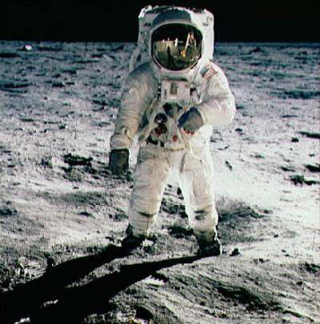
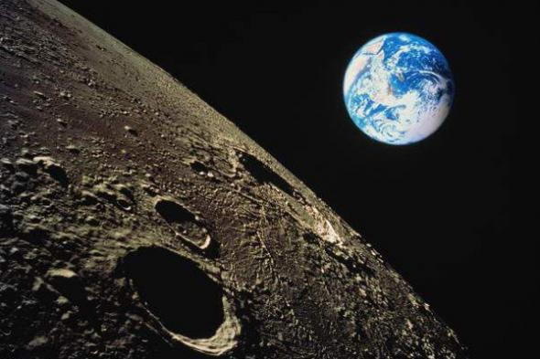
Neil Armstrong – the
First man on the Moon

Slide 5
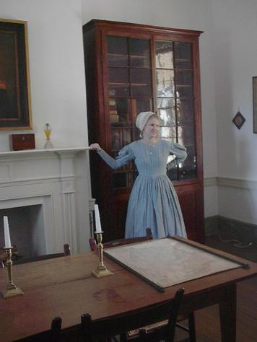
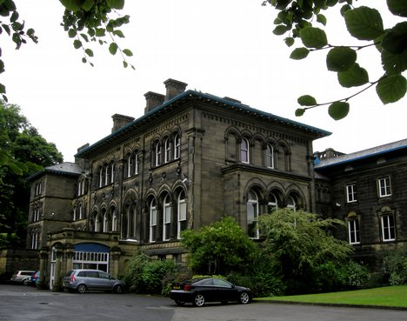
But Americans love old things too. They like to
visit historic houses and museums, they like old traditions, remember the days of the
“Wild West”

Slide 6
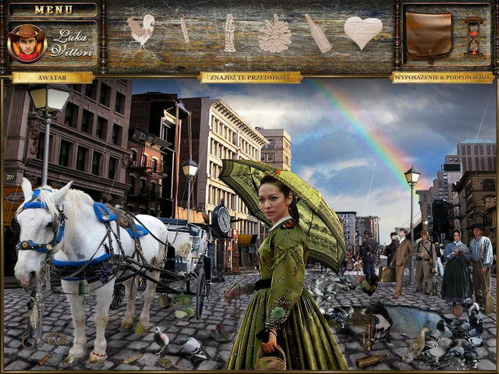
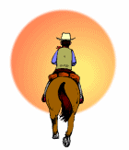
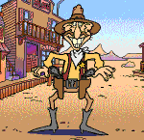
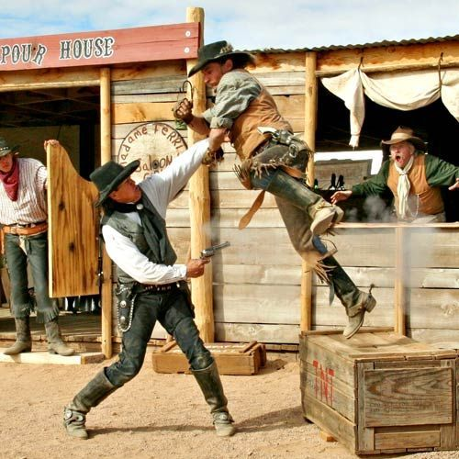
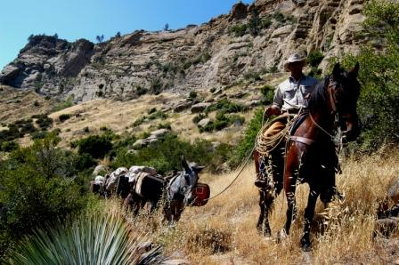
The days of the
“Wild West”

Slide 7
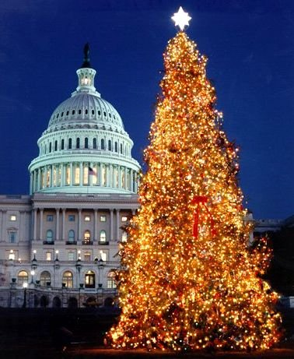
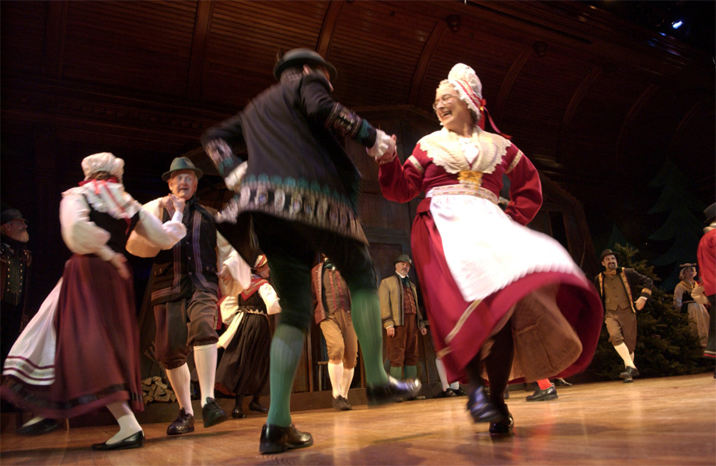
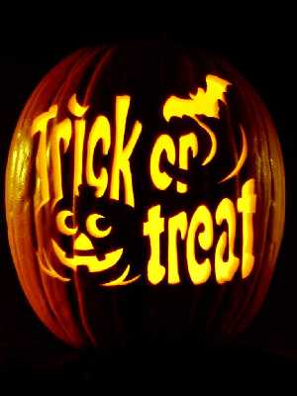
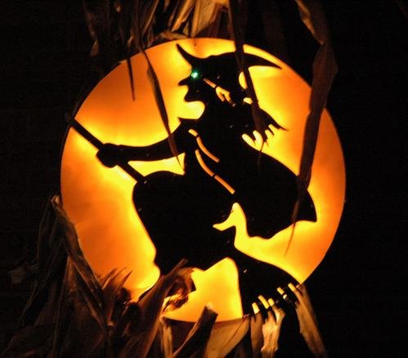
The people of the United States are in fact people from many different countries. They brought to their new country their traditions. The Germans brought the Christmas tree.
The Scots brought Halloween

Slide 8
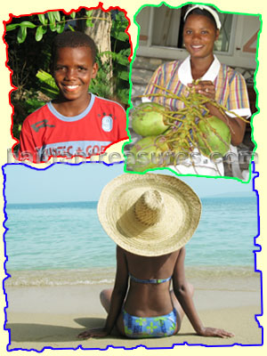
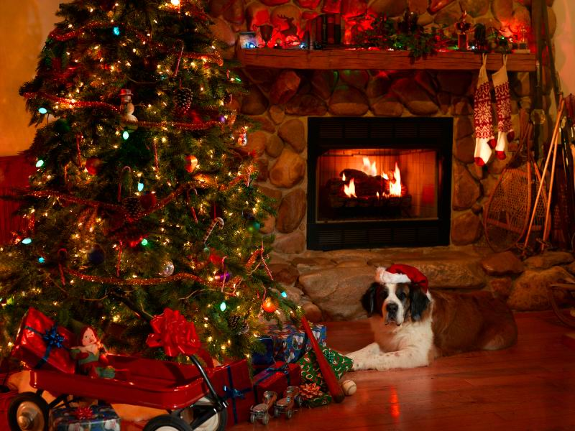
There are New American festivals and traditions too. Americans celebrate Christmas and other holydays

Slide 9
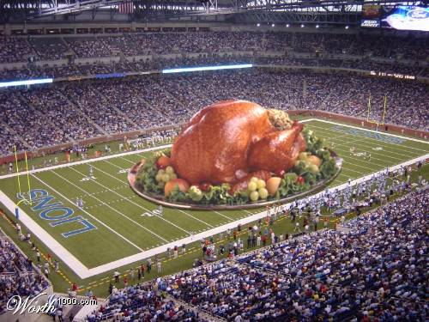
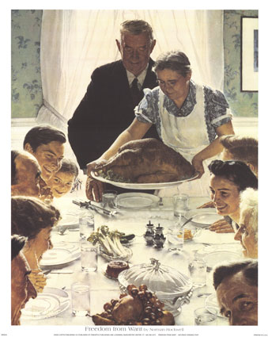
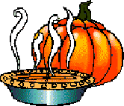
Only Americans celebrate “Thanksgiving day”

Slide 10
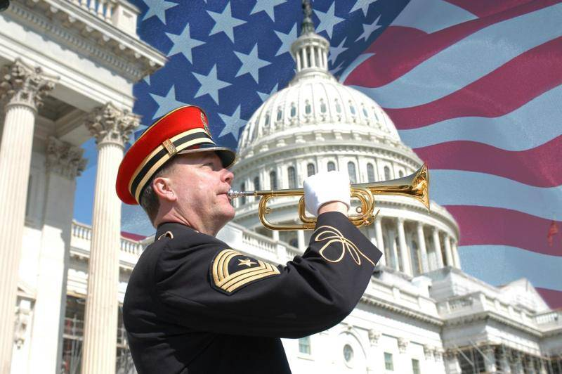
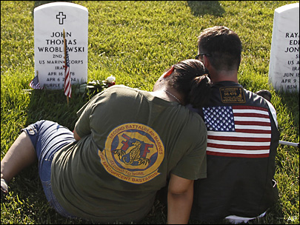
Only Americans celebrate “Memorial Day.
People Celebrate “Memorial Day” on the last Monday of May. This day is for people to remember those who died in wars, their dead friends and relatives.

Slide 11
Would you answer the questions?
Is the United States an old country with old traditions or a young country with old and new traditions?
What do Americans like?
What holidays did the Germans and the Scots take to America?
What holidays do only Americans celebrate?
When do Americans celebrate Memorial Day?

Slide 12
Источники:
1.http://www.archi.ru/events/news/news_current
_press.html?nid=5847&fl=1&sl=1
2.http://www.sites.google.com/site/ladyeonen/seekalch
13.html
3.http://deyer.org/ru/54278-41-rirr-srrrrirrye-sssryiryor
-rr-ryrrirssrrsss-rsrs.html
4.http://www.liveinternet.ru/users/mosday/rubric/
1660164
5.http://enlave.ucoz.co.uk/blog
6./http://dontableatua/news/2011-03-13
7.http://www.iqouqo.com/journal-i37015-Nashville-
8.http://www.trueknowledge.com/q/what_is_a_solids
9.http://www.culinaryhistorians.ca/resources/historic-
kitchens/upper-canadian.htm
10.http://the.tricels.com/18/tradition
11.http://windchimecentral.com/dip-native-american-christmas-music.html
12.http://www.theinnofthepatriots.com/TheAmericanRevolutionaryWarLivingHistoryExperience3

Slide 13
13.http://diyalobank.com/old-western-ranches
14.http://lorriebinnard.fastpage.name/footballanamericantradition
15.http://junkyardeg.bravejournal.com/
16.http:sgwg.net/encyklpedie/switzerland-traditions&page=4
17.http://www.coogieboogle.com/jy-american-christmas-traditions.htm/
18.http://www.nashotvet.com/forum/19-83-6
19.http://yousik.hiblogger.net/381109.htm/thread/2869894
20.http://www.haitiantreasures.com/HThaiti.guide.htm
21. http://www.sheknows.com/holidays-and-seasons/articles/811932/
22.http://www.biol.pmf.hr/Uc79Sh//
23.http://www.healingnews.com/Ancient_Healing_Remedies_introduced_05162009.html
24.http://www.coventryps.org/chs/academics/english/eng11/american_lit.html
25.http:minnemom.com/2009/04/15/cheyenne-frontier-days-wyoming/
26.http://www.lasr.net/travel/city.php?+Canyon+Sweet+Onion+Festival&Gilbert&TravelTo=AZ0608016&VE=Y&Event_ID=AZ0608016e001
27.http://www.authorstream.com/Presentation/jdiatalevi-287128-america-builn-chtap-labor-pptx-education-ppt-powerpoint/
28.http://www.komonews.com/news/photos/95262999/html

