Slide 1
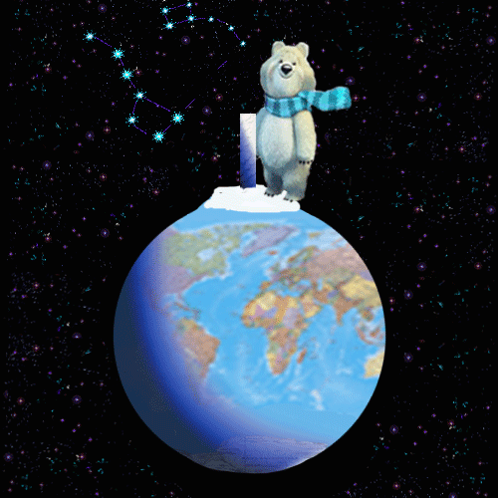
Animals in Danger Part 1 (about elephants)
Презентация к уроку “Animals in Danger”. Учебник для 5 класса школ с углубленным изучением английского языка, лицеев гимназий, колледжей. И.Н.Верещагина, О.В.Афанасьева.
Учитель английского языка ГОУ СОШ № 180
Васильева Елена Васильевна

Slide 2
People have lived on our planet for many years. They lived and live on different continents, in different countries.
People depend on their planet, on the sun, on animals and plants around them.
But nowadays many animals and birds are in danger, many of them are disappearing.

Slide 3
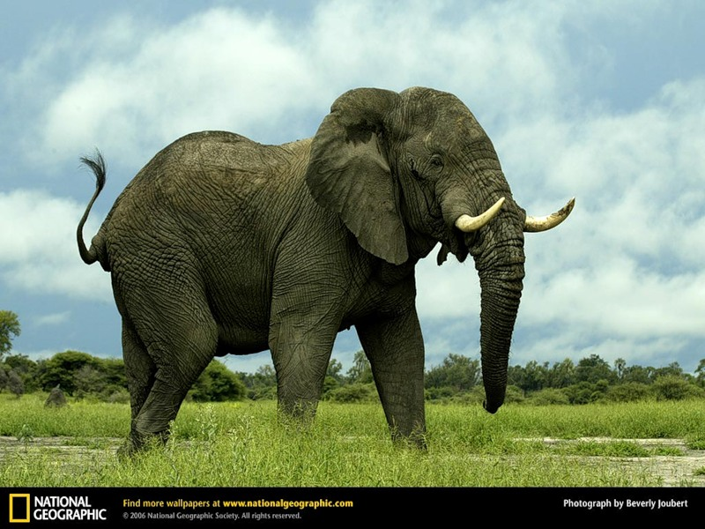
African elephants are in danger now

Slide 4
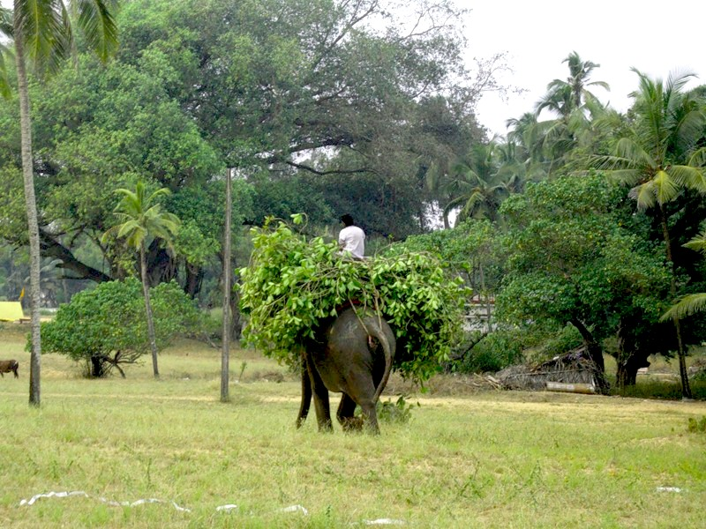
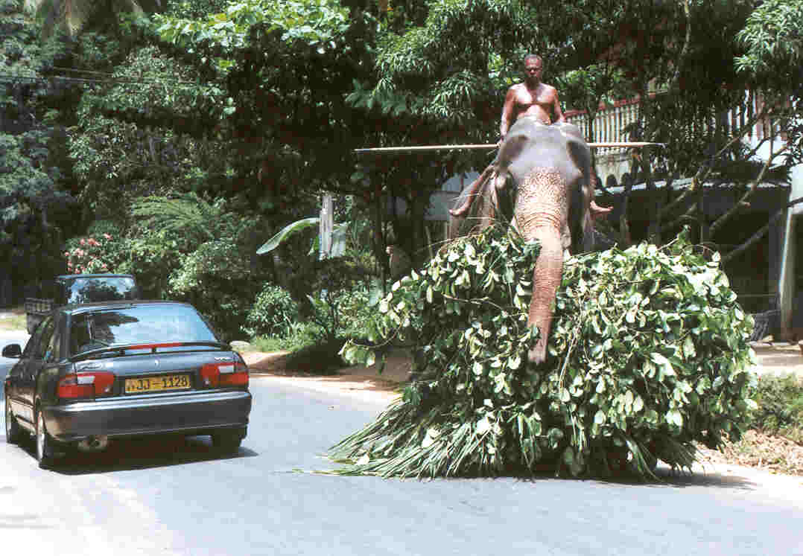
African elephants are wonderful animals. They can help men.

Slide 5
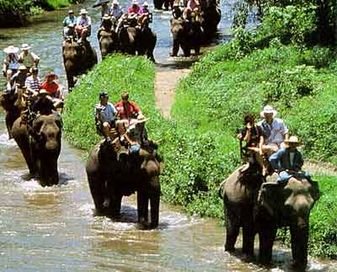
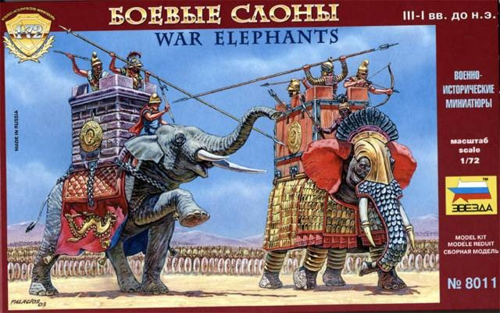
Elephants transported people, took part in wars.

Slide 6
Elephants transported people, took part in wars.

Slide 7
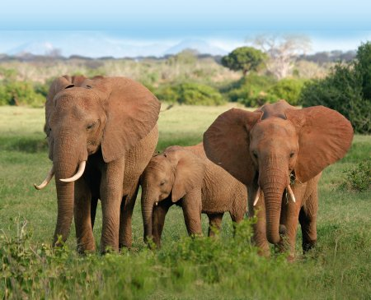
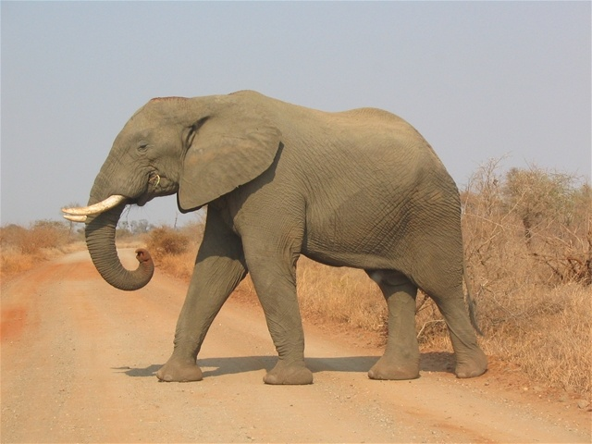
In the last century Africa was full of elephants, but these days there are not many of them in African parks

