Slide 1
Учимся читать
Урок 48-49

Slide 2
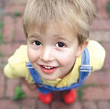
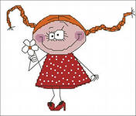
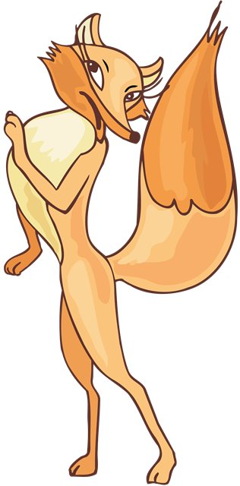
Прочитай
I –я
He -он
She -она
It – оно, это
We -мы
You –ты, вы
They -они

Slide 3
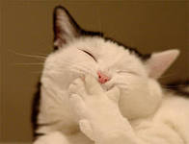
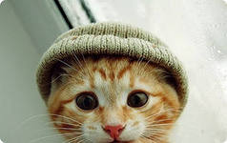
Прочитай и переведи
Jim is big. He is big.
Jill can jump. She can jump.
The cat is fat. It is fat.
The cat and the pig can run. They can run.

Slide 4
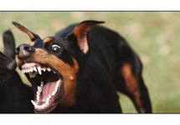
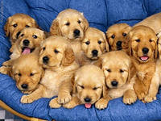
Прочитай и переведи
Pigs can run, but they can’t jump.
Cockerels can sing, but they can’t swim.
Angry dogs can’t skip, they can run and jump.

Slide 5
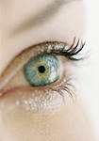
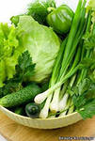
Прочитай
He
She
Me
We
Pet
Ten
Seven
Hen
Grey
Pencil
See
Green
Bee
Tree
street

Slide 6
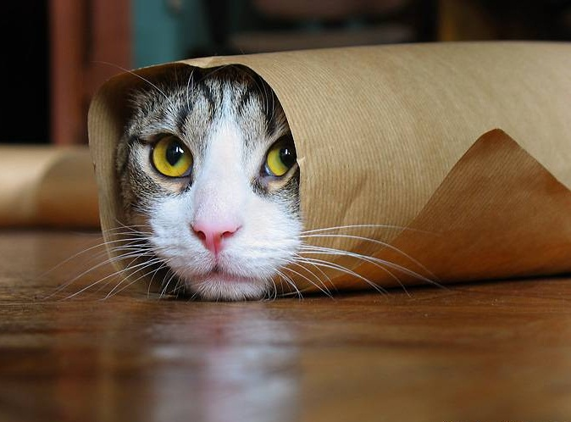
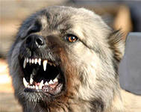
Прочитай и переведи
He can see a funny green frog.
I can see ten funny ducks.
I have got six angry dogs.
She has got a merry cat. It can run and jump.
We have got ten angry cockerels.

