Slide 1
OUR FAMILY

Slide 2
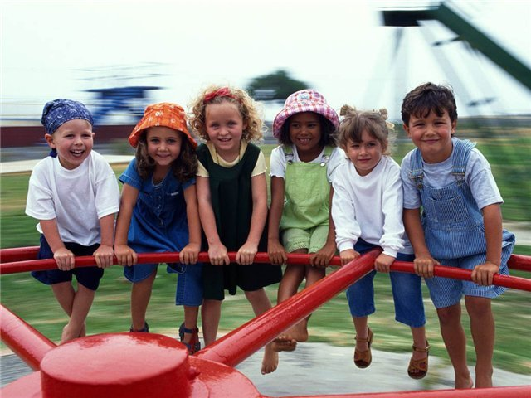
Our family comes from around the world
Our hair is straight, our hair is cirled

Slide 3
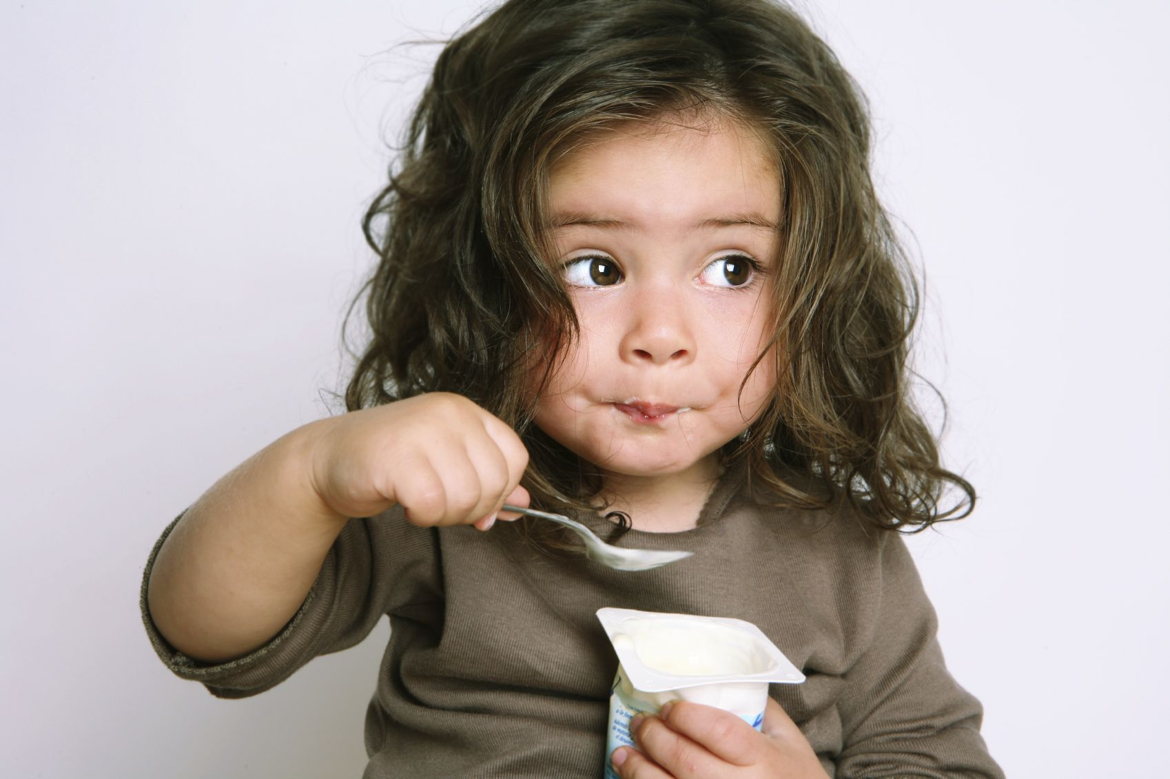
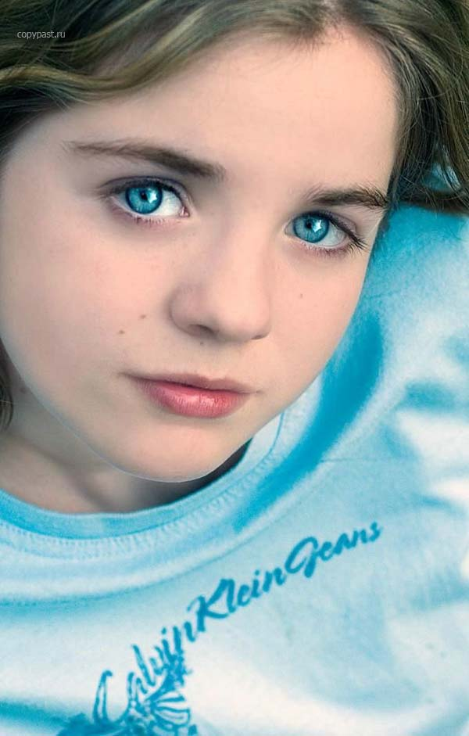
Our eyes are brown, our eyes are blue

Slide 4
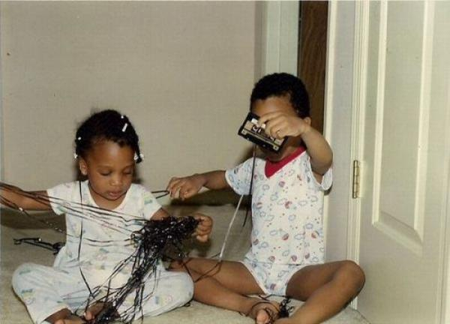
Our skins are different colors too.

Slide 5
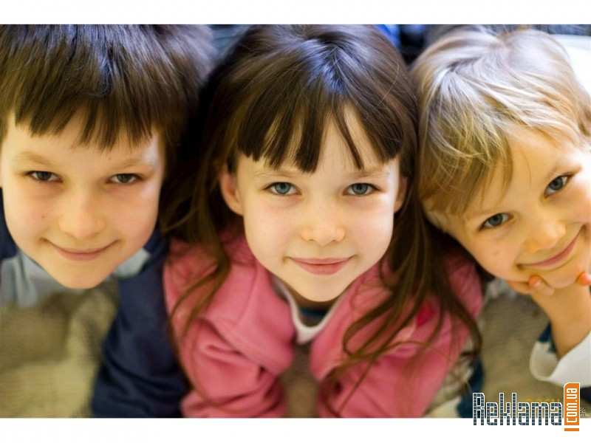
We are girls and boys

Slide 6
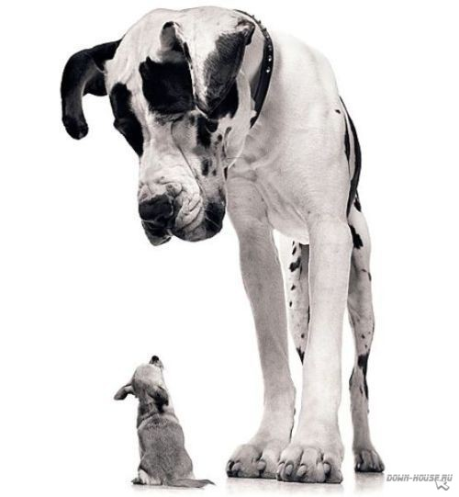
We are big and small

Slide 7
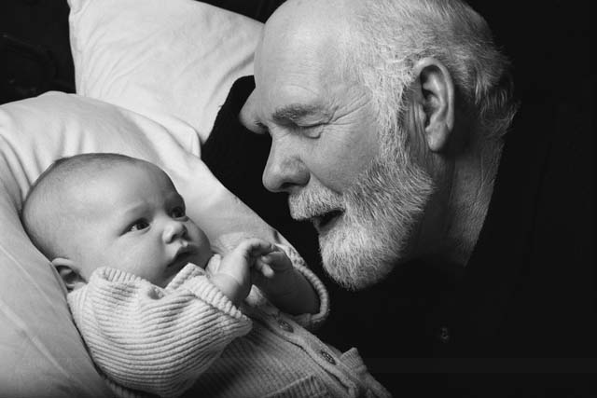
We are young and old

Slide 8
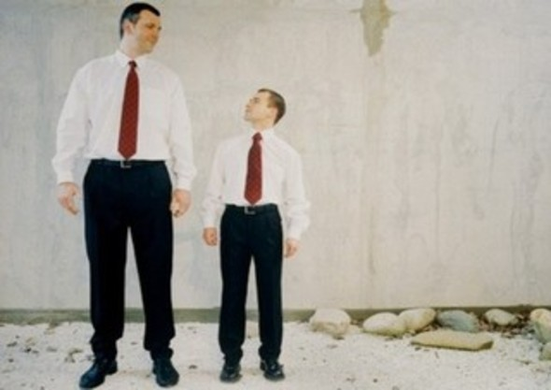
We are short and tall

Slide 9
We are everything
That we can be
And still we are
A family.

Slide 10
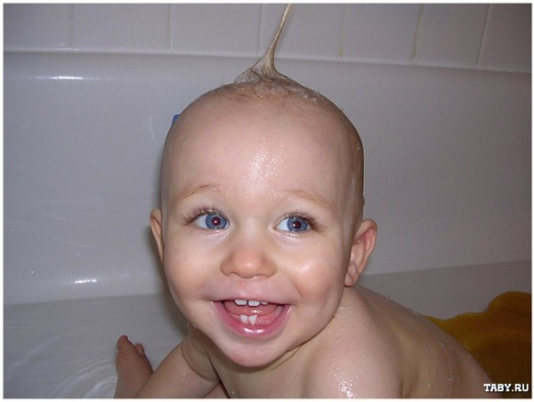
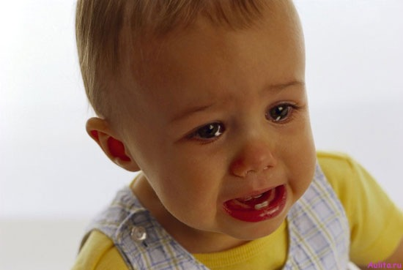
We laugh and cry

Slide 11

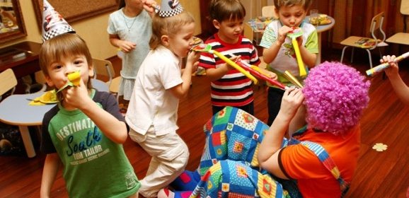
We work and play

Slide 12
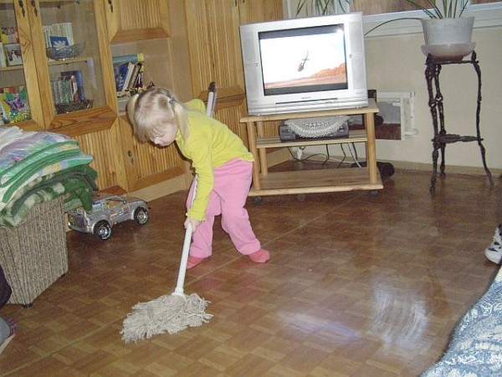
We help each other every day

Slide 13
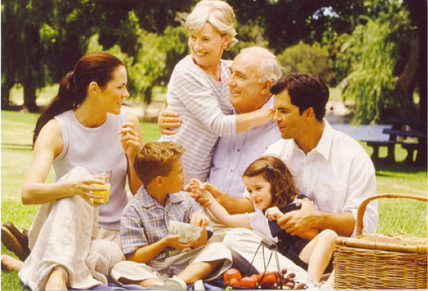
The world is a lovely place to be
Because we are a family!!!

