Slide 1
Учимся читать
Урок 46-47

Slide 2
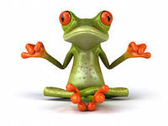
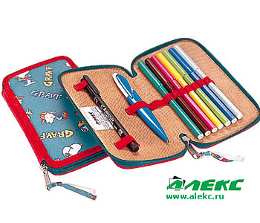
Прочитай
Ten
Pen
Red
Pencil box
Bess
Frog
Clock
Sock
Rock
Fox
Black
Sam
Hat
And
Nick
His pig
Six
Twix
With

Slide 3
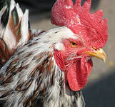
Прочитай
The cockerel is red. It is fat.
The cockerel has got a clock.
The cockerel hasn’t got a stick.
It has not a hat. It can sing.
It can’t skip. It can’t swim.

Slide 4
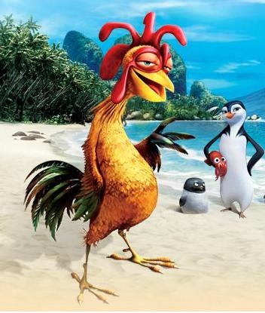
Ответы на вопросы
Is the cockerel fat?
Is the cockerel black?
Can the cockerel sing?
Can the cockerel swim?
Has the cockerel a clock?
Has a cockerel a stick?
Yes, it is.
No, it isn’t.
Yes, it can.
No, it can’t.
Yes, it has.
No, it hasn’t.

Slide 5
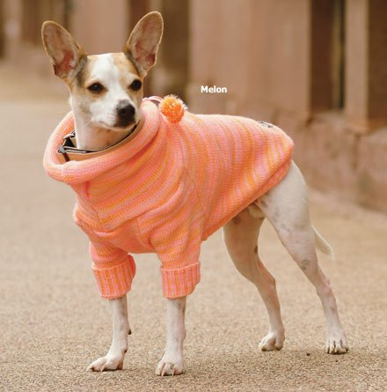
АРТИКЛИ
a dog
the dog
I have got a dog.
The dog is black.

Slide 6
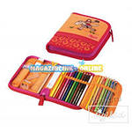
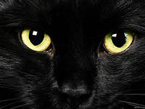
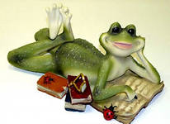
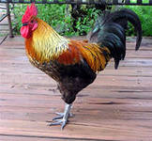
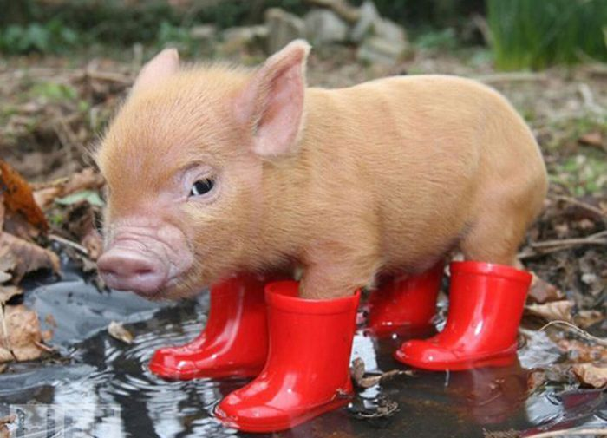
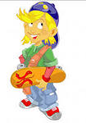
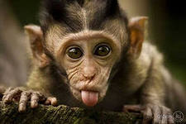
Составь предложения
I have got a…
He has got a…

Slide 7
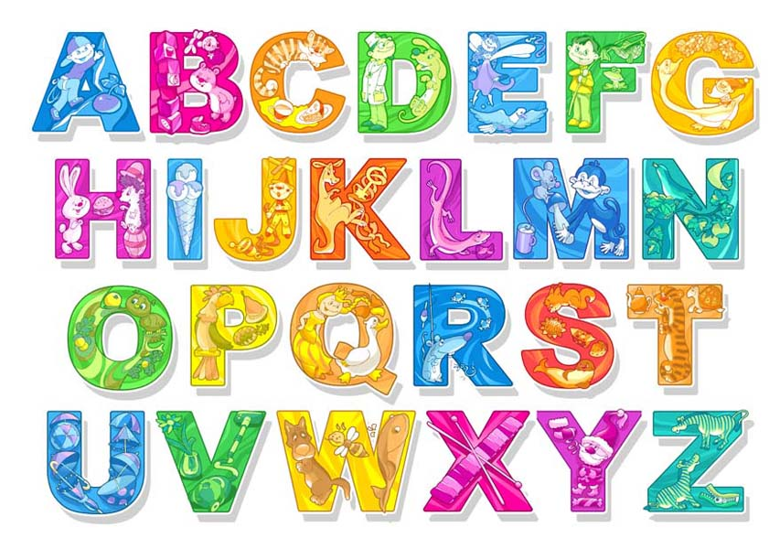

Slide 9
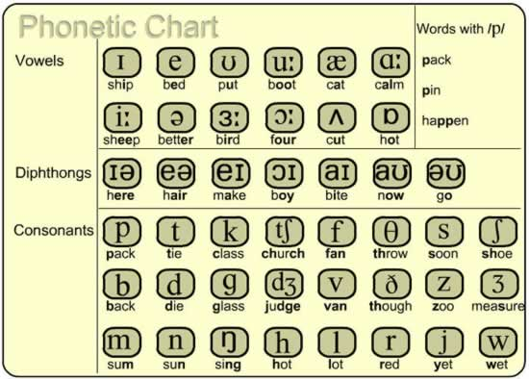

Slide 10
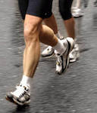
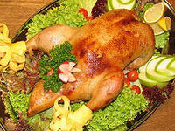
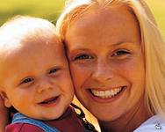
ПРОЧИТАЙ
Run
Duck
But
Up
Jump
Mum
Funny
Merry
Angry
Tricky

Slide 11
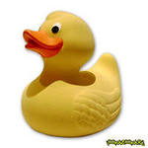
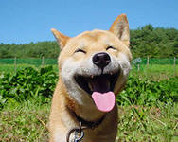
Прочитай
a funny cockerel
angry dogs
a merry cat
a funny pig
angry rabbits
a merry duck

Slide 12
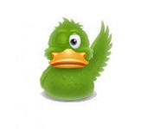
ПРОЧИТАЙ
A funny duck can run.
A merry pig can jump.
Tricky has got a funny duck
and a merry pig.

Slide 13
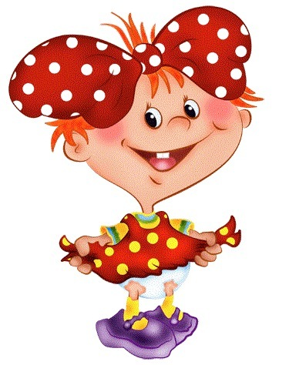
ПРОЧИТАЙ
Jill isn’t angry.
Tom isn’t merry.
Sam isn’t funny.
Tim hasn’t got a funny rabbit.
Tricky hasn’t got a merry cockerel.

