Slide 1
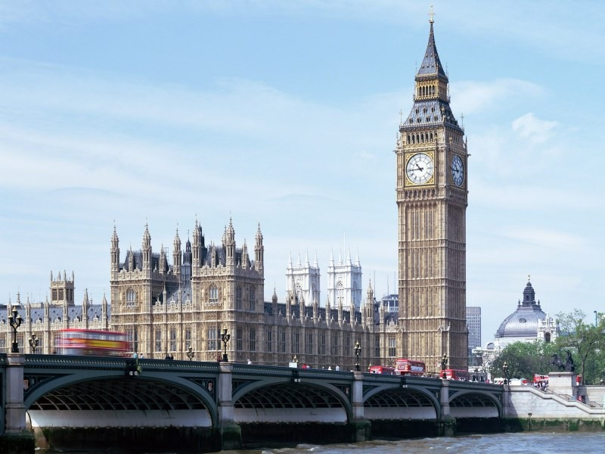

Major holidays in England at different times of the year.

Slide 2
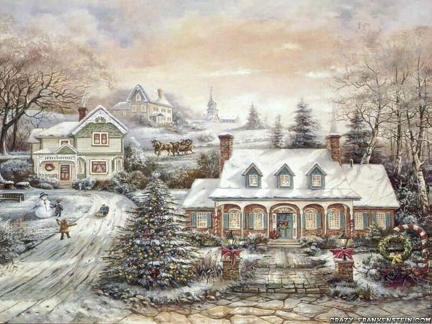

Christmas
On the 25th of December there is the greatest holiday of all in England – Christmas. People send X-mas cards to their friends and relatives. People buy a Christmas tree and decorate it with toys, coloured balls and lights.
Children wake up early to find stockings full of small presents on their bed.

Slide 3
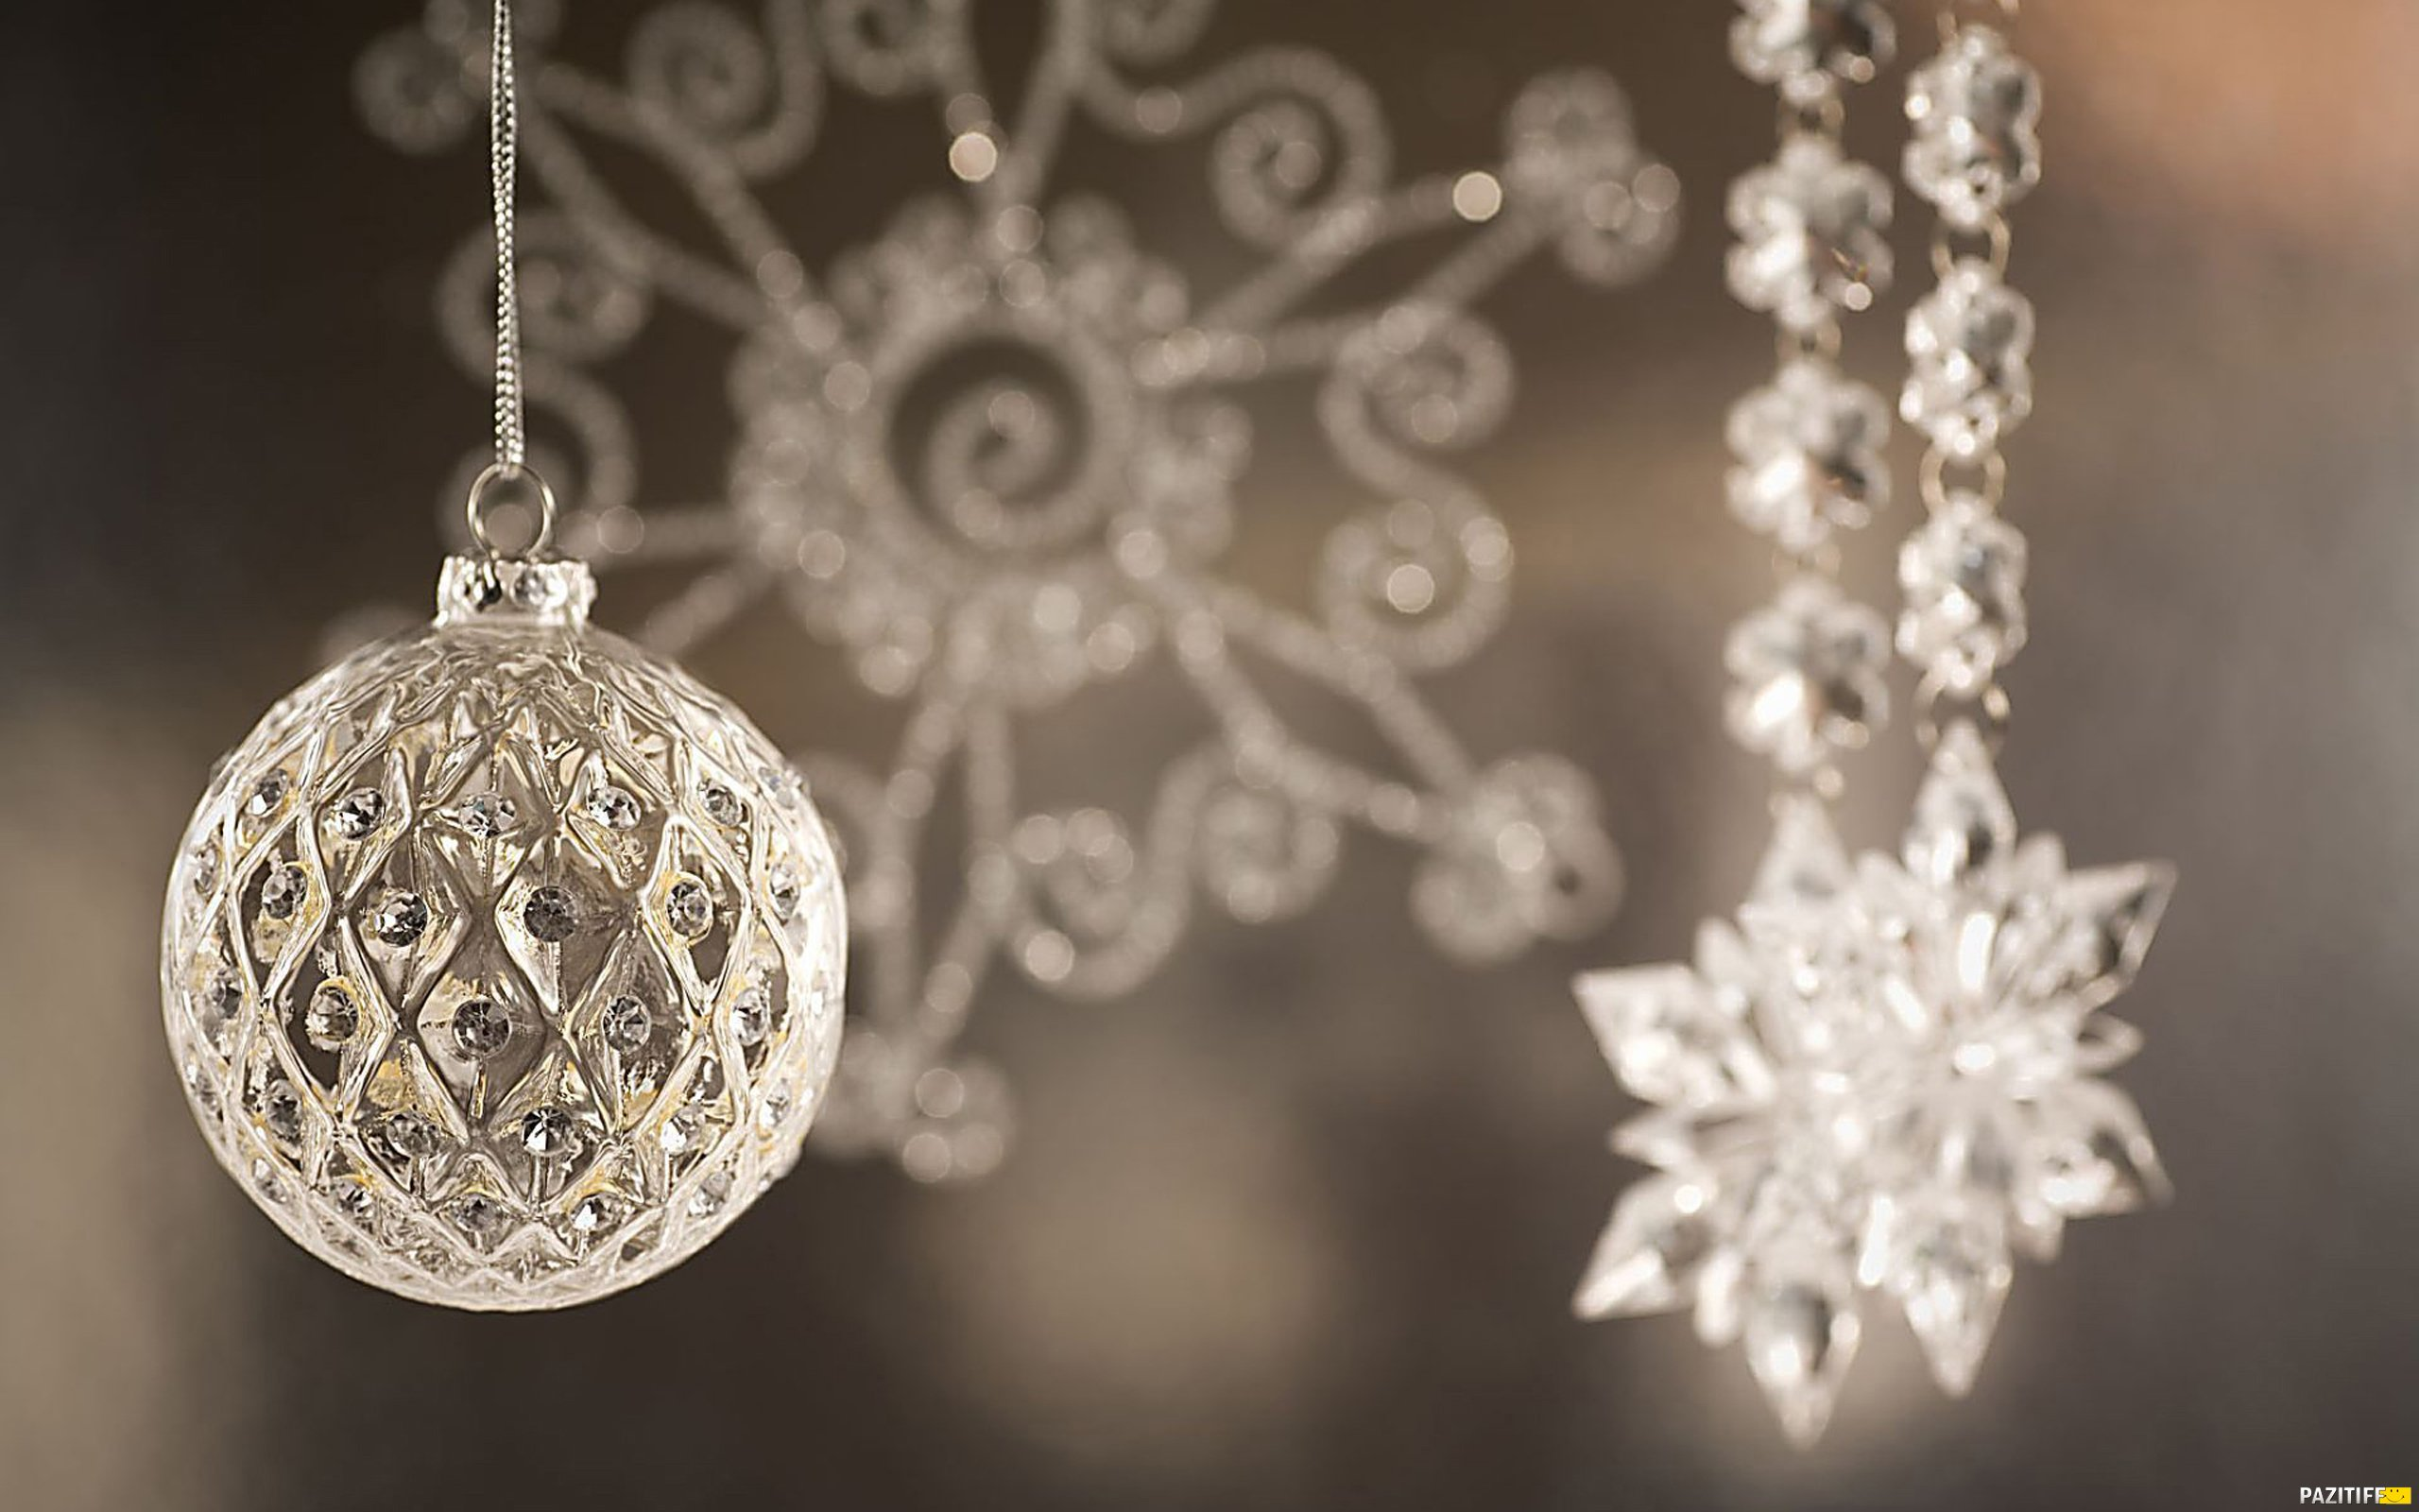
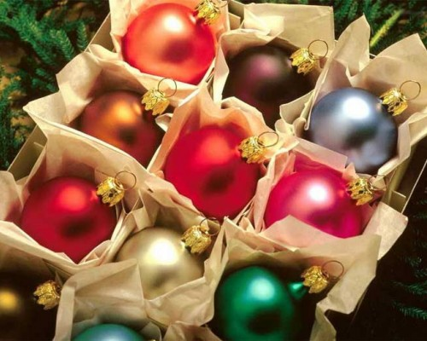
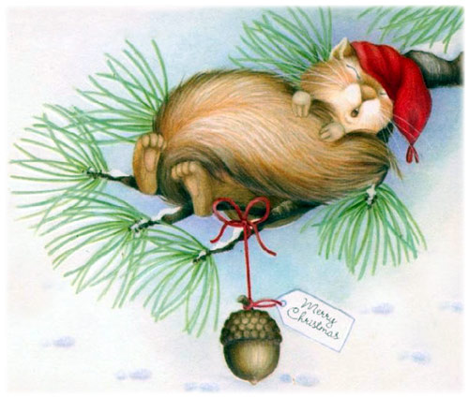
New Year
New Year’s Eve all British celebrate on the 31st of December. Most people see with friends and relatives.
At midnight they sings New Year songs and wishes a happy New Year.

Slide 4

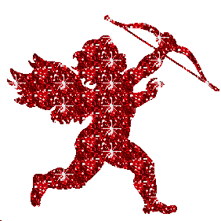
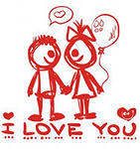
St. Valentine’s day
On the 14th of February there is St. Valentine’s Day. People send Valentine’s cards to someone they love. Usually they don’t sing them – you must guess who sent cards to you.

Slide 5
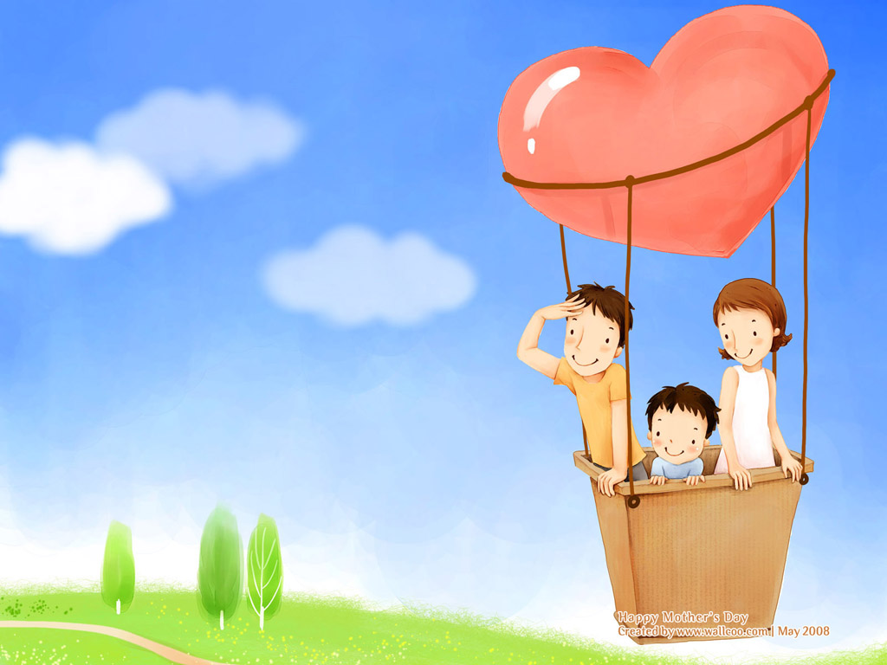
Mother’s day
In March there is a holiday for English women – Mother’s Day.
People in the family try to help her.
On that day they visit their mothers and give them presents and “A Mother’s Day Card”
Mother

Slide 6
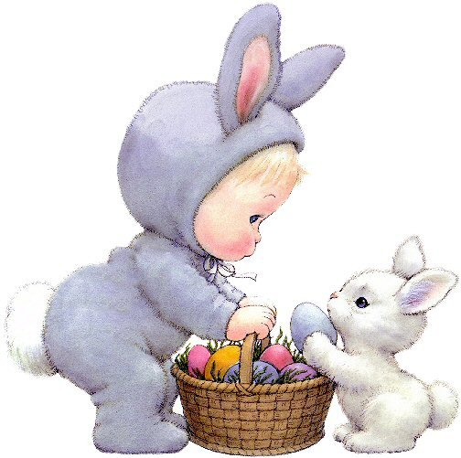

Easter
In April or at the end of March English people celebrate Easter Day.
On Easter Sunday children get chocolate eggs and rabbits.

Slide 7
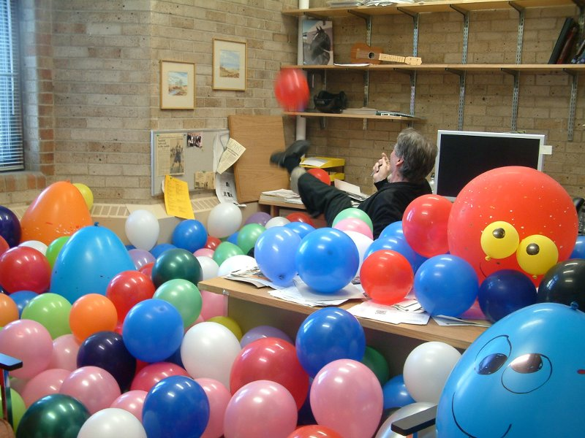
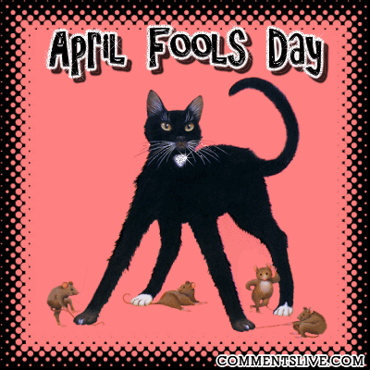
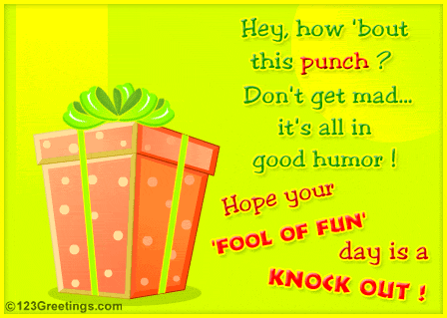
April Fool’s Day
April Fool’s Day is on the 1st of April. English children like this day very much. They play jokes and tricks on other people, even on teachers.

Slide 8

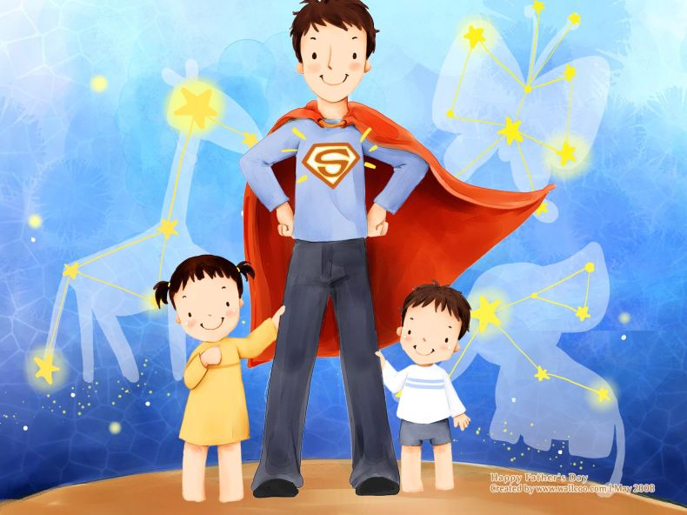
Father’s day
In June the English people celebrate Father’s Day.
On that day children send cards and give presents to their father’s.

Slide 9


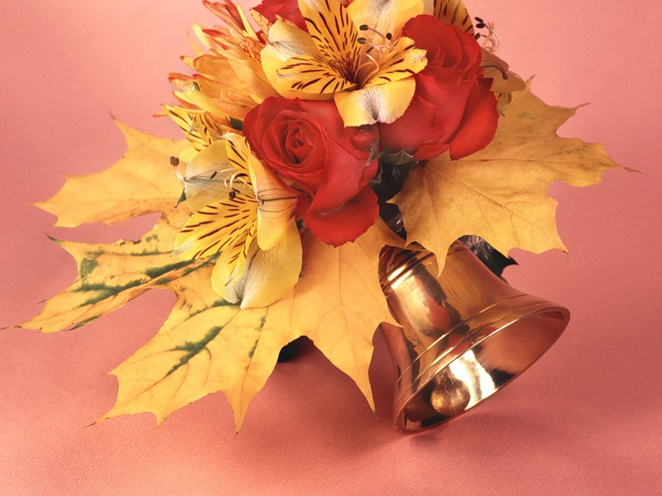
In Gteat Britai children
don’t go to school
on the 1st of September.
They begin to study on the second Tuesday of September.

Slide 10
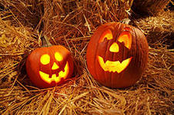
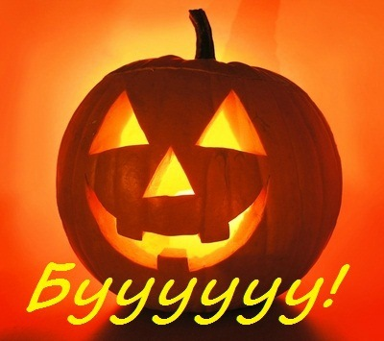
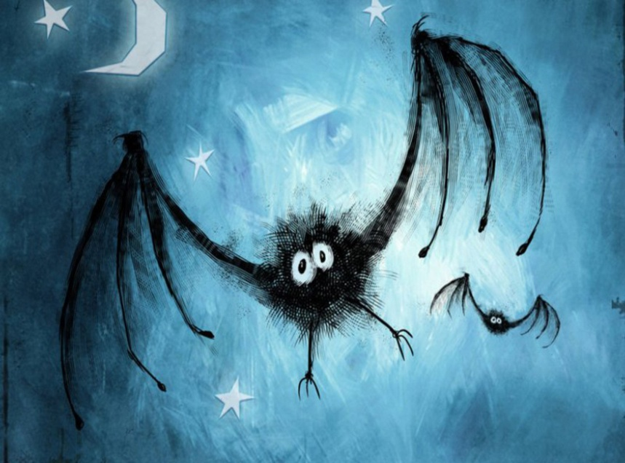
Halloween
On the 31st of October there is Halowe’en. The symbol of this holiday is "Jack o'lantern". People make it from a pumpkin.
Children like Haloween parties, they put on witch’s and ghost’s dresses. They go “trick or treat”.

