Slide 1
ГОУ ДПО СПб Региональный центр оценки качества образования и информационных технологий
Электронные дидактические материалы на тему:
"Развитие креативных способностей у учащихся посредством изучения иностранного языка "
Topic of the lesson: “At School”
Выпускная работа преподавателя английского языка
Петроградского района Пузань Дарьи Михайловны
Преподаватели: Акимов В.Б. ,Павлова Е.В.
2012 год

Slide 2
Educational aims:
To develop the students creativity and associative thinking
To instill in students a love of school and its activities
Aim/s or Objective/s:
To develop lexical skills.
To introduce vocabulary to practice the use of the new vocabulary items in context and in speech with the help of vocabulary focused activities.
To develop skills of monologue speech.
Subsidiary aims:
To improve phonetic skills.
To improve reading skills.
Aids: handouts

Slide 3
Educational aims:
Развивать креативность и ассоциативное мышление
Привить учащимся любовь к школе и занятиям в ней
Aim/s or Objective/s:
Развивать лексические навыки
Отрабатывать лексические единицы в контексте и речи
Развивать навыки монологической речи
Subsidiary aims:
Улучшать фонетические навыки
Улучшать навыки чтения

Slide 4
Give the associations which the word is
DESK
school
pencil
chair
pupil
write
sit at
classroom
school desk

Slide 5
What does your teacher ask you to do at the lesson?
Listen to CD carefully
Stop talking
Open your books
Work in pairs
Rise your hands
Look at the blackboard
Answer my questions

Slide 6
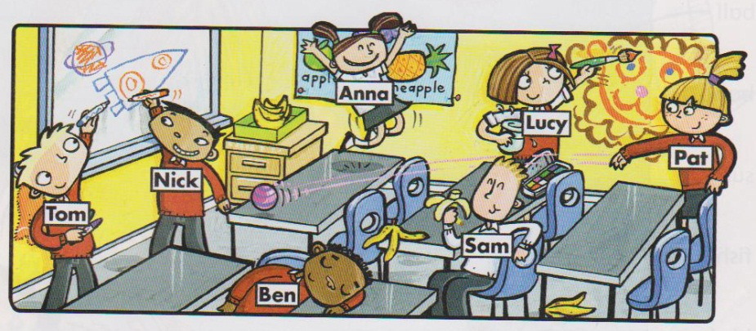
Choose the verbs which describe the picture
Listen to the teacher
Read
Ride a bike
Have lunch
Sit at the desk
Be quite
Look at the blackboard
Laugh
Jump
Paint on the wall

Slide 7
Remove unnecessary sentences and try to
put other ones in the correct order
Pupils are writing on the blackboard
Children are listening to the teacher
Children are jumping
Pupils are having lunch
Children are sitting at the desks
Pupils are reading newspapers and magazines
Children are eating
Children are quiet and attentive
Pupils are laughing
Pupils are ready to work

Slide 8
Remove unnecessary sentences and try to
put other ones in the correct order
Children are listening to the teacher
Children are sitting at the desks
Children are quiet and attentive
Pupils are ready to work

Slide 9
Color Scheme
R
ed
B
lue
G
reen

Slide 10
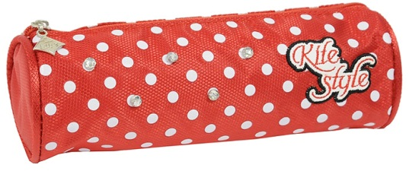
red
pencil
bow
pencil case
The Sun
The girl with red bows takes a red pencil from
the red pencil case and draws the red Sun

Slide 11
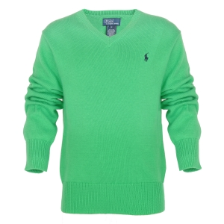
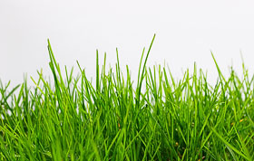
green
grass
bench
sweater
ball
The boy in the green sweater is playing with
the ball on the grass near the green bench

Slide 12
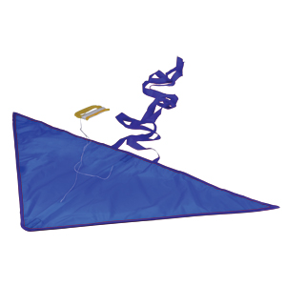
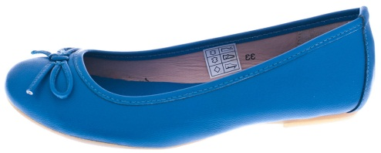
blue
kite
The Sky
shoes
The girl in the blue shoes is flying
a blue kite in the blue sky

Slide 13
Look at the figures. What are they?
What can we make up from them?
circle

