Slide 1
Graphical User Interface
Saint-Petersburg IT College
Saint-Petersburg 2014

Slide 2
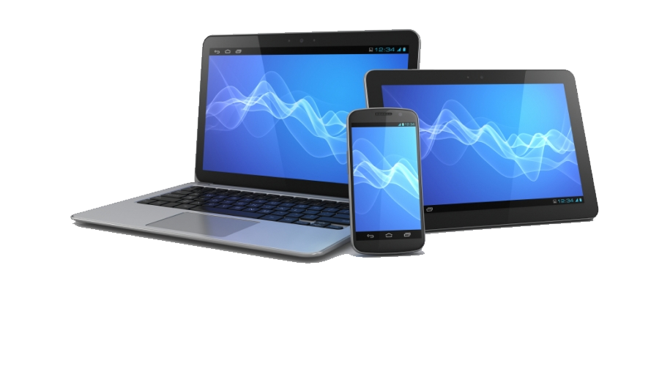
What is a GUI ?
A GUI (Graphical User Interface) allows users to interact with electronic devices like computers, hand- held devices (e.g. MP3’s, Portable media players etc), household devices and office equipment.

Slide 3
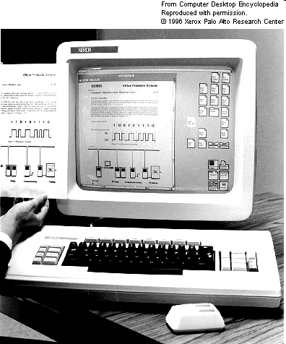
History
The first graphical user interface was designed by Xerox Corporation in 1970s. But became popular after the Apple Macintosh’s emergence in 1980’s. Before GUI was developed the operating system was strictly text based.
The 1st commercial GUI

Slide 4
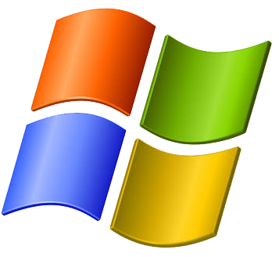
GUI and operating systems
Currently GUI is a standard part of most operating systems and applications. Examples of systems using the GUI: Mac OS, GEM, Microsoft Windows, Linux, Android.

Slide 5
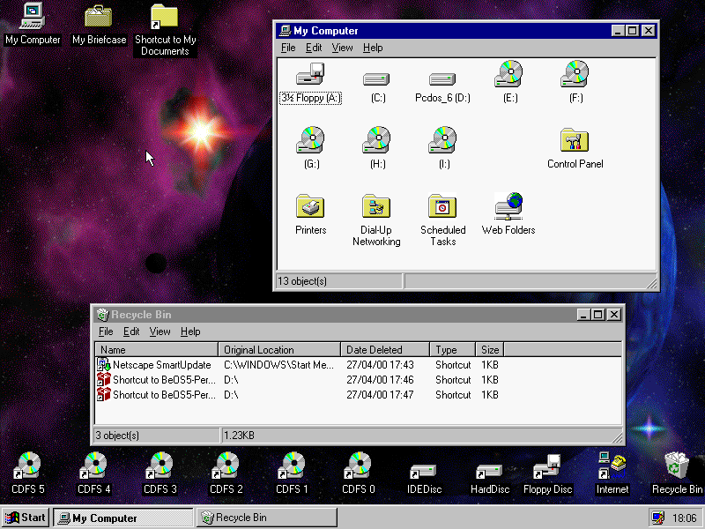
GUI elements
Pointer
Icons
Window
Folders
Menus
Desktop
Taskbar

Slide 6
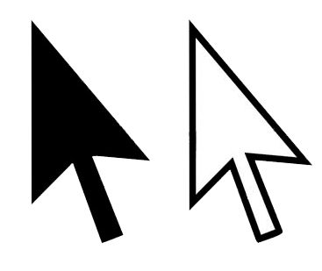
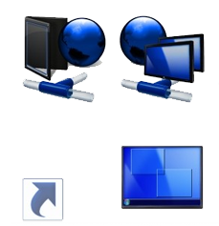
Pointer and Icons
Pointer - a symbol that appears on the screen and used to select objects and commands. It is a small arrow.
Icons - small pictures that represent commands, files, or windows. By a simple click on it we can execute a command/program or convert the icon into a window.

Slide 7
Window and Folders
Window – is one of the main elements of the interface. Window – is a framed part of the screen that displays the application, document, or message.
Folders - containers for documents and applications.

Slide 8
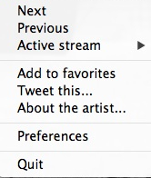
Menus and Desktop
Menus - most graphical user interfaces let you execute commands by selecting a choice/option from a menu.
Desktop - the area on the display screen where icons are grouped.

Slide 9
Taskbar
Taskbar - looks like the band, which by default is located along the bottom of the screen. It contains:
Digital clock
Notification area
Program buttons
The "Start " button

Slide 10
Thank you for your time! Hope you have enjoyed my presentation and were able to learn something new. Have a nice day!

