Slide 1
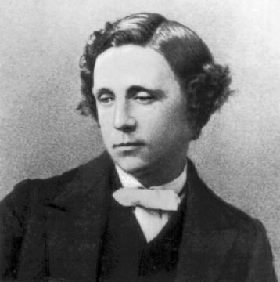
Lewis Carroll (27.01.1832 – 14.01.1898)

Slide 2
Answer the questions, say:
When Lewis Carroll was born
What his real name was
Which of the 3 lives was most successful
Who asked him to write down the story
From what words his pen-name came
What in the text shows popularity
What shows that the book is still widely read
How Lewis entertained children
When he died and why

Slide 3
Answer the questions, say:
When Lewis Carroll was born-in 1832
What his real name was –Charles Lutwidge Dodgson
Which of the 3 lives was most successful-writing
Who asked him to write down the story-Alice
From what words his pen-name came-first two names
What in the text shows popularity- thousands of copies
What shows that the book is still widely read-every child reads his book
How Lewis entertained children-stories,games, puzzles
When he died and why- in 1898,bronchitis

Slide 4
Describe the book:
I think
In my opinion + the book is…
To my mind

Slide 5
Make up the story:
It tells about the boy named Harry Potter who becomes a wizard, and his adventures in the magic world.
I’d like to tell you about my favourite book.
It was published in 1997.
The book was written by Joanne Rowling.
I think the book is very exciting and fantastic.
Harry Potter and the Philosopher’s Stone is a novel.

Slide 6
I’d like to tell you about my favourite book.
Harry Potter and the Philosopher’s Stone is a novel.
It was published in 1997
The book was written by Joanne Rowling.
It tells about the boy named Harry Potter who becomes a wizard, and his adventures in the magic world.
I think the book is very exciting and fantastic.

Slide 7
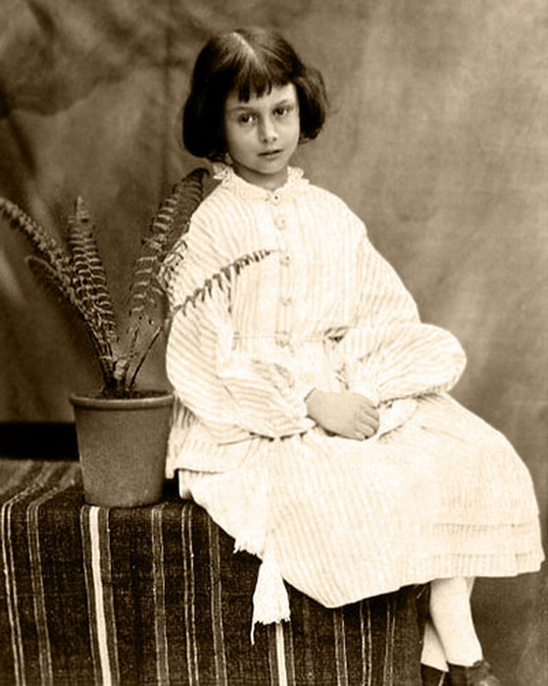
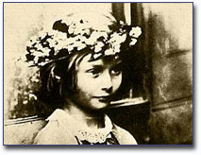
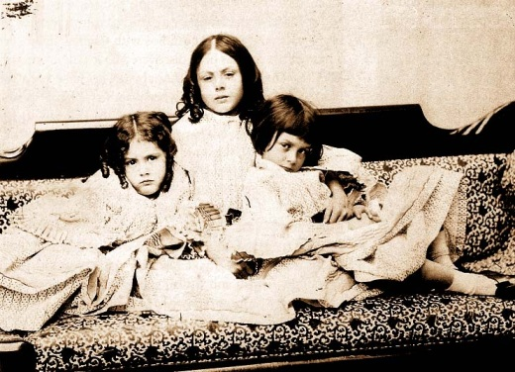
Alice’s Adventures in Wonderland

Slide 8
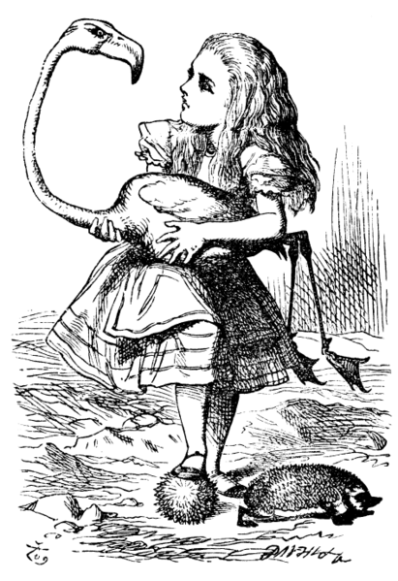
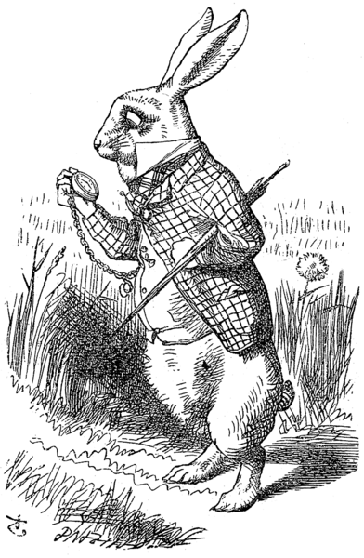
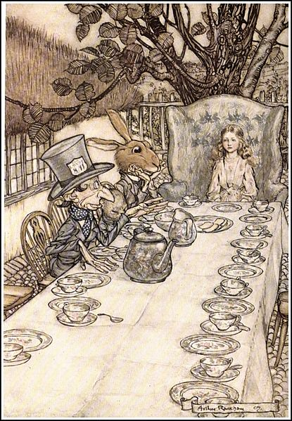
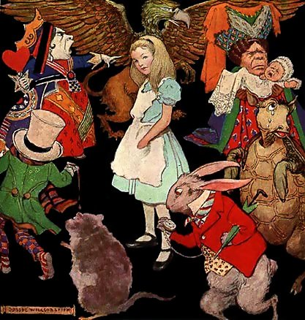
Creatures in the book

Slide 9
Interesting facts about the book:
There are about 6 million copies of the book around the world;
2. It is translated into 11 languages;
3. About 60 films are based on the book

