Slide 1
Advantage and Disadvantage Influences of the Internet on a Human Life
Saint-Petersburg IT College
Saint-Petersburg 2014

Slide 2
we can find any information
Notes:
The Internet is a treasure trove of information; which offers knowledge on any given topic under the sun. Search engines make information accessible on various subject matters such as, government law and services, trade fairs and conferences, market information, new innovations and technical support, and even dispense advice on love and relationships matters.

Slide 3
we can communicate with your friends and make new acquaintances
Notes:
One cannot imagine a social life without Facebook or Twitter. These portals have become our means to stay connected with friends and family, and stay in touch with the latest happenings in the world. Social networking has also evolved as a great medium to connect with like-minded individuals and become a part of interesting groups and communities.

Slide 4
we can easily buy the required product or service
Notes:
Thanks to numerous monetary services, we can perform all our financial transactions online. We can book tickets for a movie, transfer funds, pay utility bills and taxes without having to leave our homes or offices. Travel websites for instance, offer quick booking schemes and plan itineraries as per the preferences of their clients.

Slide 5
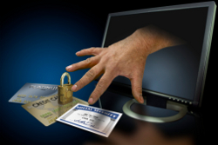
Theft of Personal Information
Notes:
The use of Internet for banking, social networking, or other services, often makes our personal information vulnerable to theft. There are no fail-proof ways to securing names, account numbers, addresses, photos, and credit card numbers from being stolen or misused by thieving websites and individuals.

Slide 6
Spamming
Notes:
Spamming refers to sending unwanted e-mails, which serve no purpose and needlessly obstruct the computer system. Such illegal activities can be very frustrating as it makes it slower to access our email accounts and makes the entire service unreliable for consumers.

Slide 7
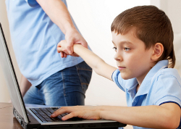
Social Isolation, Obesity, and Depression
Notes:
The biggest problem with having the Internet is, its ability to create rifts between the real and virtual world. The virtual world can often seem so alluring that once hooked, going back to real life seems daunting. Read more at Buzzle: http://www.buzzle.com/articles/advantages-disadvantages-internet.html

