Slide 1
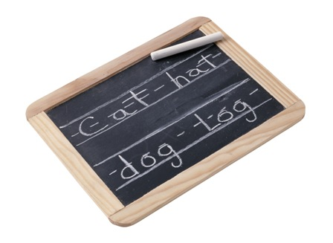
E
n
g
l
i
s
h
Лексика по теме “My house”
(интерактивный плакат)
Автор: Залипаева Ирина Юрьевна,
учитель английского языка
МОУ гимназии №10 г.Волгограда
http://aida.ucoz.ru

Slide 2
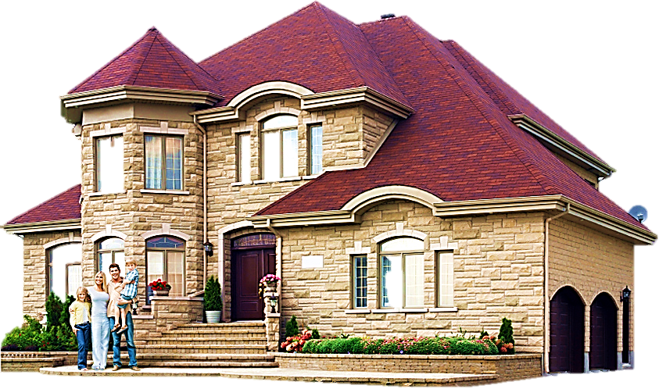
My house
My family

Slide 3
This is my family.
My family is not big.
I’ve got a mother,
a father and a sister.
We live in a big house.
Our house is nice.
There are three bedrooms,
a living room, a bathroom
and a kitchen in it.

Slide 4
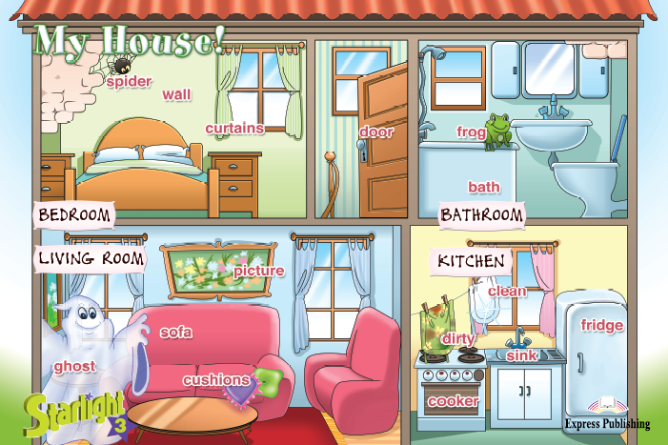
spider
wall
curtains
door
frog
bath
picture
clean
sofa
fridge
dirty
ghost
sink
cushions
cooker

Slide 5
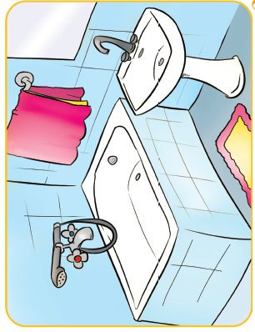
There is a bathroom in our house. There is a sink and a bath here. There is a carpet on the floor. I can have a bath in the bathroom.
bathroom

Slide 6
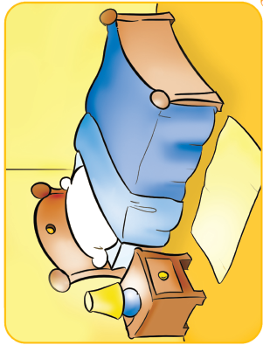
This is my bedroom. There is a bed, a desk, a chair and a lamp here. There is a carpet on the floor. I can sleep and play games here.
bedroom

Slide 7
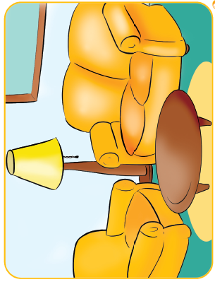
This is our living room. There is a sofa, two armchairs, a table and a picture here. There is a carpet on the floor. We can read books and talk here.
living room

Slide 8
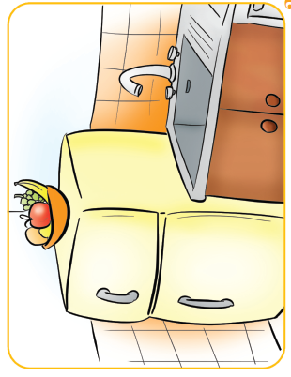
This is our kitchen. There is a fridge, a sink and a cooker here. We have got a big table in the kitchen. We can eat here.
kitchen

Slide 9
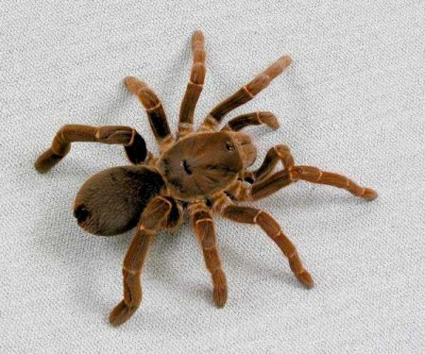
spider

Slide 10
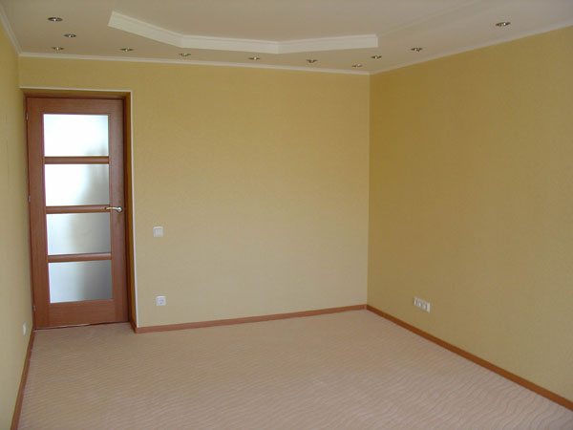
wall

Slide 11
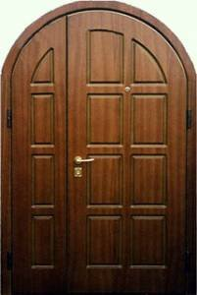
door

Slide 12
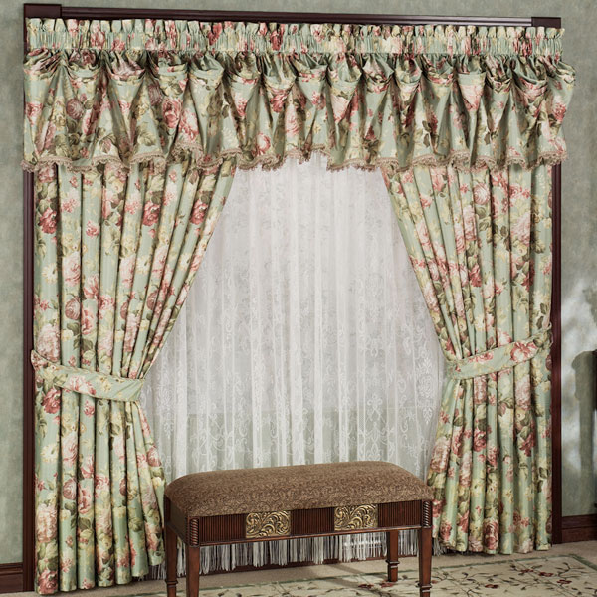
curtains

Slide 13
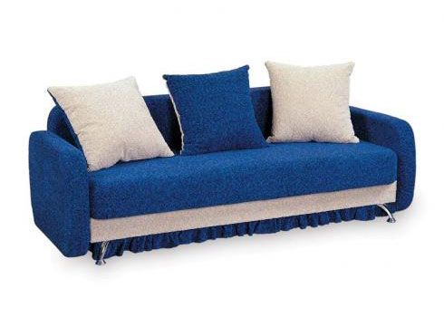
sofa

Slide 14
cushions

Slide 15
picture

Slide 16
ghost

Slide 17
cooker

Slide 18
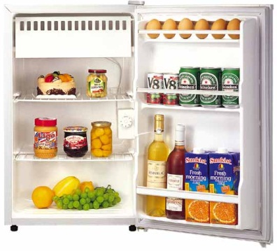
fridge

Slide 19
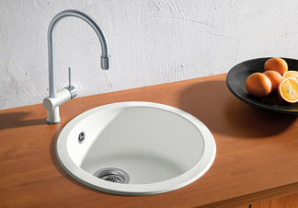
sink

Slide 20
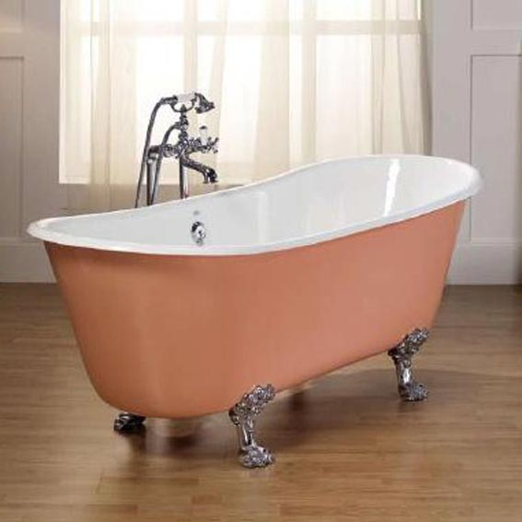
bath

Slide 21
clean

Slide 22
dirty

Slide 23
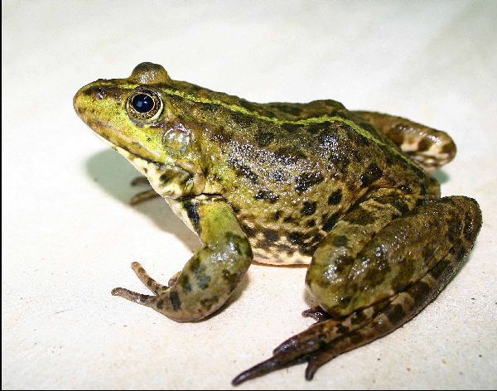
frog

