Slide 1
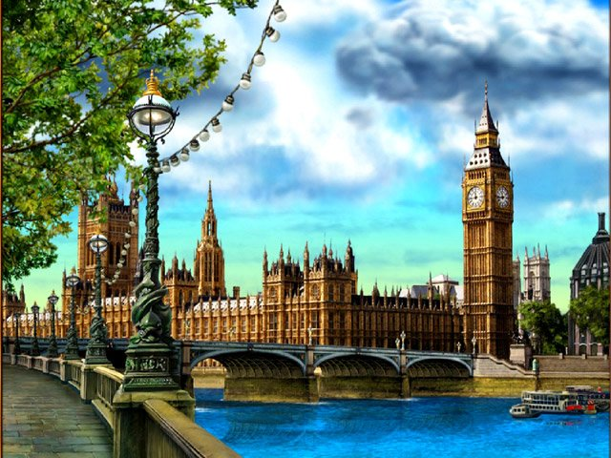
Welcome
to London!!!

Slide 2
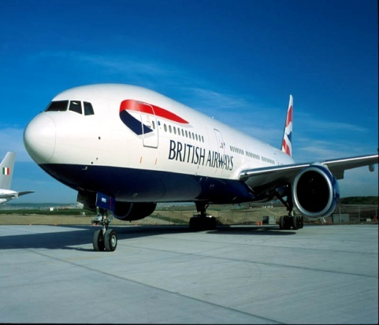
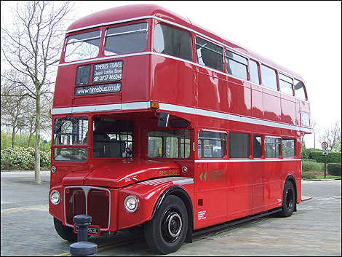
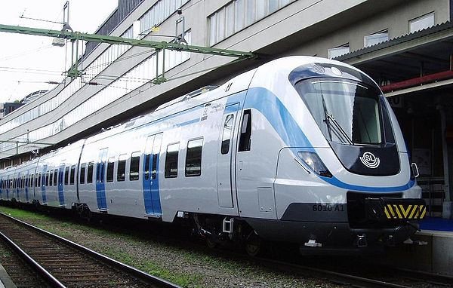
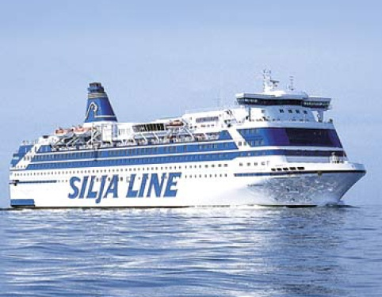
How are we going
to get to England?
Bus
Ferry Plane Train

Slide 3
We are going to get to London by plane.

Slide 4
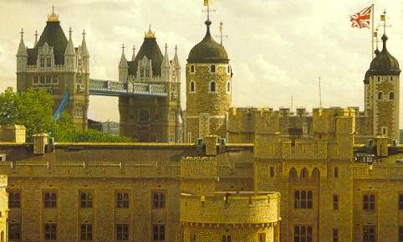
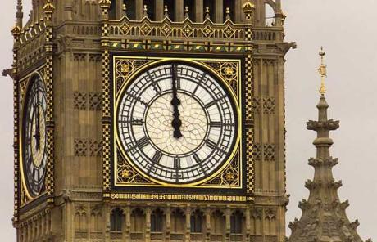
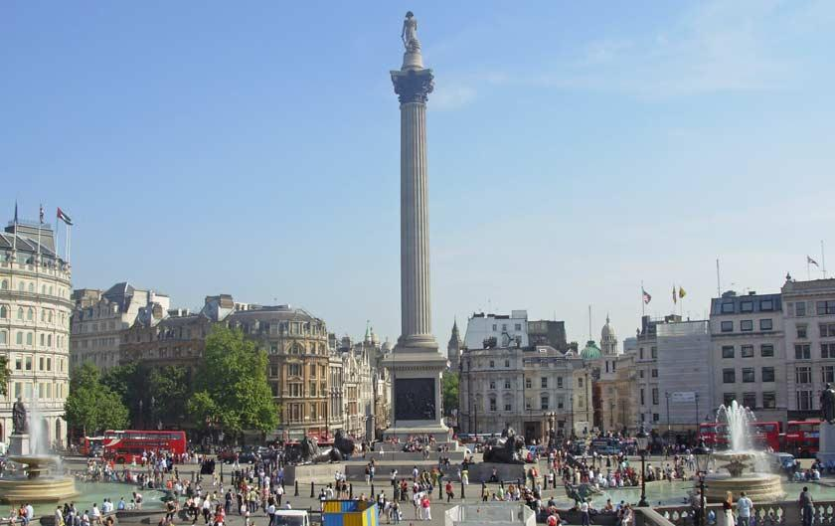
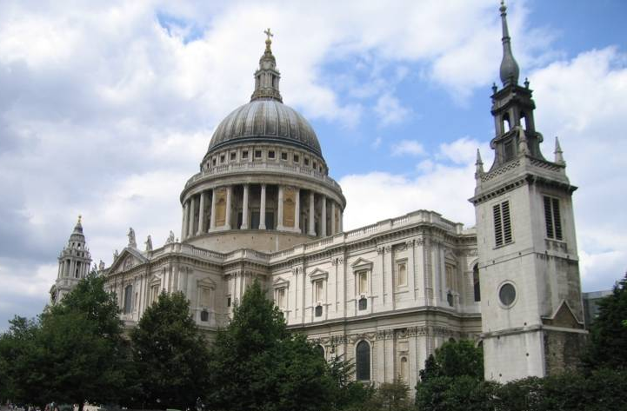
London
In London
sights
many sights
there are many sights
Tower
Square
Cathedral
Big Ben
St. Paul’s Cathedral
Trafalgar Square

Slide 5
In London there are many sights:
St. Paul’s Cathedral,
Trafalgar Square,
the Tower,
Big Ben,
We want to see them.

Slide 7
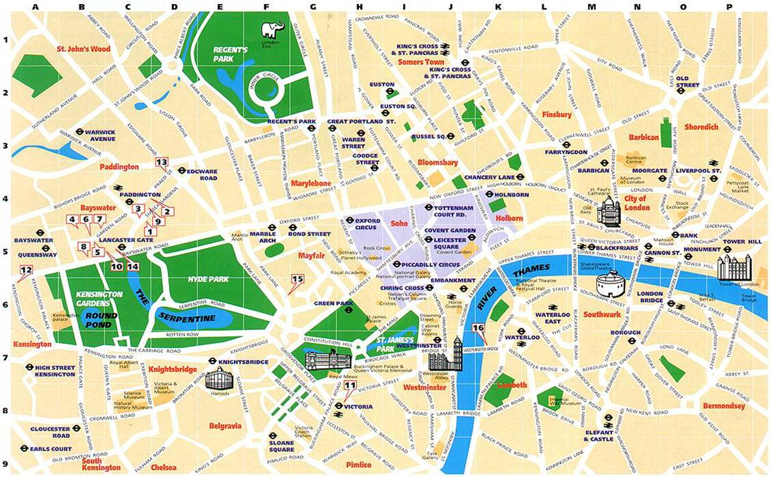
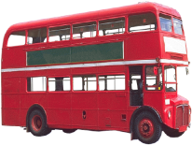

Slide 8
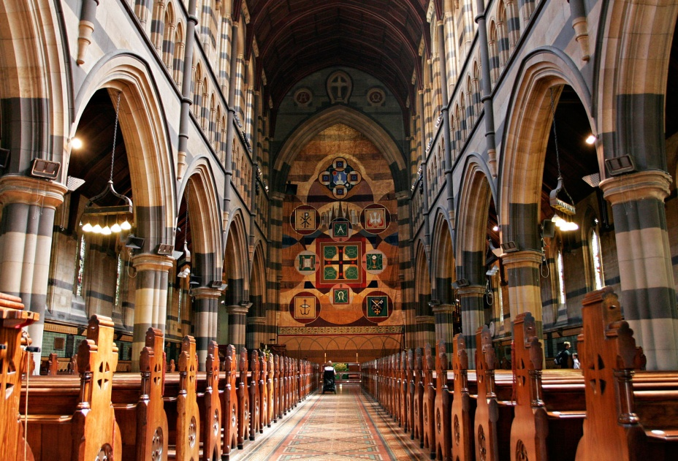
1. Собор Святого Павла расположен в Сити.
2. Он был построен знаменитым английским архитектором Кристофером Реном.
3. Коронации и свадьбы проходят в соборе.

Slide 10
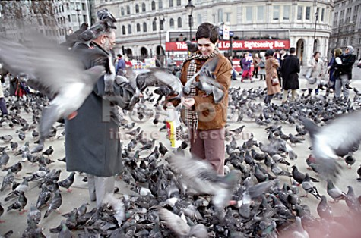
Trafalgar Square is situated in the----------------..
In the centre of it stands-------------------.
Trafalgar Square is a place for all kinds of------------------, marches and political meetings.
And every day it is full of ---------------feeding the pigeons.

Slide 12
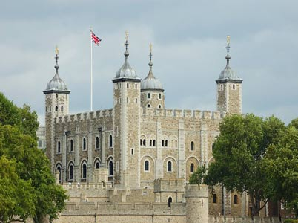
The Tower of London
Where is situated | In the City | In Westminster | In the West End
Was used as | Supermarket | A state prison | office
What to see | Ceremony of Oscar | Ceremony of Keys | nothing

Slide 15
Finish my sentences.
…by a famous English architect, Sir Christopher Wren.
1.St. Paul’s Cathedral is situated…
2.It was built…
…in the city.
3.The Tower of London is situated…
…in the City.
4.At first it was built as a fortress to protect London, and it was built by…
…William the Conqueror.

Slide 16
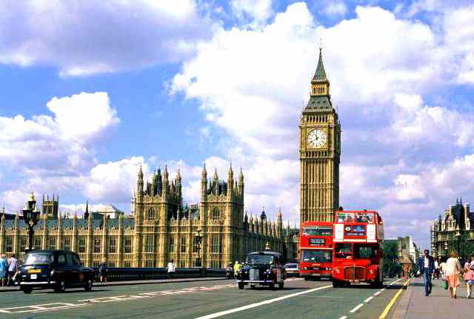
Dear -----------------!
I’m in --------------- now.
Yesterday I visited --------------------.
Also I’d like to visit -------------------.
London is wonderful!
I’m OK.
Bye

