Slide 1
Ecology problems…

Slide 2
Since ancient times Nature has served man, being the source of his life. For thousands of years people lived in harmony with environment and it seemed to them that natural riches were unlimited. But with the development of civilization man’s interference in nature began to increase.

Slide 3
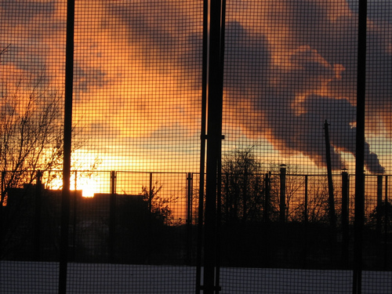
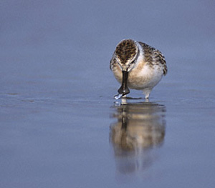
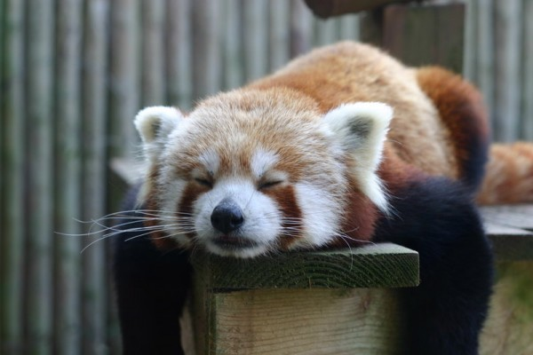
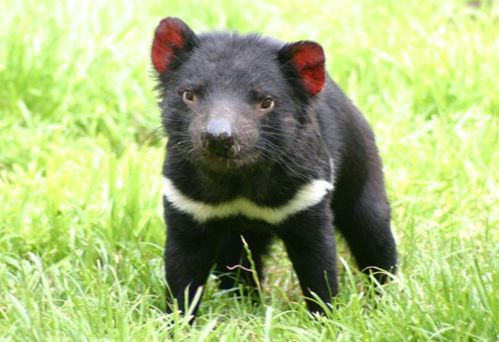
Every year world industry pollutes the atmosphere with about 1000 million tons of dust and other things. As a result some rare species of animals, birds, fish and plants disappear forever. Many cities suffer from smog.

Slide 4
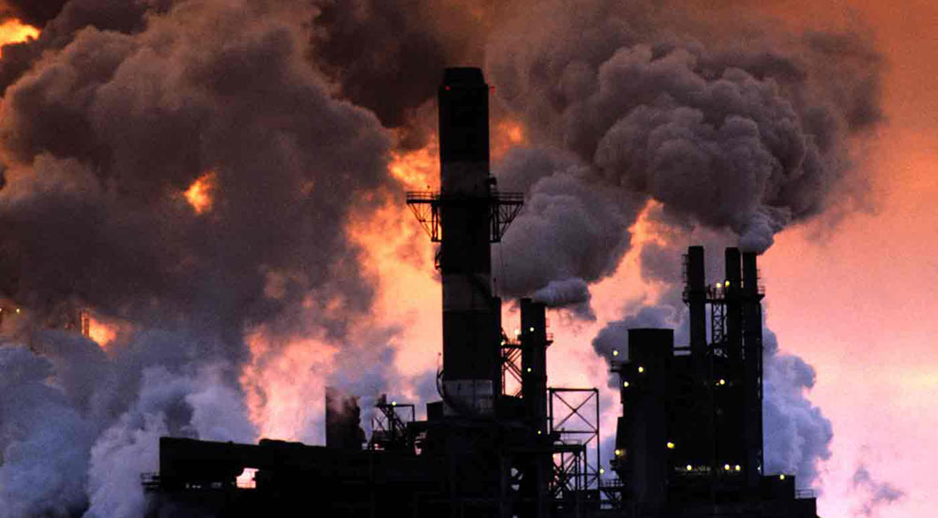
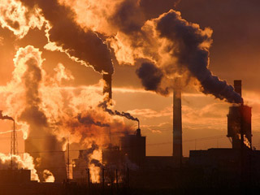
Large cities with thousands of smoky industrial enterprises appear all over the world today. The by-products of their activity pollute the air we breathe, the water we drink, the land we grow vegetables.

Slide 5
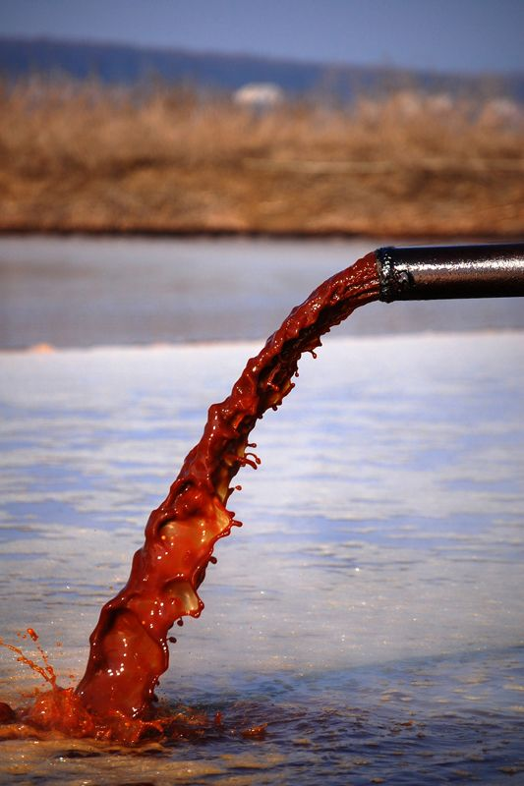
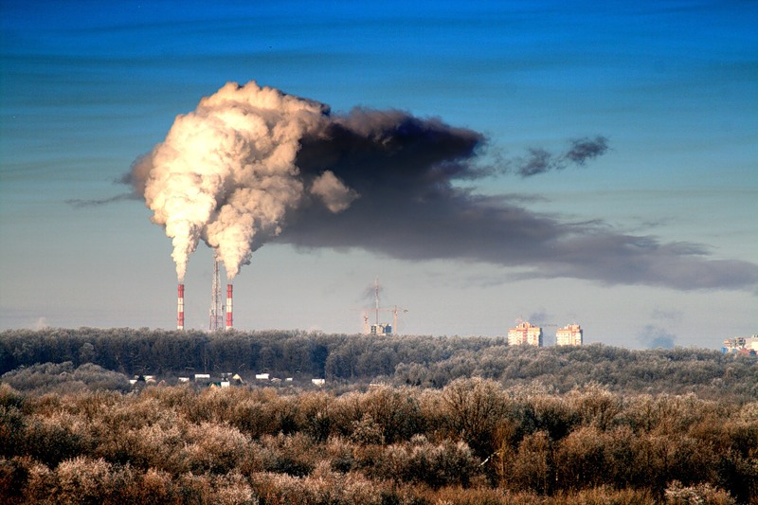
The pollution of air and the world’s ocean, destruction of the ozone layer is the result of man’s careless interaction with nature. Environmental protection is of a universal concern. That is why serious measures to create a system of ecological security should be taken.

Slide 6
Some progress has been already made in this direction. As many as 159 countries - members of the UNO - have set up environmental protection agencies. Numerous conferences have been held by these agencies to discuss problems facing ecologically poor regions including the Aral Sea, the South Urals, Kuzbass, Donbass, Semipalatinsk and Chernobyl. An international environmental research centre has been set up on Lake Baikal. The international organization Greenpeace is also doing much to preserve the environment
Tsay Ekaterina «8A»

