Slide 1
Презентация к учебнику М.А. Гацкевич
St. Isaac’s Cathedral
Учитель английского языка
ГОУ СОШ № 180 г.Санкт-Петербург
Белоброва Е.Д.

Slide 2
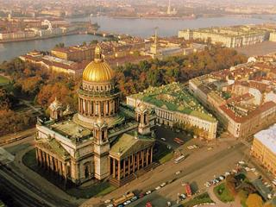
Saint Isaac's Cathedral
It is dedicated to Saint Isaac, a patron saint of Peter the Great.

Slide 3
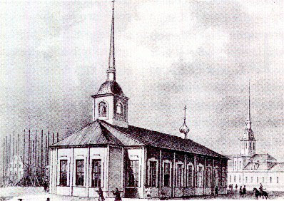
The first wooden church dedicated to Saint Isaac was built in 1710.
Peter I and Catherine I got married in this church.

Slide 4
The second church Dedicated to St Isaac was built in 1727
on the place where The Bronze Horseman stands now.
This church was destroyed by fire

Slide 5
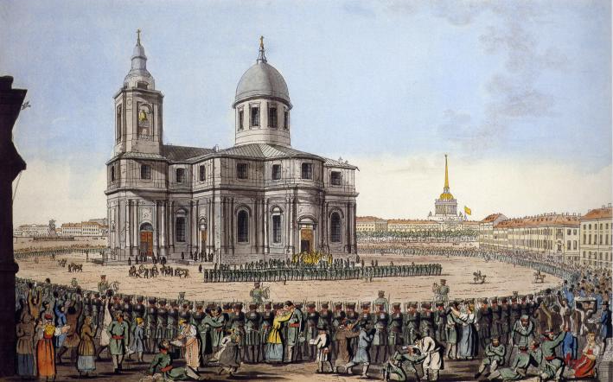
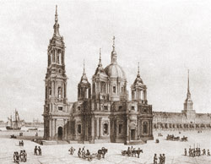
The project of the third
St Isaac’s Cathedral
made by the achitect
A.Rinaldi.
Paul I ordered the achitect V.Brenna
to complete the construction.
The project was changed.
The cathedral didn’t look magnificent.

Slide 6
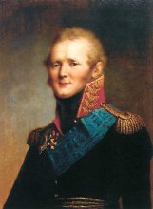
The church on St Isaac's Square was ordered by Tsar Alexander I
On the throne: 1801-1825
(son of Paul I)
Montferrand's design was criticised
by some members of the commission
for the dry and boring rhythm of its four identical porticos.
The tsar solved the dispute in Montferrand's favor.

Slide 7
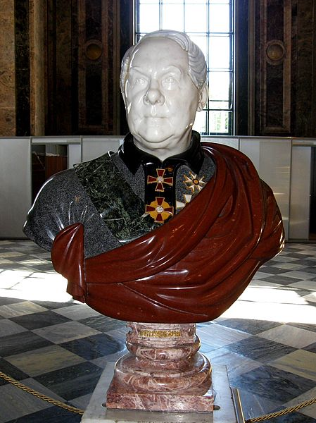
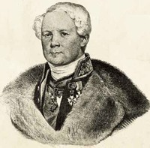
Auguste de Montferrand
1786 - 1858
He died a month later after opening the cathedral.

Slide 8
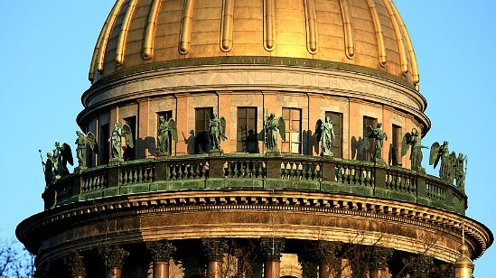
The cathedral's main dome rises 101.5 m and is plated with pure gold.
The dome is decorated with statues of angels .

Slide 9
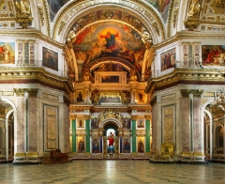
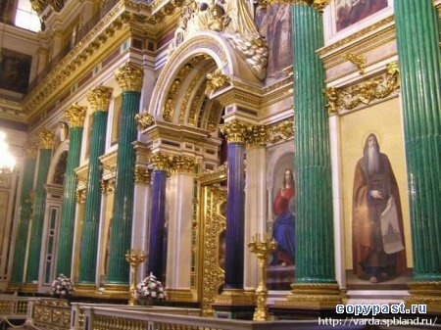
The interior of the cathedral

Slide 10
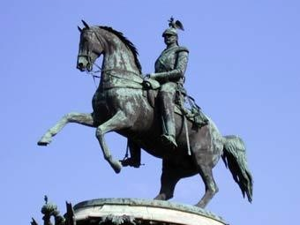
The monument to Nicholas I
The monument was a technical wonder of its time.
It was the first equestrian statue in Europe
with only two support points

Slide 11
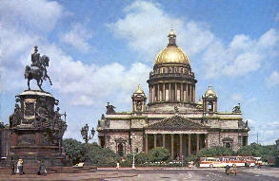

Slide 12
Используемые интернет-ресурсы
http://static.vmurmanske.ru/serverdata/news_info/2011/06/11/896000/imgFull.jpg
http://www.ulyanovskcity.ru/images/trpub/fdbfb.jpg
http://shkolazhizni.ru/img/content/i59/59964.jpg
http://copypast.ru/uploads/posts/thumbs/1228991292_malakhit_i_lazurit.jpg
http://www.voskres.ru/kolonka/images/petersburg3001.jpg
http://img-fotki.yandex.ru/get/3705/mly-n.7/0_1ac61_4cfb042a_XL
http://upload.wikimedia.org/wikipedia/commons/a/ab/Opolchenie.jpg?
http://www.opeterburge.ru/pictures/4410ec34_na.jpg
http://img-fotki.yandex.ru/get/4408/nataly-pamsiktravel.5/0_5d789_56834610_M.jpg
http://img-fotki.yandex.ru/get/5822/134813707.e/0_652de_67c8c4fb_S

