Slide 1
A double-decker bus

Slide 2
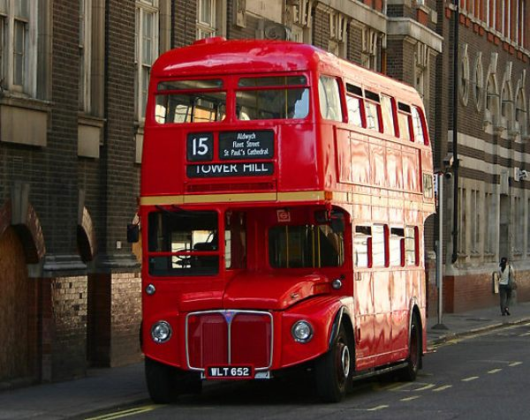

Slide 3
London Buses are very fast and convenient way to get around the city, and, on the road you can see the many sights.

Slide 4
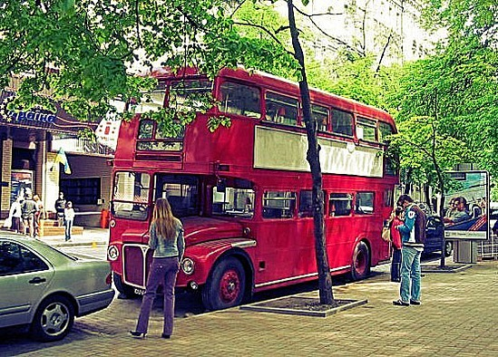

Slide 5
Legendary London bus was created by AEC in 1954 and was in service a little less than fifty years. During this time he gained enormous popularity among residents and visitors to the city, becoming one of London's business cards.

Slide 6
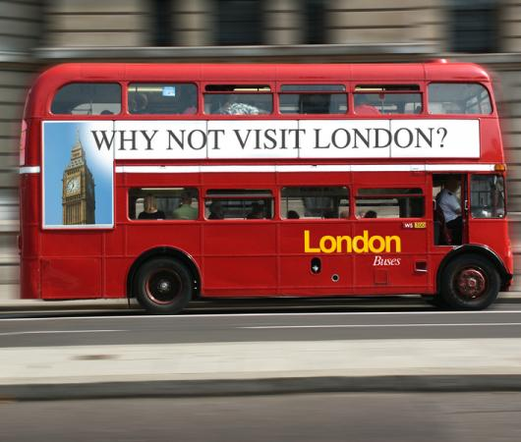

Slide 7
Two buses, longevity still ply the tourist attractions in central London, delighting tourists.

Slide 8
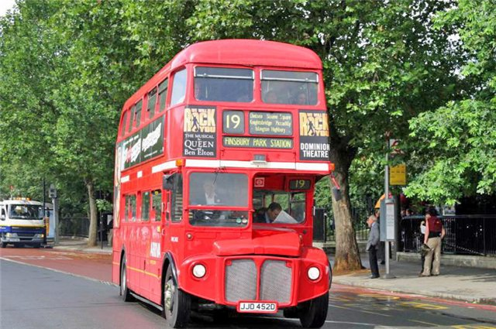

Slide 9
The oldest of London's buses is by far the Routemaster, which means "master of roads." Design bus was developed about 9 years and has appeared on the streets of London in 1956.

Slide 10
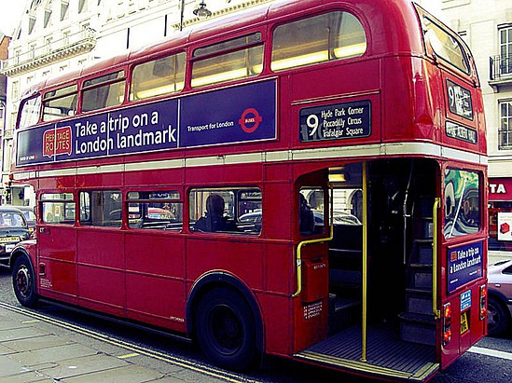

Slide 11
The
end

