Slide 1
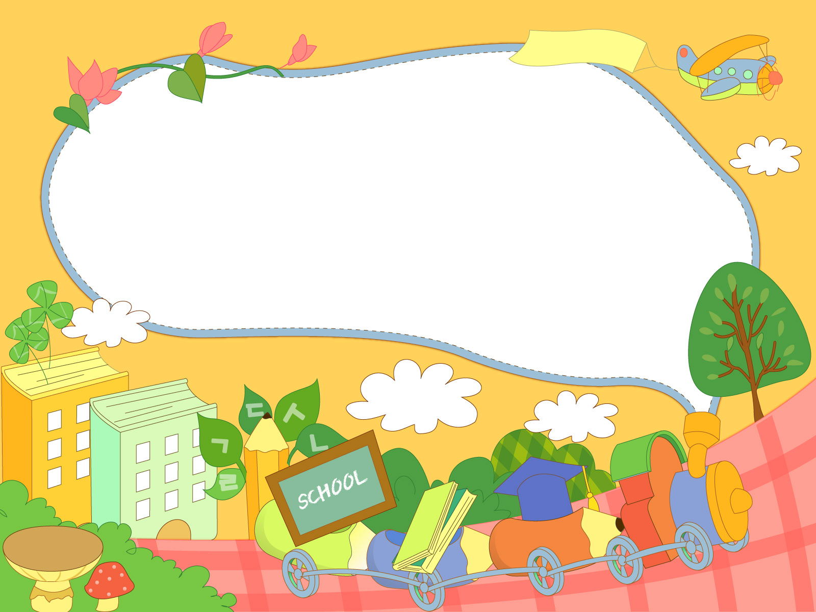
School objects

Slide 2
School

Slide 3
Classroom

Slide 4
Board

Slide 5
Desk

Slide 6
Schoolbag

Slide 7
Book

Slide 8
Notebook

Slide 9
Pencilcase

Slide 10
Pen

Slide 11
Pencil

Slide 12
Eraser

Slide 13
Pencil sharpener

Slide 14
Colourful pencils

Slide 15
Crayons

Slide 16
Scissors

Slide 17
Glue

