Slide 1
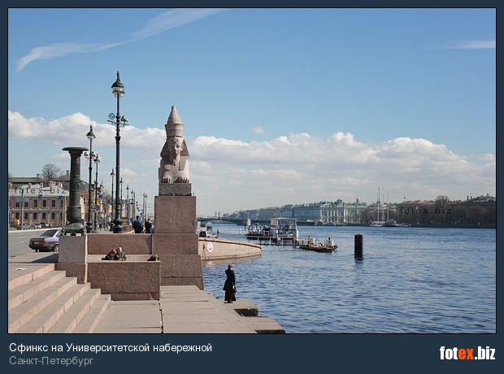
Презентация
по теме: «Сфинксы» для уч-ся 10 класса
Учебное пособие М.А. Гацкевич «Санкт-Петербург»
http://fotex.biz/countries/russia/spetersburg/7812003040/
Учитель английского языка
высшей категории
ГБОУ СОШ № 180
Красногвардейского района СПБ
Дмитрук Л.Е.

Slide 2
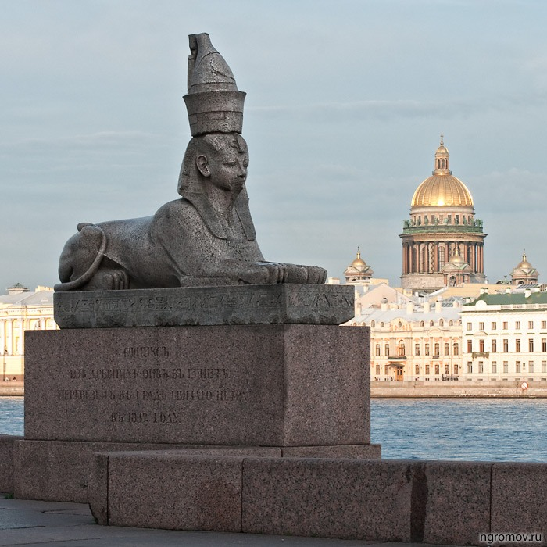
The Sphinxes
http://ngromov.ru/new/sfinks-na-universitetskoj-naberezhnoj

Slide 3
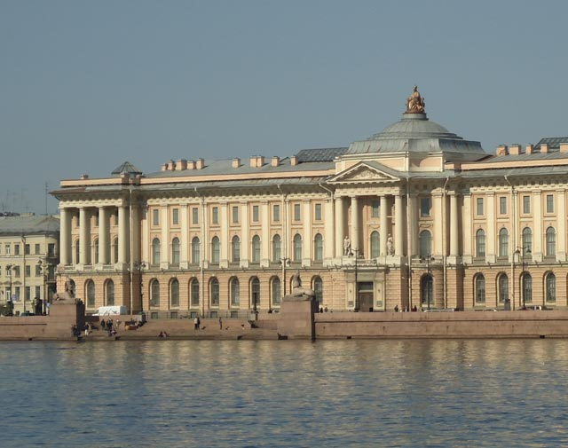
On the embankment before the main façade of the Academy of Arts there is a granite pier. It was erected after the design of the architect Konstantin Thon between 1832 and 1834.

Slide 4
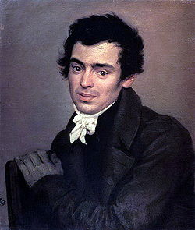
Konstantin Andreyevich Thon,
also spelled Ton ( October 26, 1794 – January 25, 1881) was an official architect of Imperial Russia during the reign of Nicholas I.
Konstantin Thon, 1820s
Konstantin, born in St. Petersburg to the family of a German jeweler, was one of three Thon brothers who all rose to become notable architects. He studied at the Imperial Academy of Arts (1803–15) under the Empire Style architect Andrey Voronikhin, best remembered for his work on the Kazan Cathedral, situated right in the middle of the Nevsky Prospekt. He studied Italian art in Rome from 1819 to 1828, and on his return home was admitted to the academy as its member (1830) and professor (1833). In 1854, he was appointed rector of the architectural division of the academy.
Thon first attracted public attention with his sumptuous design for the interiors of the Academy building on the Neva embankment.
http://commons.wikimedia.org/wiki/File:Konstantin_Thon_1820-th.jpg?uselang=ru

Slide 5
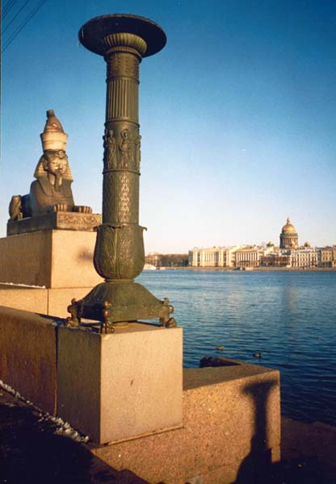
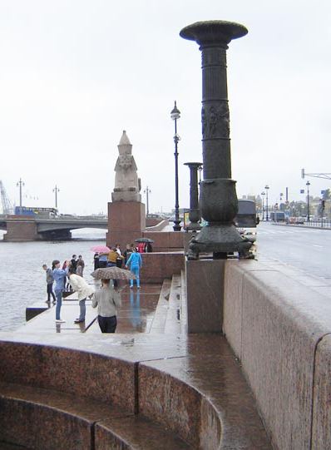
On the upper terrace stand the bronze lamps.
http://travel.gerodot.ru/russia/sfinksy-amenxotepa-iii.htm
http://hellopiter.ru/Sfincsi.html

Slide 6
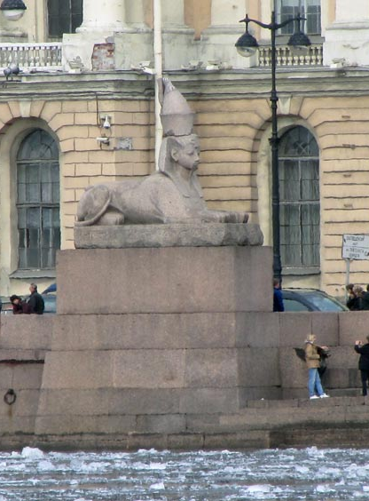
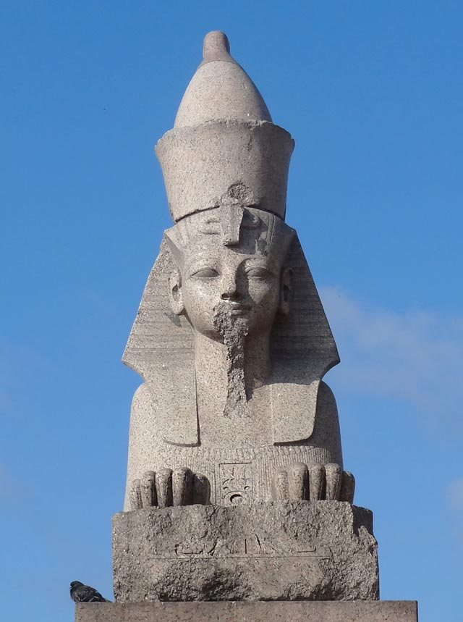
The lower terrace is decorated with two Egyptian sphinxes on high pedestals.
http://hellopiter.ru/Sfincsi.html

Slide 7
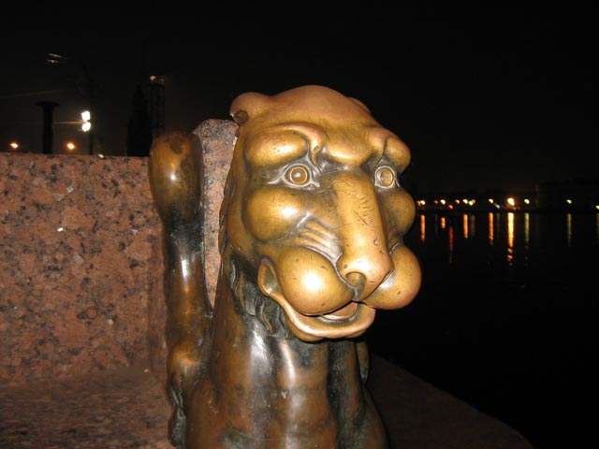
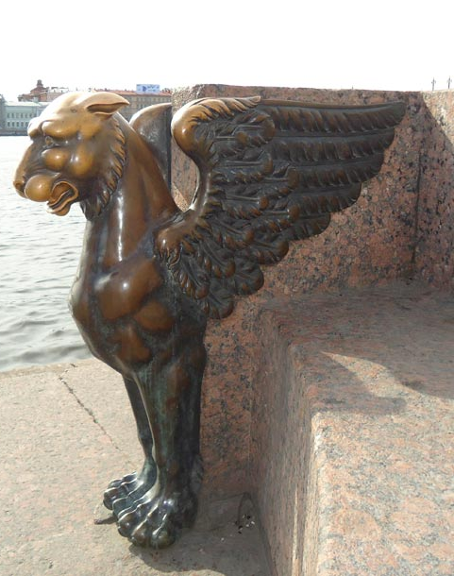
The pier is embellished with granite benches images of gryphons and stylized bronze girandoles each of which stands on four lion’s paws.
http://hellopiter.ru/Sfincsi.html

Slide 8
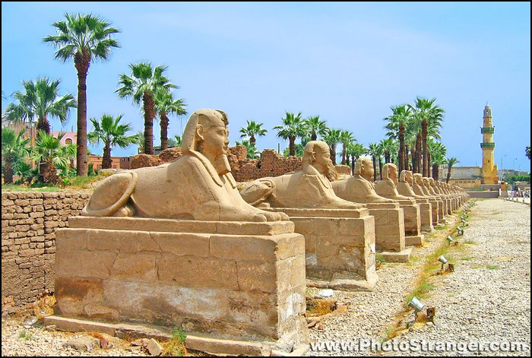
The sphinxes were found during excavations in ancient Thebes, the ancient capital of Egypt.
http://www.photostranger.com/gallery/gallery_egypt/luxor/imagepages/image47.htm

Slide 9
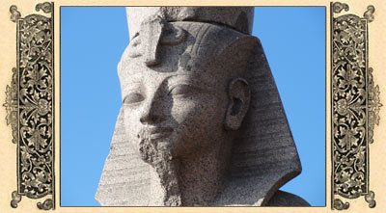
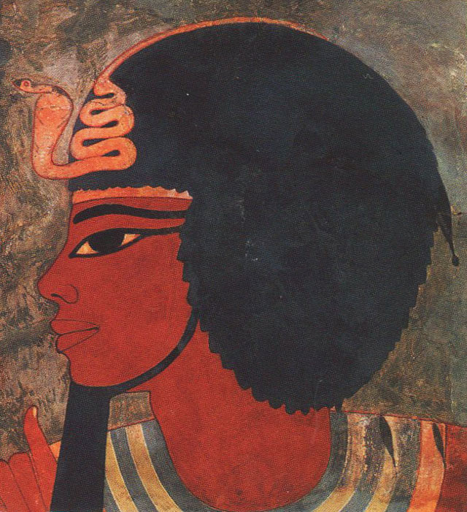
Each sphinx features the head of the Egyptian pharaoh Amenkhotep III
and lion’s body.
http://hellopiter.ru/images/756455756444456.jpg

Slide 10
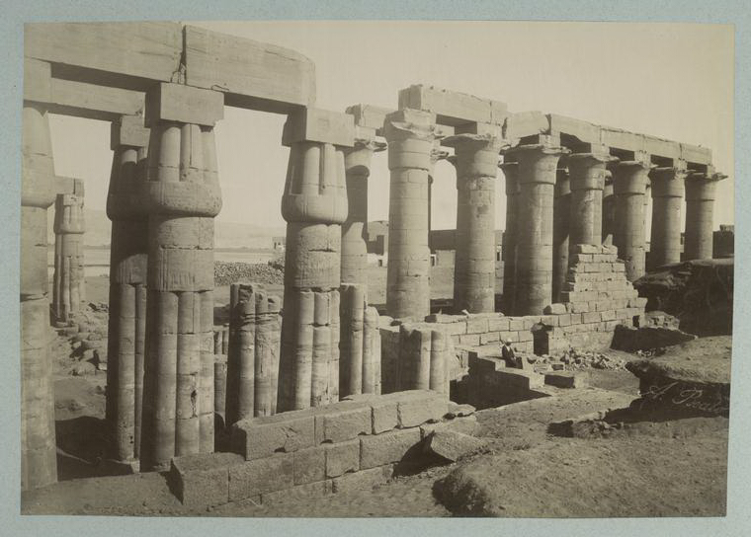
The sphinxes embellished the Palace of Amenkhotep III
ruins of the Temple
http://ru.wikipedia.org/wiki/%D0%90%D0%BC%D0%B5%D0%BD%D1%85%D0%BE%D1%82%D0%B5%D0%BF_III

Slide 11
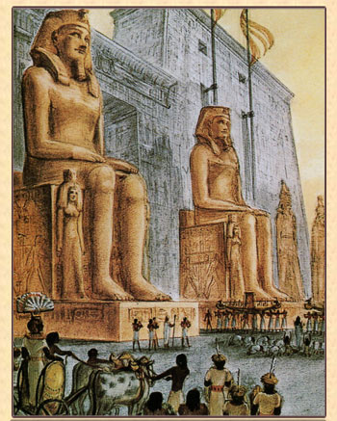
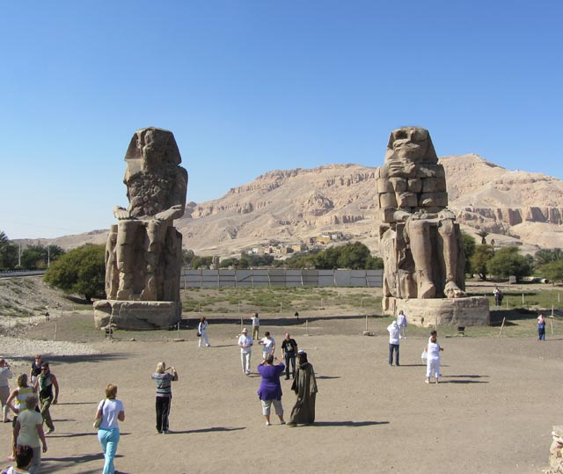
The sphinxes were brought from the praying temple of Thebes where “Memnon Colossus” is standing now
Memnon Colossus before lost funerary temple of Amenkhotep III
http://hellopiter.ru/Sphinx.html

Slide 12
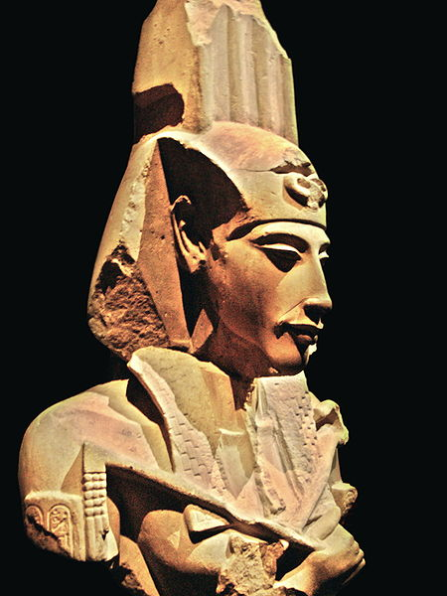
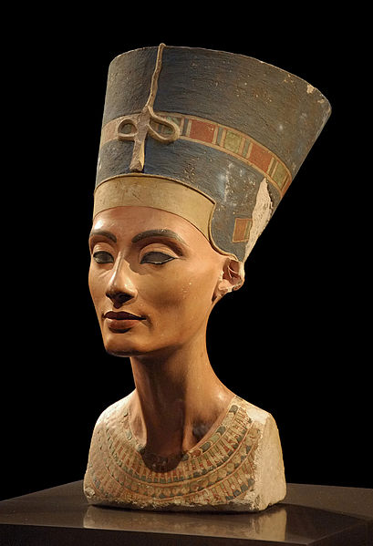
The son of Amenhotep was a notorious pharaoh-reformer Echnaton
Akhenaten (also spelled Echnaton, meaning "living spirit of Aten") known before the fifth year of his reign as Amenhotep IV and was a Pharaoh of the 18th dynasty of Egypt who ruled for 17 years and died perhaps in 1336 BC or 1334 BC.
Nefertiti (1370 BC –1330 BC) was the Great Royal Wife of the Egyptian Pharaoh Akhenaten. Nefertiti and her husband were known for a religious revolution, in which they worshiped one god only, Aten, or the sun disc.
http://commons.wikimedia.org/wiki/File:Akhenaten_-_Ajenat%C3%B3n.jpg?uselang=ru
http://commons.wikimedia.org/wiki/File:Nofretete_Neues_Museum.jpg?uselang=ru

Slide 13
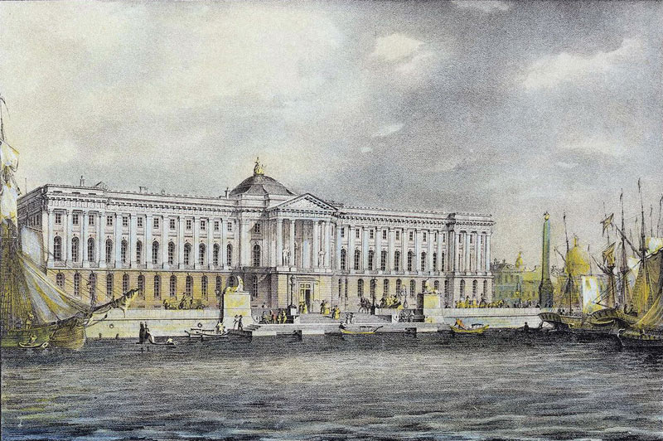
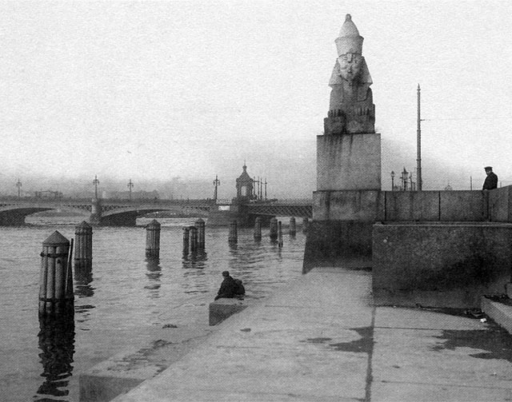
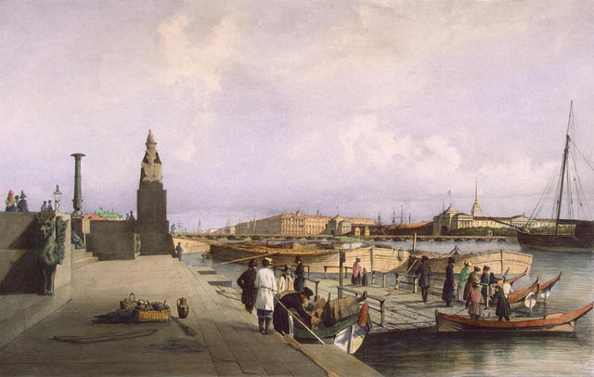
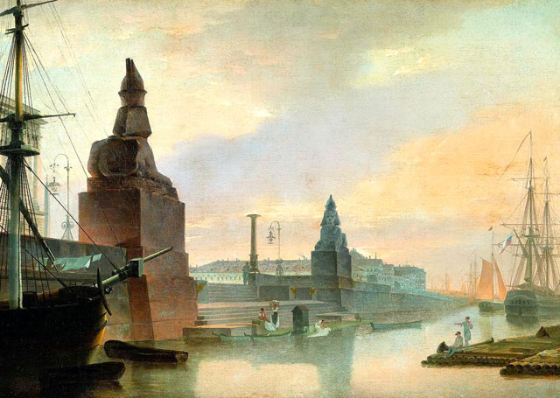
The sphinxes were bought by Russia from Egypt in 1831. They were brought from the banks of the Nile to Saint-Petersburg in 1832.
http://hellopiter.ru/Sphinx.html

Slide 14
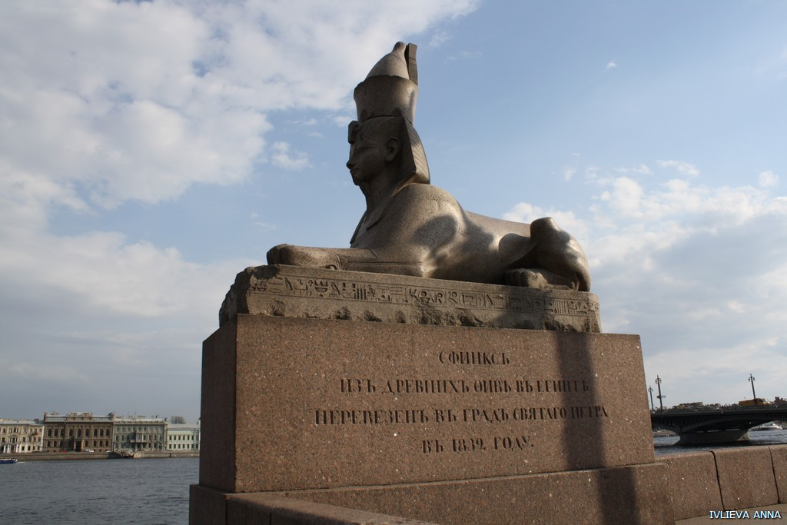
On the pedestal the words are inscribed: “ Brought to Saint-Petersburg in 1832 from the ancient Egyptian city of Thebes”
http://legendy.spb.ru/

Slide 15
Choose the correct item.
The sphinxes were brought from the banks of……to St Petersburg in the spring of 1832.
the River Thames □ the Nile □ the Mississippi □
The sphinxes were bought by Russia from ………. in 1831.
Egypt □ Rome □ Venice □
This classically austere pier was erected after the design of the architect ….. between 1832
and 1834.
Auguste Montferrand □ Vasily Stasov □ Konstantin Thon □
The sphinxes feature the head of Egyptian pharaoh Amenkhotep III and ……… .
lions’ body □ tiger’s paws □ eagle’s wings □
The sphinxes were found during excavations in ancient …….., the capital of Egypt.
Thebes □ Rome □ Aswan □
http://legendy.spb.ru/

Slide 16
Write the correct form of the verbs in brackets.
1. They (to find) during excavations in ancient Thebes.
2. The lower terrace (to decorate) with two Egyptian sphinxes on high pedestals.
3. The sphinxes (to feature) the head of Egyptian pharaoh Amenkhotep III and lion’s body.
4. At that time Egypt (to reach) the peak of power and wealth.
5. On their pedestals the words (to inscribe): “Brought to St Petersburg in 1832 from the ancient Egyptian city of Thebes”;
6. Sphinxes (to bring) from the praying temple of pharaoh in Thebes where “Memnon Colossus” (to stand) now.
7. The majestic effigies of sphinxes set on massive granite pedestals (to mount) on the either sides of the stairway leading to water.
http://legendy.spb.ru/

Slide 17
Write sentences using one of these verbs in each sentence.
stand, feature, emerged, were cast, has become, embellished
The sphinxes are a thousand years older than the Neva River which …… only
2,000 or 3,000 years ago.
Both gryphons and girandoles …… in 1834.
The sphinxes ……. the head of Egyptian pharaoh Amenkhotep III and lion’s
body.
The sphinxes ……. the palace of Amenkhotep III.
The mysterious mythological creature ……. a notable symbol of the northern
capital of Russia.
On the upper terrace ……. two bronze lamps.
http://legendy.spb.ru/

