Slide 1
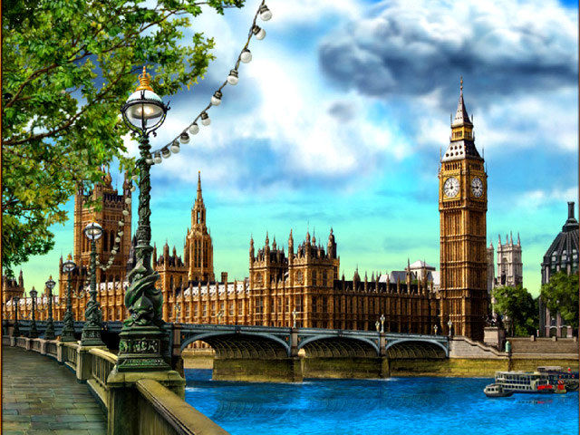
London
Работу выполнила:
ученица 6 «В» класса
средней школы №1
Лесных Яна

Slide 2
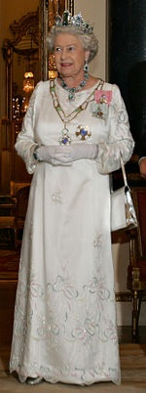
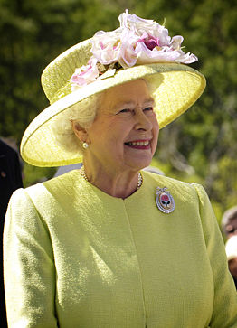
The official head of U.K. is Elizabeth II
The U.K. is a constitutional monarchy with a parliament and the Queen as Head of State.

Slide 3
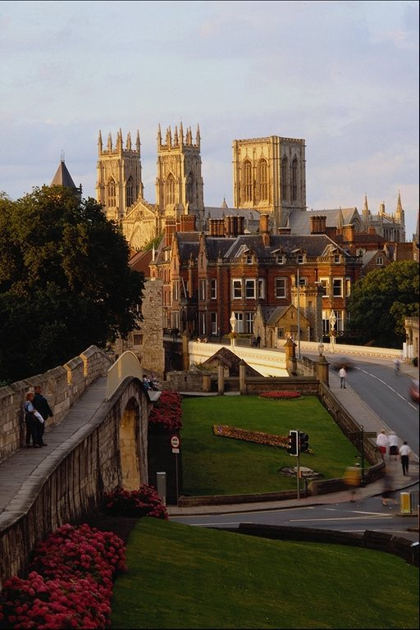
About London
London is the capital of the United Kingdom of Great Britain and Northern Ireland. It is situated on the both banks of the river Thames. The city is very old, is more than 20 centuries. Its population is nearly 9 million people. London has many beautiful and interesting places.

Slide 4
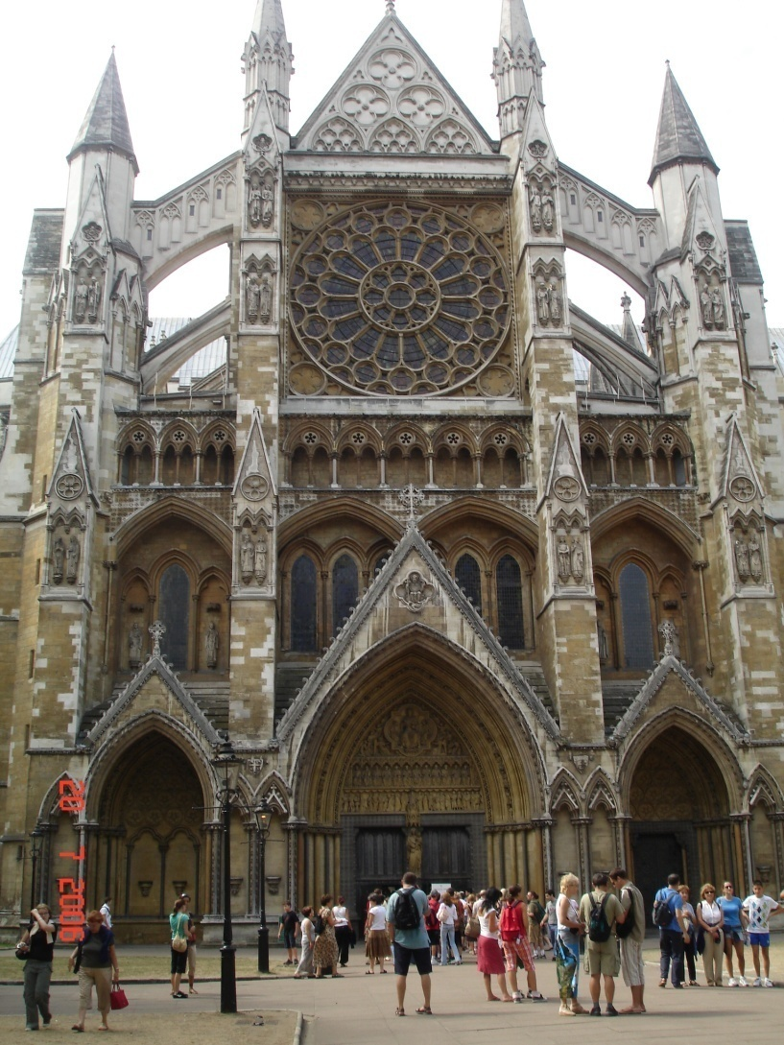
Westminster Abbey
Westminster Abbey is the aristocratic, official part of London. It’s very attractive for tourists because it has historical places full of customs and traditions. Westminster Abbey is very beautiful church, which is more than 900 years old. Nearly all the kings and queens were crowned and buried there. Many famous people of this country were buried in the Abbey.

Slide 5
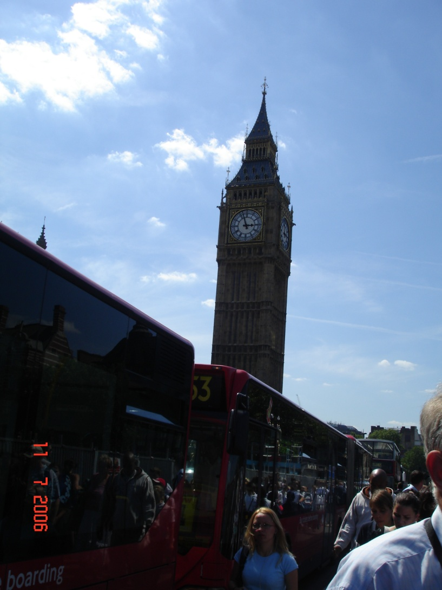
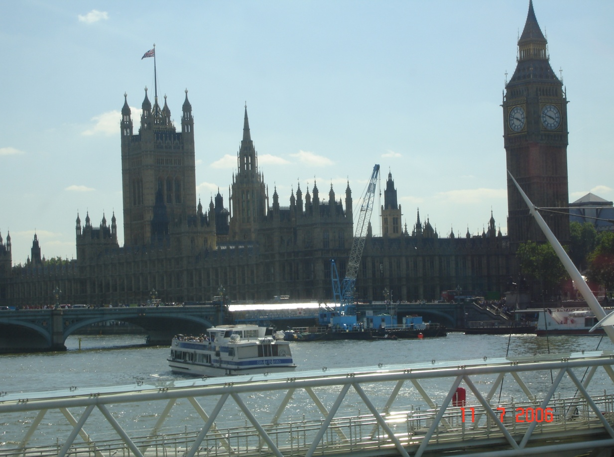
Big Ben
“ Big Ben” is the name of great bell which strikes the hour. It is in the Clock Tower of the Houses of Parliament.

Slide 6
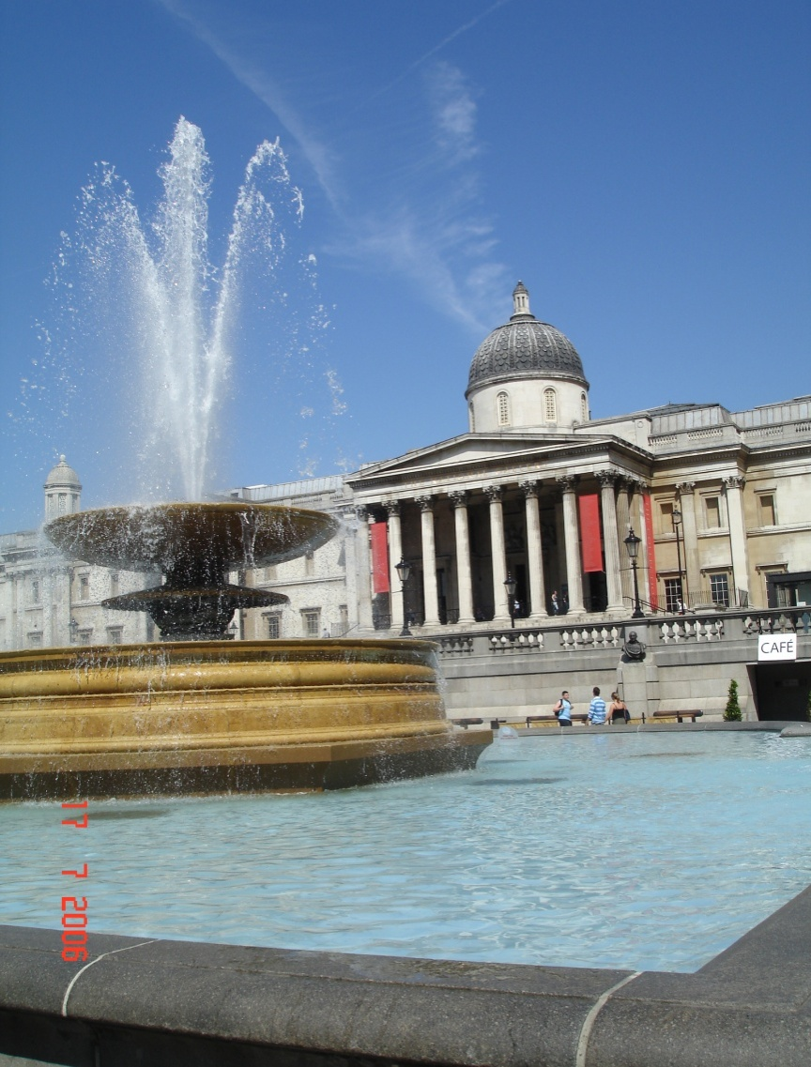
Piccadilly Circus
Piccadilly Circus is a square in the central part of London. London’s best-known theatres and cinemas and most famous restaurants are on Piccadilly Circus. In the square you can see people of many nationalities and hear a lot of different languages.

Slide 7
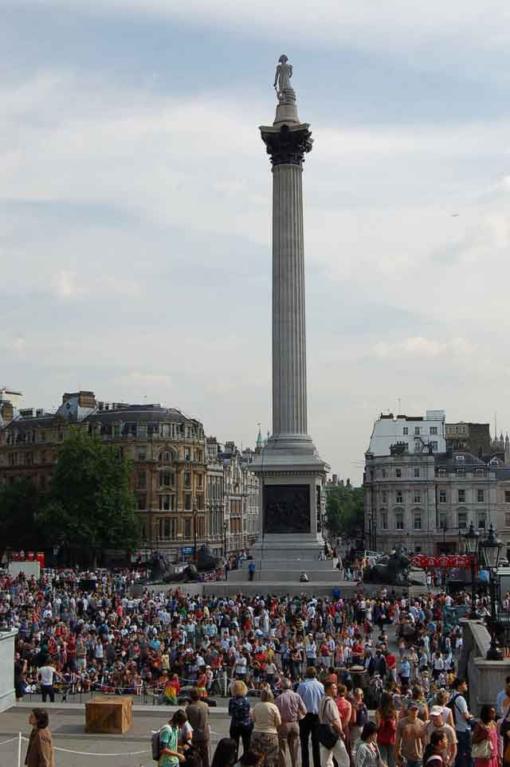
Trafalgar square
In the centre of the square there is a statue of Admiral Nelson who had to fight the French at the Battle of Trafalgar in 1805.

Slide 8
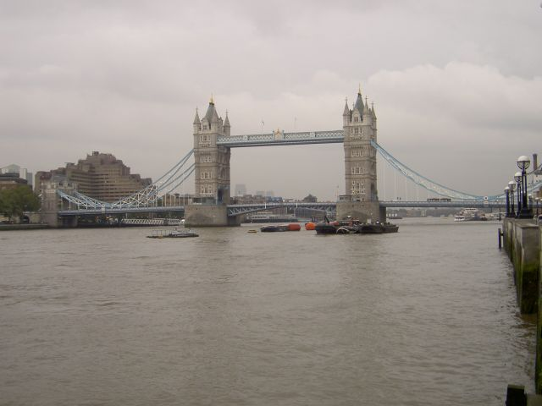
Thames and Tower Bridge
London is situated on the river Thames about forty miles from its mouth. It is divided into two parts by the river.

Slide 9
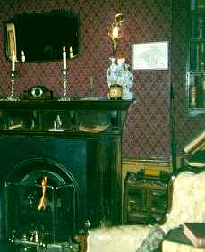
Sherlok Holmes's house
Sherlok Holmes's house was build in 1815. The British government was declare, that the building is an architectural and historical monument of 2-nd category.

Slide 10
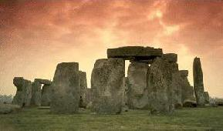
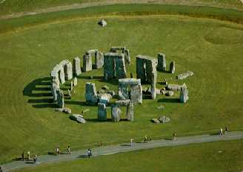
Stonehenge
Huge construction a Stonehenge - a stone riddle in the center of Europe. It was name one of researchers doctor Umlmor Trever. As a whole the Stonehenge represents a construction from 82 five-ton stones, 30 stone blocks, weight on 25 tons and 5 huge stones, stones which weight reaches 50 tons.

Slide 11
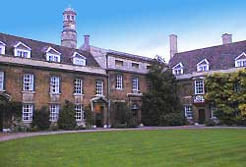

1.Thames and Tower Bridge a)
2.Cambridge
3.Stonehenge
4.Trafalgar square b)
5.Big Ben
e)
d)
c)

