Slide 1
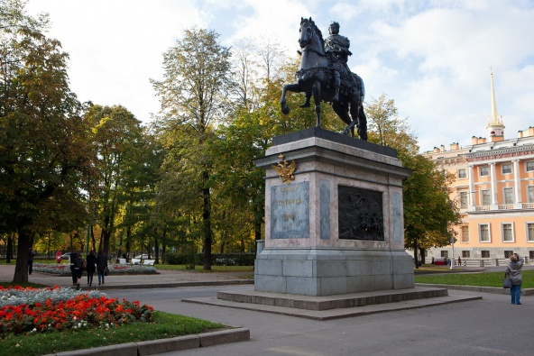
Презентация к учебнику М.А. Гацкевич
The Monument to Peter I
in Maple Alley
http://shatunovsky.ru/spbtrip/3/26/
Учитель английского языка
ГБОУ СОШ № 180 Санкт-Петербург
Дмитрук Л.Е.

Slide 2
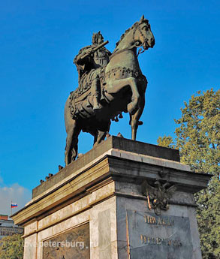
This monument was ordered to the Italian sculptor Carlo Rastrelli while Peter I was alive.
The height of the statue is 4.8 m, the height of the pedestal is 7 m.
http://spasskievorota.ru/313.htm

Slide 3
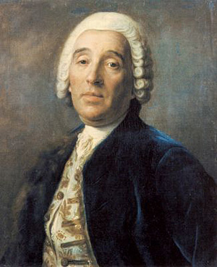
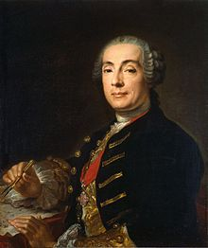
Carlo Rastrelli is the father of the famous architect Bartolomeo Rastrelli.
Carlo Rastrelli
Bartolomeo Rastrelli
http://persons-info.com/persons/RASTRELLI_Bartolomeo_Karlo/
http://commons.wikimedia.org/wiki/File:Rastrelli.

Slide 4
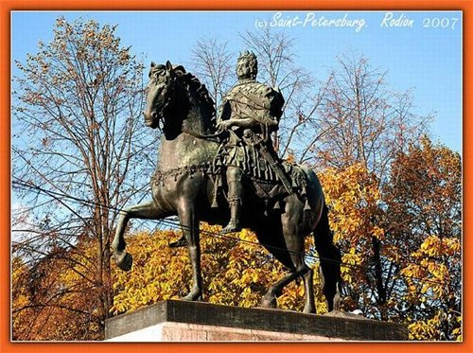
This monument was supposed to be erected near the Twelve Colleges building on Vasilievsky Island.
But the work took more time than it was supposed to and the sculpture was finished only in 1746.
Initially - Maple alley (since 1868) ran from the Engineering street to the Manezh Square. Name refers to the fact that here until the middle of XX century were growing maple trees.

Slide 5
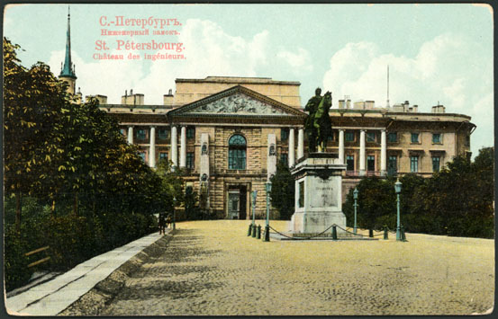
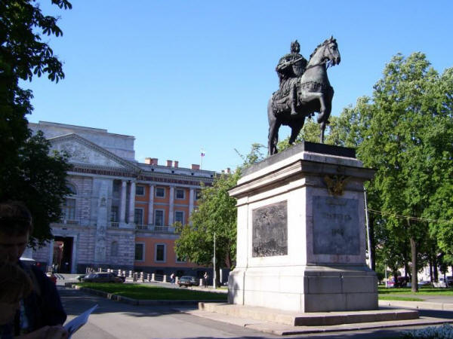
The statue of Peter the Great was erected before the main entrance to the Mikhaylovsky Castle in 1800.
http://commons.wikimedia.org/wiki/

Slide 6
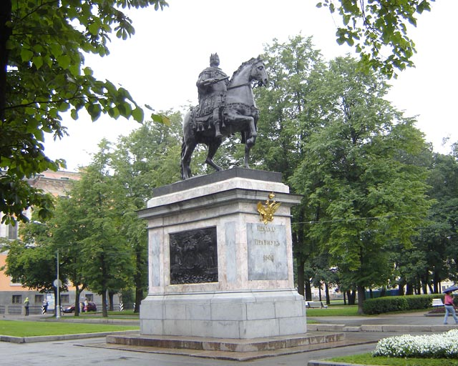
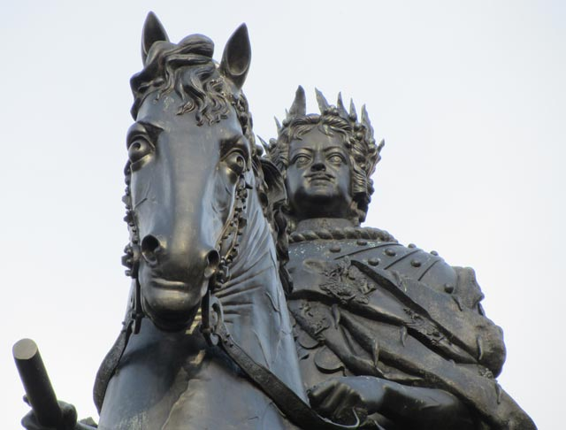
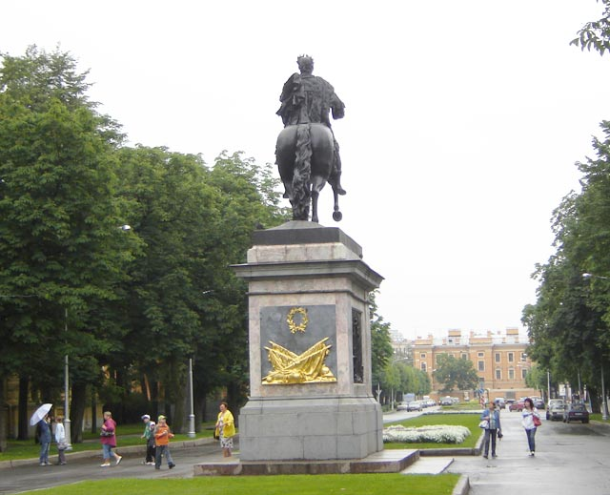
Peter I is depicted as a military leader and victor, powerful and threatening to the external and internal enemies of his state.
http://hellopiter.ru/Monument_to_peter_photo.html

Slide 7
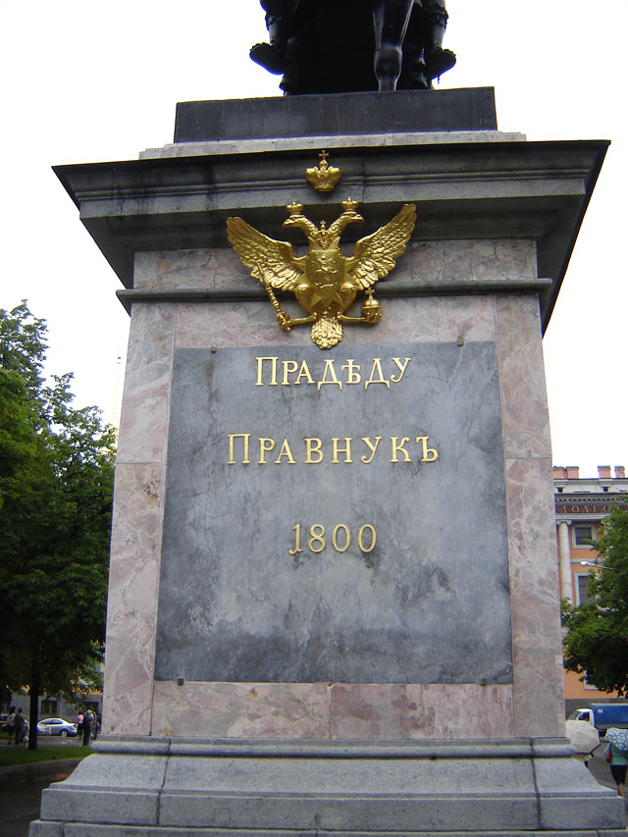
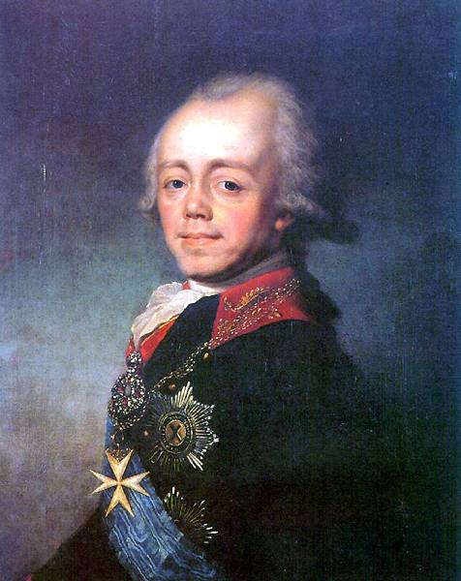
Paul I ordered the following inscription to be made: “To the Grandfather - Grandson. 1800.”
http://hellopiter.ru/Monument_to_peter_photo.html
http://commons.wikimedia.org/wiki/

Slide 8
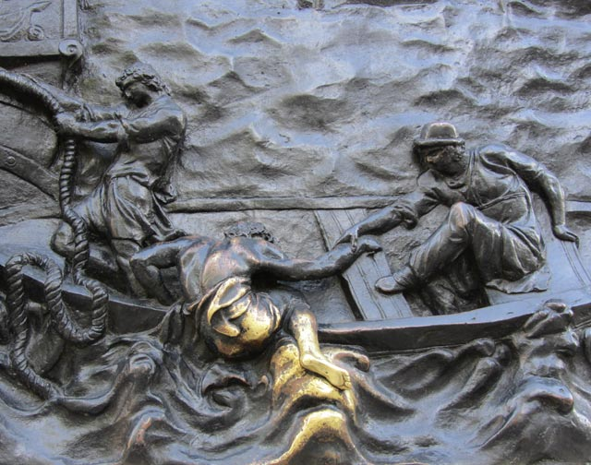
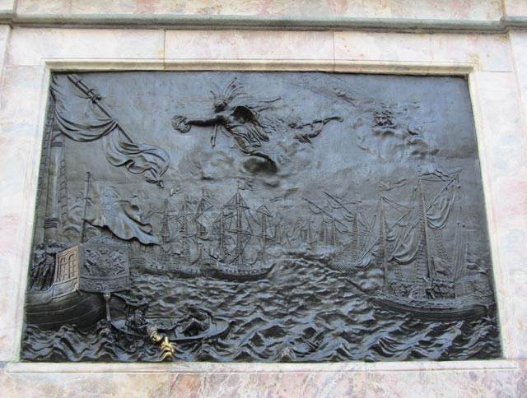
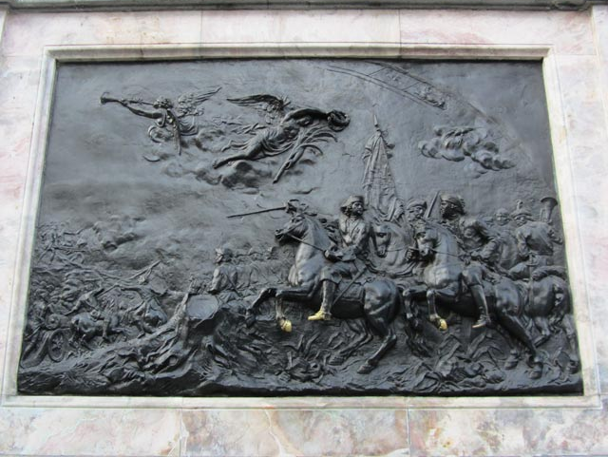
The pedestal is decorated with bronze bas-reliefs depicting the main victories of Peter’s time: “Poltava Battle” and “The Naval Fight of Gangut”.
The Naval Fight of Gangut
Poltava Battle

Slide 9
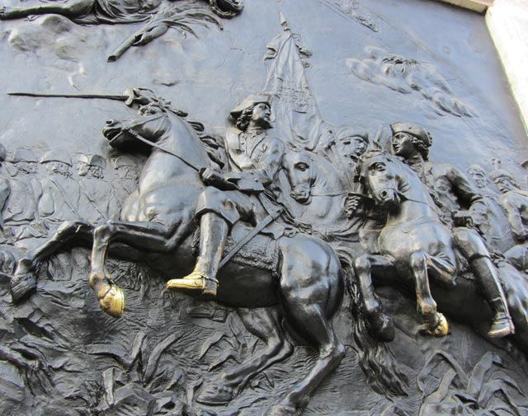
http://hellopiter.ru/Monument_to_peter_photo.html
In the bas-relief devoted to the battle of Poltava, the Russian troops are depicted on the right. In the foreground Peter I stands pointing out with his sword the way to pursue the fleeing Swedes. Next to the tsar is his friend and comrade-in-arms, Alexander Menshikov, who commanded the Russian cavalry.

Slide 10
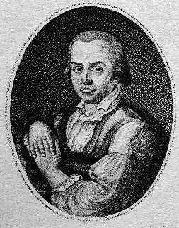
The bronze bas-reliefs were created by the sculptor Mikhail Kozlovsky.
Mikhail Ivanovich Kozlovsky
(6 November 1753 – 30 September 1802)
Was a Russian Neoclassical sculptor active during the Age of Enlightenment.
Beginning his training at the Imperial Academy of Arts in 1764, he went to Rome in 1774 and then to Paris in 1779. In 1788, he returned to Paris with the task of superintending Russian students abroad. He was appointed a professor at the Academy of Arts in 1794 and instructed young sculptors in St Petersburg until his death.
http://commons.wikimedia.org/wiki

Slide 11
In the left part of the bas-relief the Swedes are shown saving their king, Charles XII. He was wounded in the leg.
http://hellopiter.ru/Monument_to_peter_photo.html

Slide 12
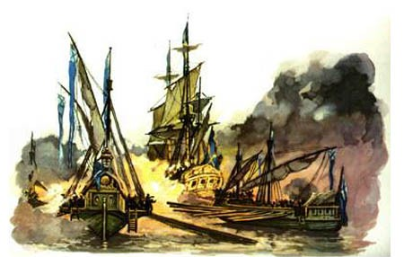
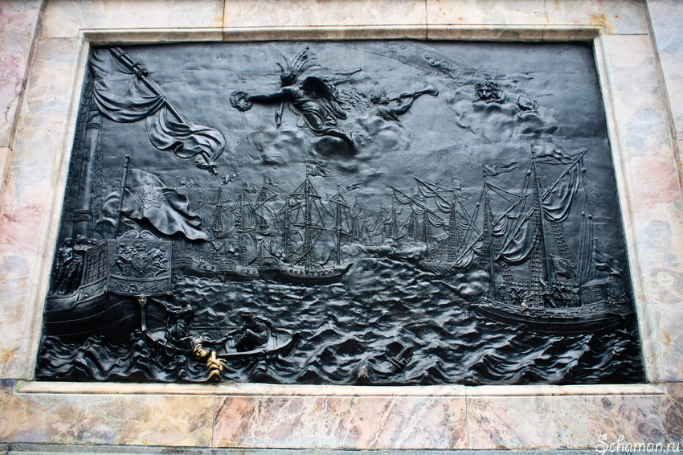
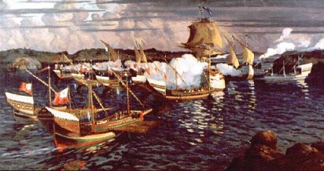
In the clouds, in the upper part of the bas-relief is Cancer the Crab, the sign of the Zodiac for June. The battle took place in June.
http://www.schaman.ru/archives/2373
The Naval Fight of Gangut
http://www.bochkavpechatleniy.com/

Slide 13
On the left side of the bas-relief devoted to the bat­tle of Gangut Peter I is depicted on the flag-ship over­shadowed by the Genius of Victory.
On the right side of the bas-relief the capture of a Swedish ship by the Russian forces is shown. In the clouds is Leo the Lion, the sign of the Zodiac corresponding to July.

Slide 14
