Slide 1
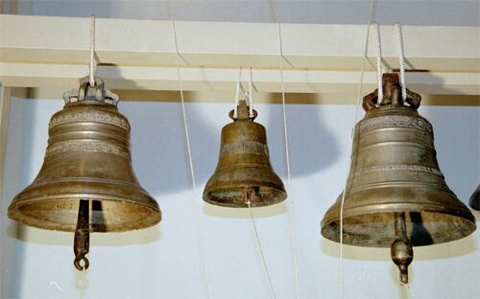
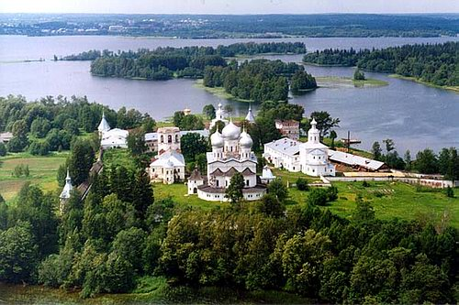
Welcome to the Pearl of Russia- Valdai
Ilyina E.V.
School N 515

Slide 2
Contents
Where is Valdai?
Тне соат of arms
The sightseeings of Valdai
Valdai is a counrty of lakes
Tourism in Valdai
Do you know Valdai well?

Slide 3
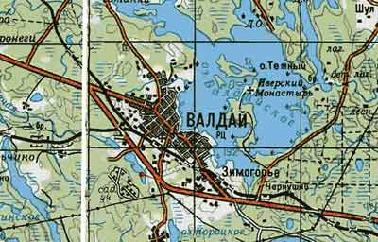
Where is Valdai?
Valdai is situated in the
North-west of Russia.
This ancient town is in
the very centre of Valdai
hills,on the coast of
Valdai lake.

Slide 4
The coat of arms
The draft of the XIX century
The Soviet coat of arms
Nowadays

Slide 5
The historic coat of arms
A shield cut in two by a perpendicular line
An empire crown on the fur
A green hill showing mountainous grounds of Valdai

Slide 6
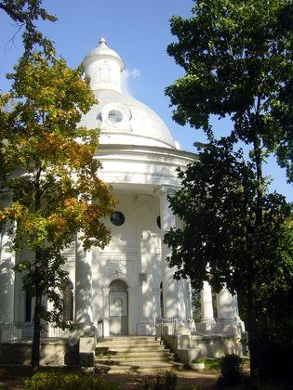
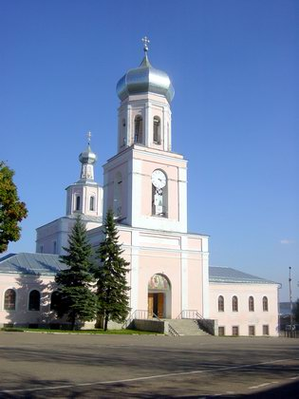
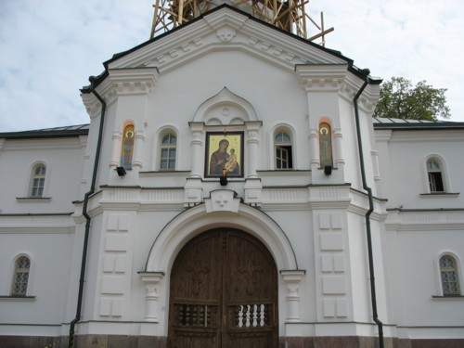
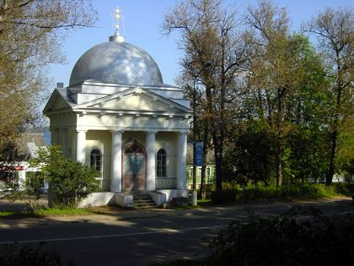
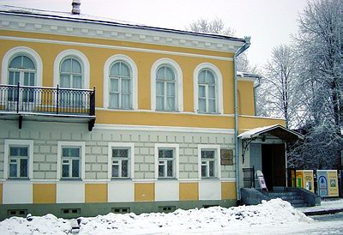
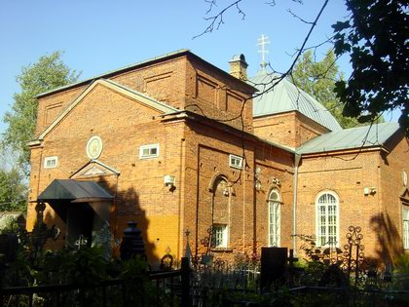
The sightseeings of
Valdai
.

Slide 7
Martur Katherin church
It was built in 1793. It was a road palace
church for Katherine II. It is near the main
Road Moscow-St.Petersburgh.
Now it is Bells museum.

Slide 8
Iverskiy monastery
It was founded in 1653 by patriarch
Nicon.It was on fire many times.
The monastery was closed in 1927
and opened in 1997.There are 5
temples in the monastery.
The monastery is on one of the
picturesque islands of Valdai lake.
Every summer it is visited by a lot of
tourists.

Slide 9
St.Trinity cathedral
The cathedral is in Svoboda Square. It was the
first brick building in Valdai in1694 .It was the
House of Culture during Soviet times.In 1993
it was on fire but was rebuilt.Many bells were
brought.The bell weighs 250 kg!

Slide 10
Jakob Borovochskiy s chapel
It is situated near the road not far
from the centre of Valdai.It is on a
lofty hill at Katherine church.
Now there is a religious bookshop.

Slide 11
Museum of a chief town
It was opend in 1998.It is in the centre of Valdai and in the two-storeyed mansion of the XIXcen.There you can
see a lot of portraits,things,letters,postcards dealt with the past of Valdai and its people.

Slide 12
St.Peter and Paul`s church
This church was built in 1853.
It is a stone one.The
Chuch is attracted by its
unusual structure.

Slide 13
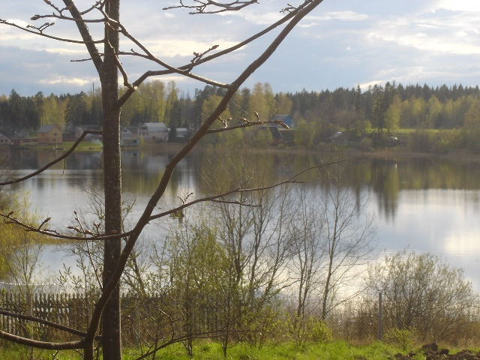
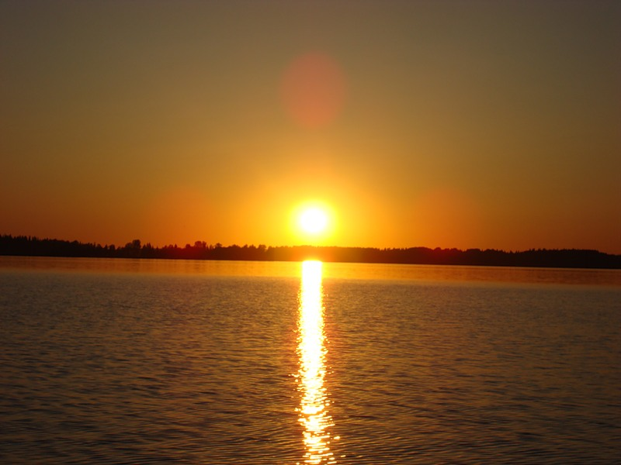
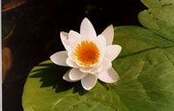
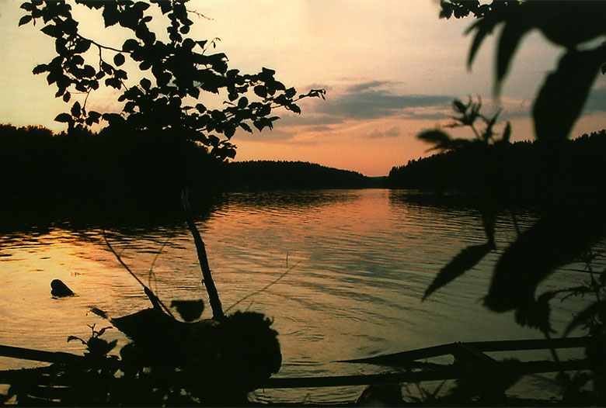
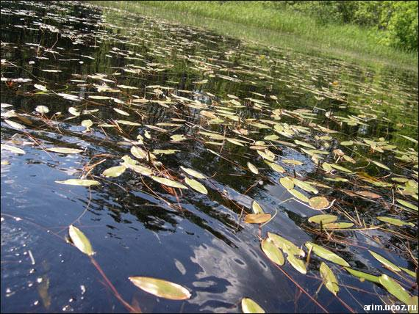
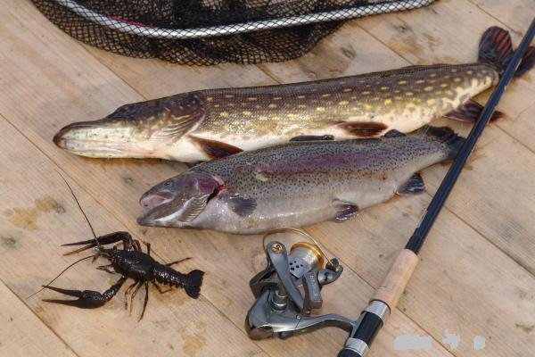
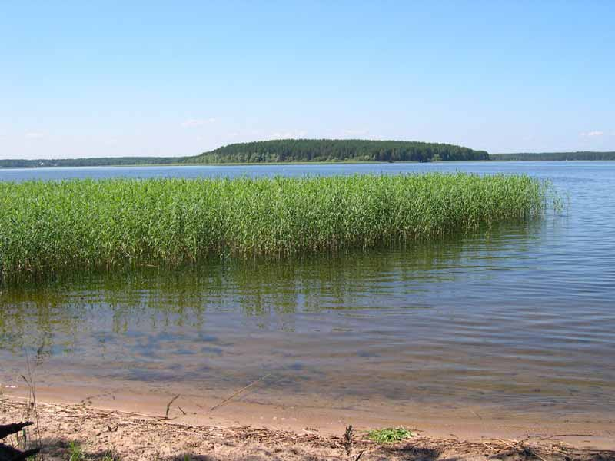
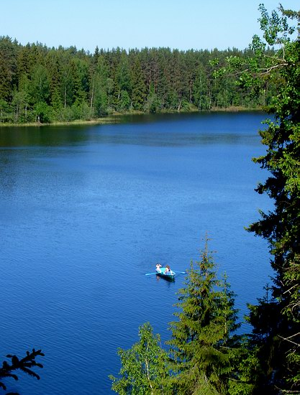
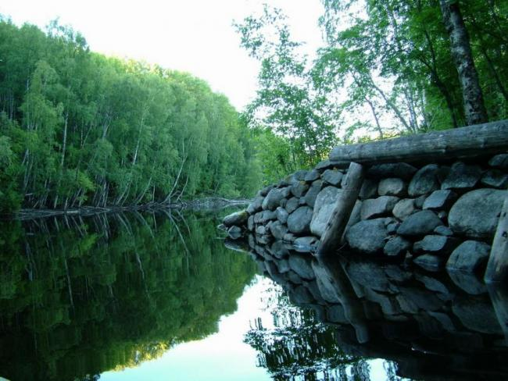
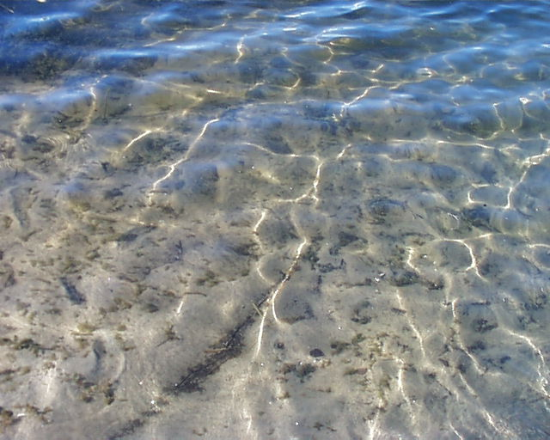
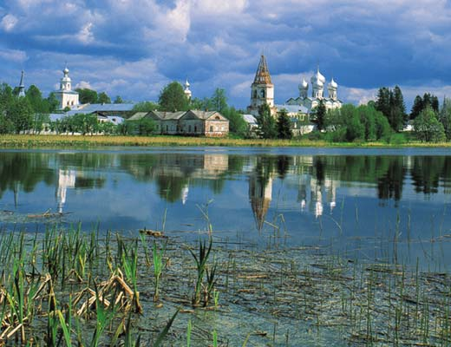
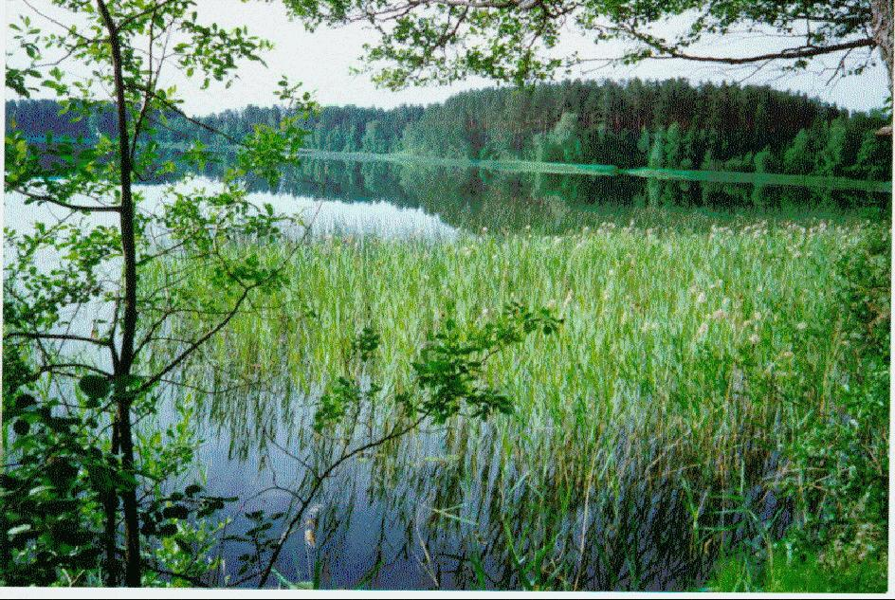

Slide 14
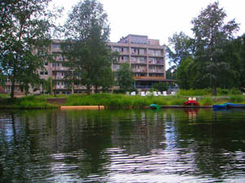
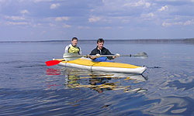
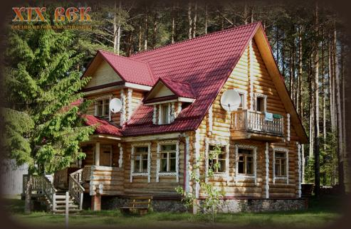
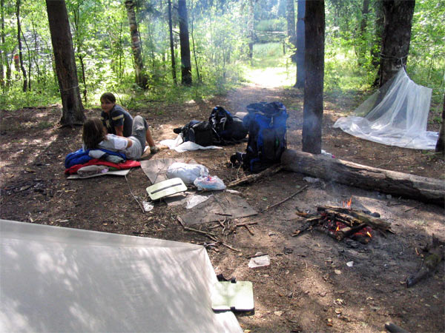
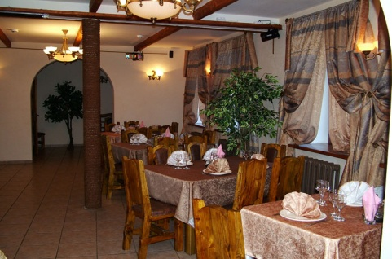
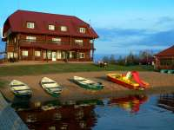
Enjoy your visiting Valdai !
Every summer a lot of
Tourists come to Valdai !
Everyone who will see the
marvellous Valdai
landscapes for the first
time ,will exclaim:
« Paradise is on the sky,but
Valdai is on the ground!!!»
http/valdai.com/fishing
http/valdai.com/rest
http/valdai.com/tourism

Slide 15
What is it?
Iverskiy monastery
Museum of a chief
town
St.Trinity cathedral

Slide 16
Your homework
1. Make up a dialogue about Valdai
2.Write a letter to your friend about Valdai
3.Find more information about the town

Slide 17
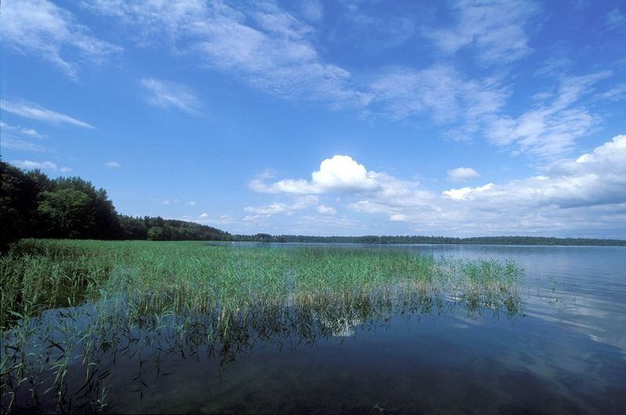
Used sources
1. Сайт города Валдай режим доступа: http://valday.com/
2.Живой GIF. Режим доступа: http://www.livegif.ru
3.Путеводитель Валдайского национального парка,
Тверь ,изд-во ООО НТИФ,,2005.

Slide 18
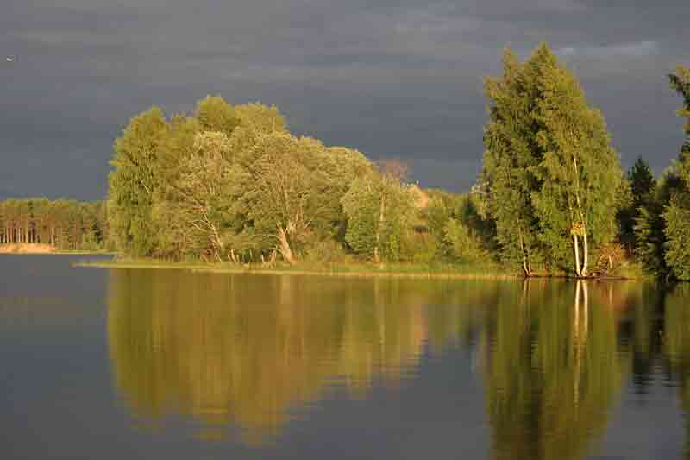
Самооценка мероприятия
I enjoy
I like it
I am indifferent

