Slide 2
What are The Boys' Brigade doing today?
The Boys' Brigade works with thousands of young people, many of whom have no other connection with the Church. Today they are working with over 60,000 children & young people in over 1500 groups in the UK & Republic of Ireland every week.
The Boys' Brigade provides a balanced programme of activities for children and young people from 5 to 18 years old.

Slide 3
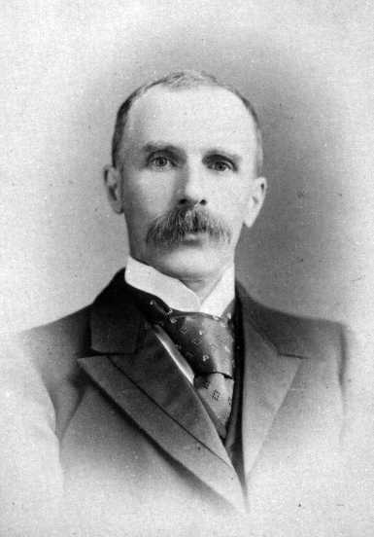
Where have The Boys' Brigade come from?
Sir William Alexander Smith (October 27, 1854 - May 10, 1914), the founder of the Boys' Brigade.
The Boys' Brigade was founded in Glasgow, Scotland in 1883.

Slide 4
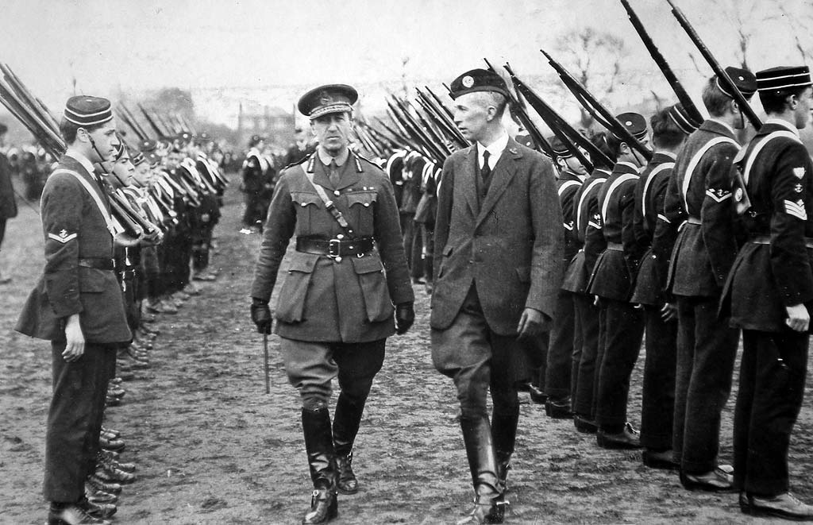
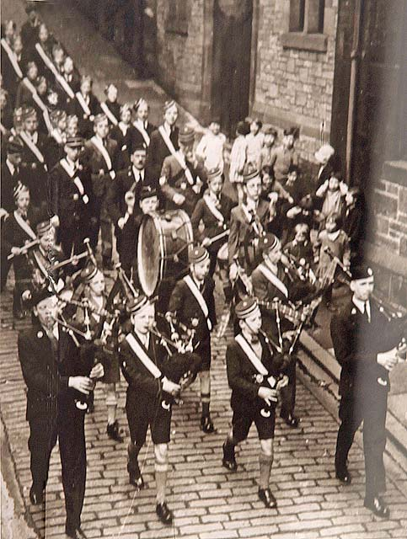
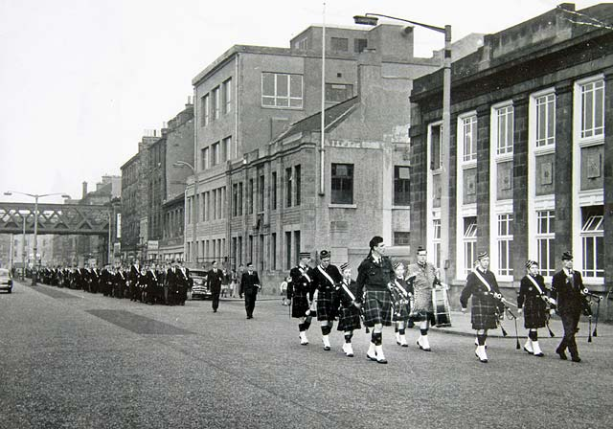
1917

Slide 5
The Boys' Brigade provides a balanced programme of activities for children and young people from 5 to 18 years old.

Slide 6
The Boys' Brigade work is split into age groups as follows:
Anchor Section - for Boys aged 5 to 8 years
Junior Section - for Boys aged 8 to 11 years
Company Section - for Boys aged 11 to 15 years
Seniors - for young men aged 15 to 18 years
Volunteer - for young people aged 14 to 22 years

Slide 7
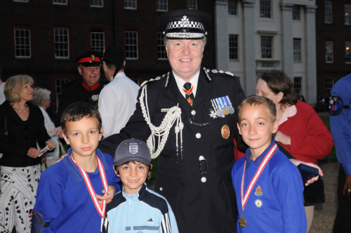
Anchor Boys have lots of fun doing different activities which include making things, crafts, music, games, sports, stories going on visits, making friends, and working towards their badges.
All of this is done as part of a balanced programme that is separated into 5 different zones . . .
Body- fit for fun
Mind - think and do
Spirit - God and me
Community - me and my world
Creativity - make and do

Slide 8
Juniors have fun!
Their meetings are crammed full of challenges, games and activities, usually ones that they themselves have suggested. There are hundreds of activities catering for just about every possible interest. At the same time leaders try to encourage them to explore other new interests. There is loads of variety and little chance of becoming bored!

Slide 9
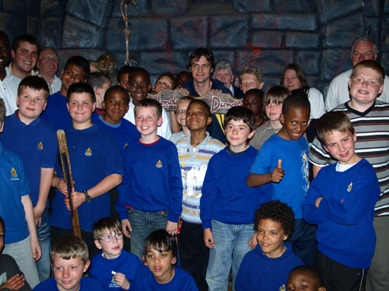
Those in the Company Section take part in the Discover programme, that enables you to . . .
Take part in a a fun, balanced and challenging programme
Be recognized for your effort and achievement
Build trusting relationships

Slide 10
Projects are grouped into 3 programme zones
Community
Life Skills
Recreation & Leisure

Slide 11
BB provides opportunities for children and young people to:
have fun
play games and sport
learn new skills
find out about the Christian Faith
have new experiences
go on a residential (Camp or Holiday)
engage with friends

Slide 12
The Boys' Brigade’s Object
"The advancement of Christ's kingdom among Boys and the promotion of habits of Obedience, Reverence, Discipline, Self-respect and all that tend towards a true Christian manliness."

Slide 13
Motto & Emblem
'Sure & Steadfast'

