Slide 1
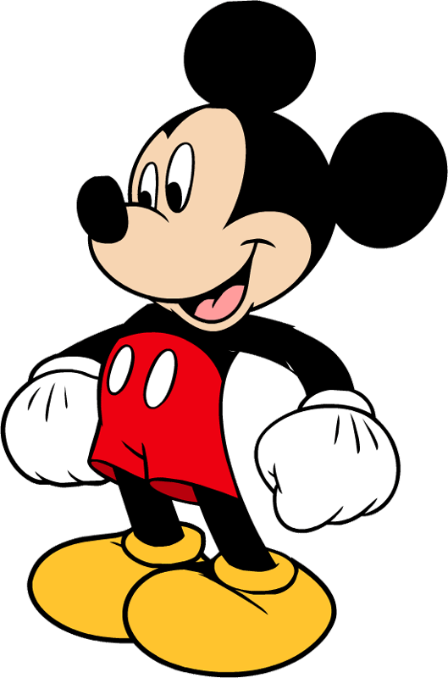
Day of week with Disney

Slide 2
Day of week
Sunday
Monday
Wednesday
Thursday
Friday
Saturday
Tuesday

Slide 3
On the last Sunday we played with our friends in our garden.

Slide 4
On Monday I went to school. It’s difficult after Sunday.

Slide 5
I like Tuesday! On Tuesday we usually go to swimming pool.

Slide 6
On Wednesday my friends go to the theatre.

Slide 7
On the last Thursday I lost my tail.

Slide 8
On Friday we have last working day.

Slide 9
On Saturday we go to the forest for picnic.

Slide 10
Oops! I lost some letters in words.
a
S_nday
Mon_ay
Tuesda_
We_nesday
Thu_sday
Frid_y
Sa_urday
d
y
d
r
a
t

Slide 11
Peter Pen’s diary
MONDAY – the longest school day
TUESDAY – reading day
WEDNESDAY – helping about the house day
SANDAY – play day
THURSDAY – cooking day
FRIDAY – shopping day
SATURDAY – tennis day

