Slide 1
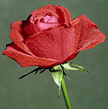
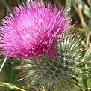
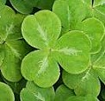
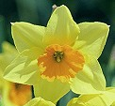
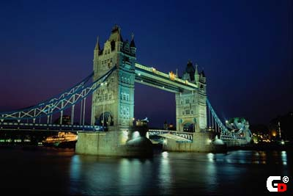
British Symbols

Slide 2
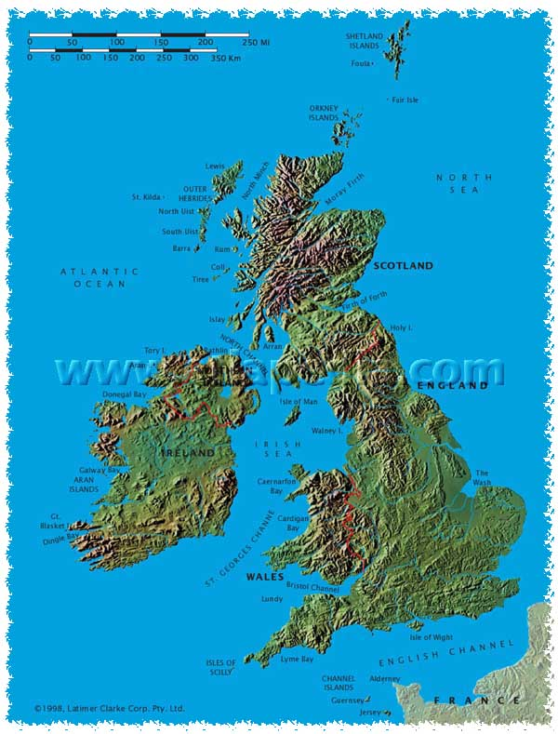
The United Kingdom
of Great Britain
and Northern Ireland

Slide 3
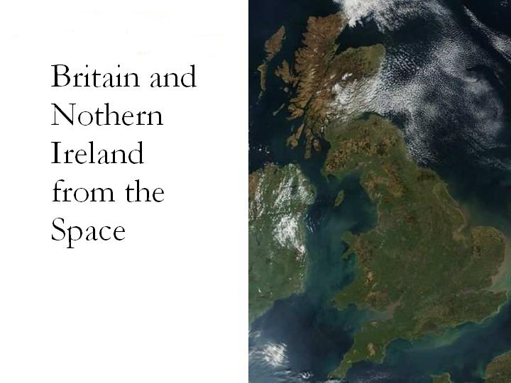

Slide 4
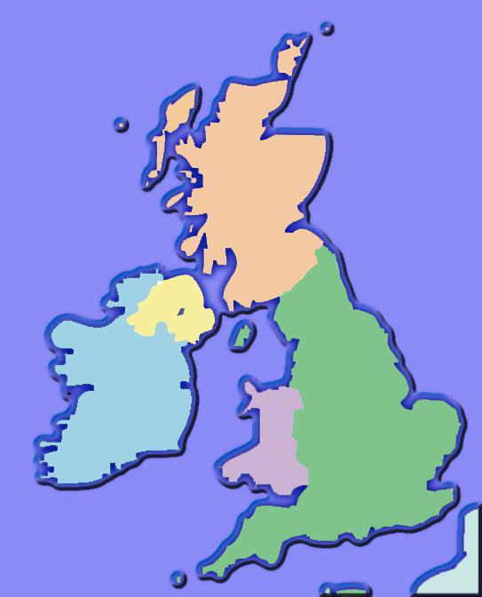
Northern Ireland
Scotland
England
Wales

Slide 5
Each country in Britain has its own patron saint and floral emblem

Slide 6
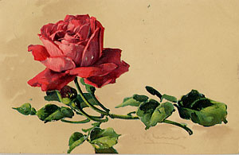
Red rose
Emblem of Lancaster

Slide 7
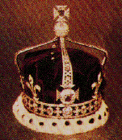
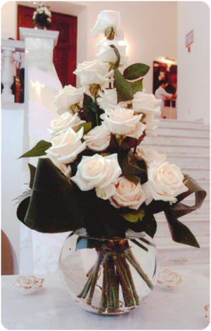
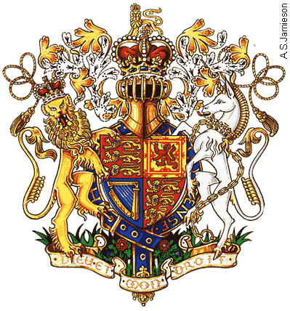
White rose –
emblem of York

Slide 8
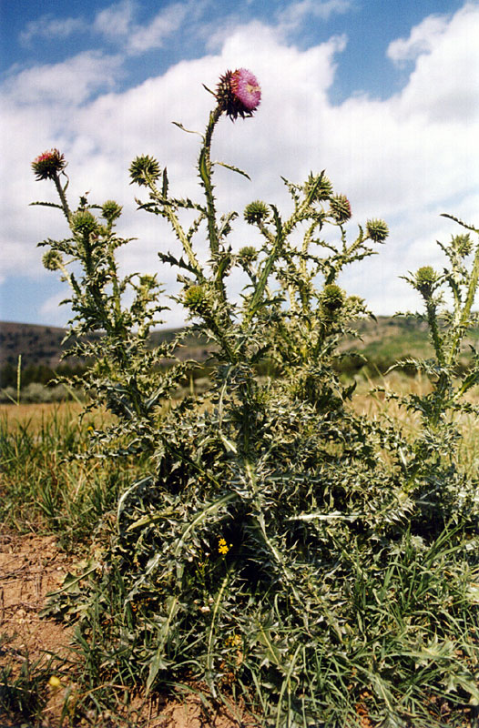
Emblem of Scotland –
thistle
According to the legend the thistle saved the country from the enemies during the war.

Slide 9
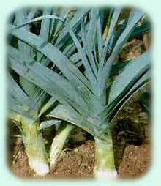
Leek
Symbol of Wales
Welsh people think that the leek deals with the legends about St.David. According to the legend this Christian ascetic ate only bread and leek.

Slide 10
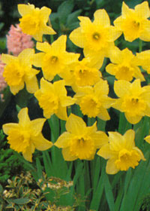
Daffodil -
emblem of Wales
Welsh people are convinced that daffodils opens as a sign of their love to St.David

Slide 11
The national flower of Northern Ireland is the shamrock, a three-leaved plant similar to clover. It is a symbol of trinity
Northern Ireland

Slide 12
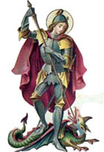
St.George’s flag
It is the first flag of England. St.George is a patron of England. He won the dragon.

Slide 13
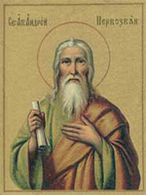
St.Andrew’s flag
St. Andrew is one of the 12 apostles, which is known as the patron of Scotland. He advocated Christianity.

Slide 14
St.Patrick’s flag
St.Patrick is the first bishop of the Irish Christian church. This red cross is the «part» of Ireland which is represented on the flag of the United Kingdom of Great Britain.

Slide 15
The flag of the UK is a combination of the flags of England (the cross of St. George), Scotland (the cross of St. Andrew), and Ireland (the cross of St. Patrick).

Slide 16
The British flag
UNION JACK

Slide 17
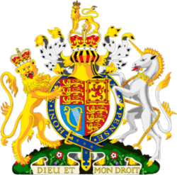
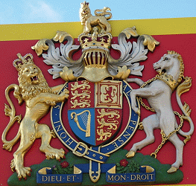
UK Royal Coat of Arms

Slide 18
On the coat of arms you see three yellow leopards on the red background (coat of arms of England), a red lion on the yellow background (coat of arms of Scotland), a yellow harp on the blue background (coat of arms of Ireland)
England has a leading role.

Slide 19
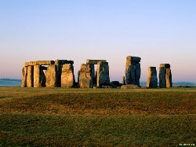
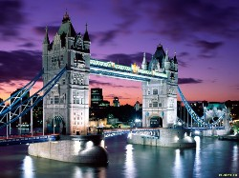
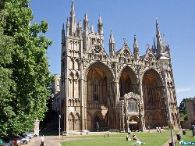
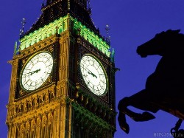
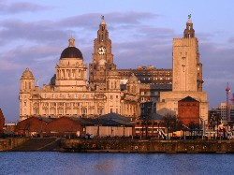
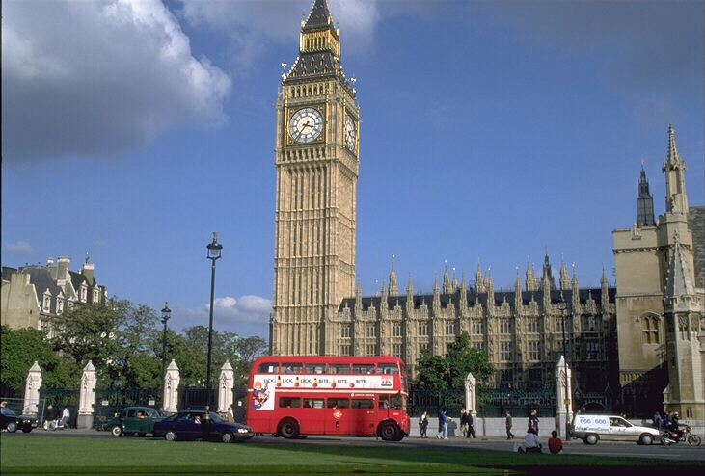
Other British symbols

Slide 20
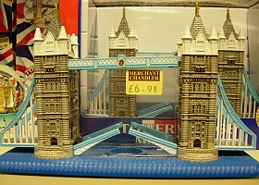
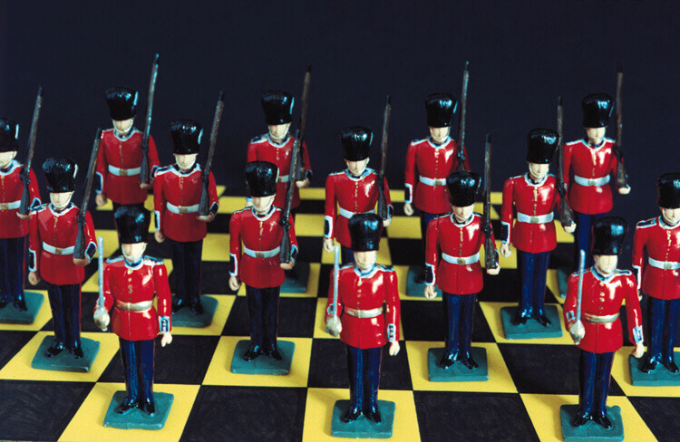
British souvenirs

Slide 21
The national anthem of Great Britain
The author of the anthem is Henry Carry.
People sang it first in 1740.
Strike down her enemies,
And make them fall:
Confound their politics,
Frustrate their knavish tricks,
On thee our hopes we fix:
God save us all!
God save our gracious Queen
long live our noble Queen,
God save the Queen!
Send her victorious,
happy and glorious,
long to reign over us:
God save the Queen!
O Lord our God arise,
Thy choicest gifts in store
on her be pleased to pour;
long may she reign;
may she defend our laws,
and ever give us cause
to sing with heart and voice
"God save the Queen!"

