Slide 1
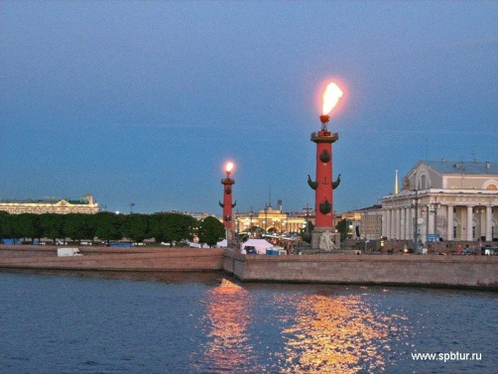
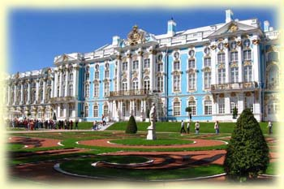
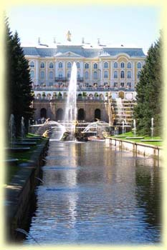
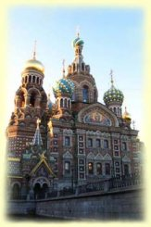
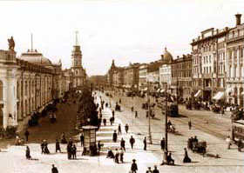
The History of St. Petersburg
REVISION

Slide 2
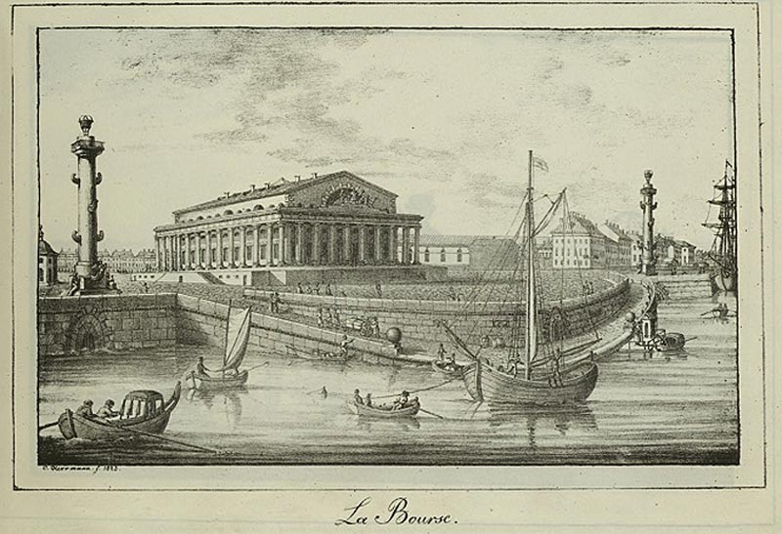
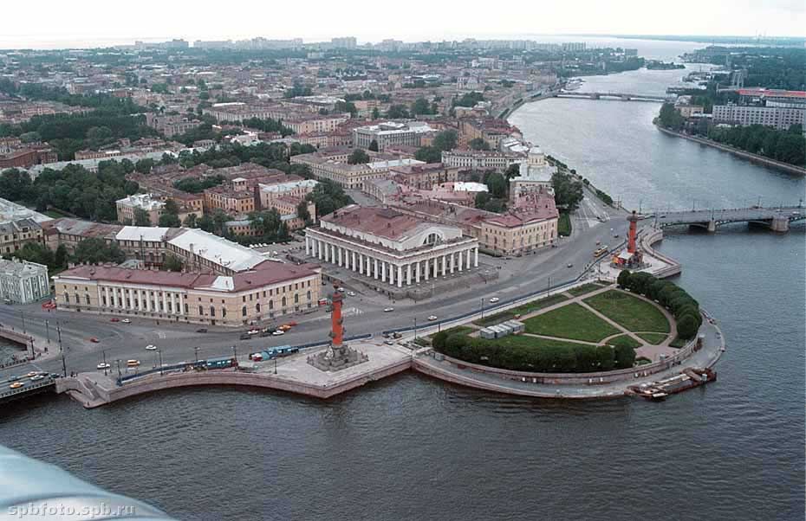
The Spit (Strelka)
of Vasilievsky Island

Slide 3
Match the events with the dates
1. There was a port until …
… in 1709
2. The foundation stone was laid…
… between 1829 and 1832
3. The Stock Exchange was founded…
… in 1710’s
4. The building of the Customs House was erected…
… between 1805 and 1810
5. The two Rostral Columns were installed…
… 1837
6. Peter the Great decided to make Vasilievsky Island the centre of his newly built capital…
… the middle of the 19th century
… in June 1805
7. The building of the architectural ensemble of the Spit began…
… in the first third of the 19th century
8. The commercial port was situated here till…

Slide 4
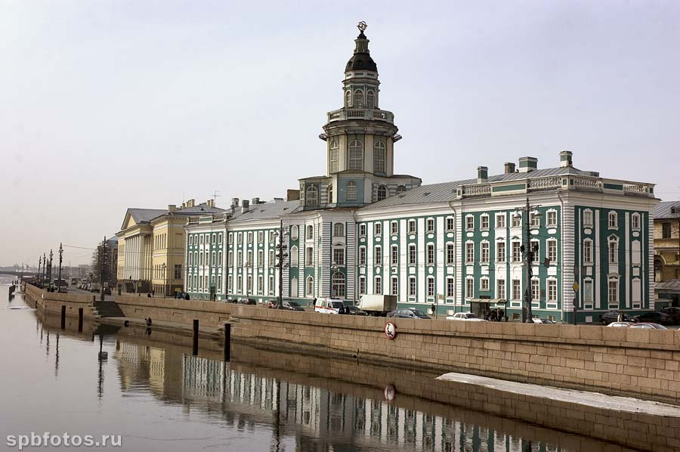
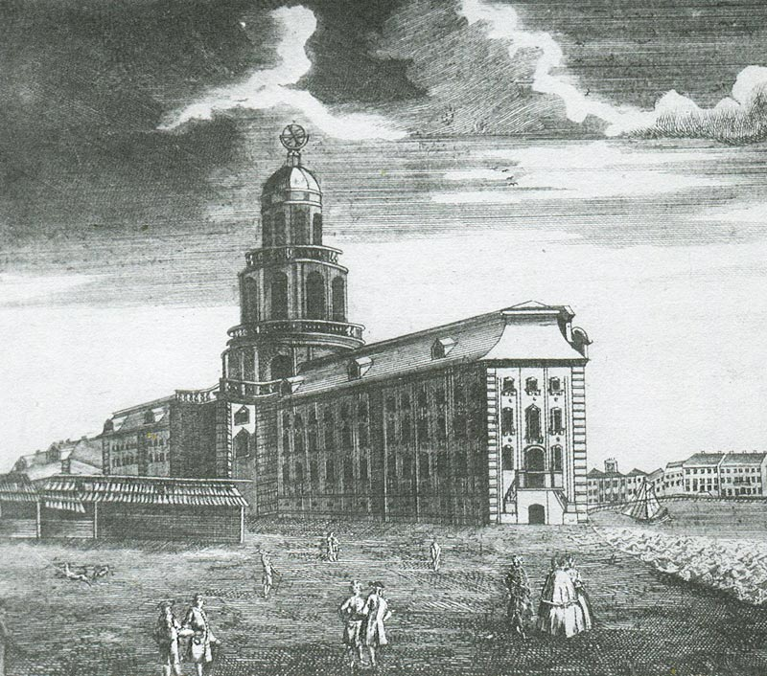
The kunstkammer

Slide 5
Choose the correct item
1. In 1878, the Peter the Great Museum of Anthropology and Ethnography ……… .
will be formed
was formed
is formed
2. The upper part of the building ……… in 948 – 1949.
was restored
is restored
were restored
3. The façade of the building ……… in three parts.
was divided
were divided
is divided
4. In 1836, on the base of the Kunstkammer collection several academic museums …… .
was created
were created
is created
5. First, the private collections of Peter the Great …….. In this building.
are exhibited
is exhibited
were exhibited

Slide 6
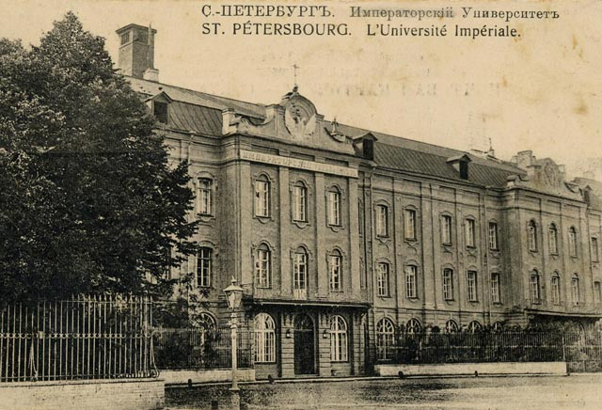
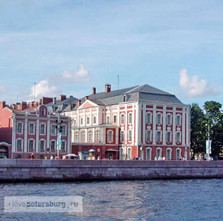
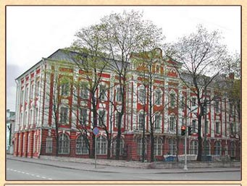
The Twelve Collegiums Building

Slide 7
Put these words in each sentence
are enrolled, was started, faces, were committed, is divided, stretches, were replaced
were replaced
1. The numerous state establishments (prikazy) ……………….. …… in 1718 by “collegiums” set up by Peter I.
was started
2. The construction of the Twelve Collegiums building ..………………. after Domenico Trezzini’s project in 1722.
were committed
3. The colleges …..…………………….. in the direction of certain branches of economy and state services.
is divided
4. The building ………………… into twelve identical but independent sections.
are enrolled
5. Nowadays, over 17,000 students ……………………. in its departments.
faces
stretches
6. One end of the building ………………… the Neva, the main façade ……………………. for nearly half a kilometre into the island.

Slide 8
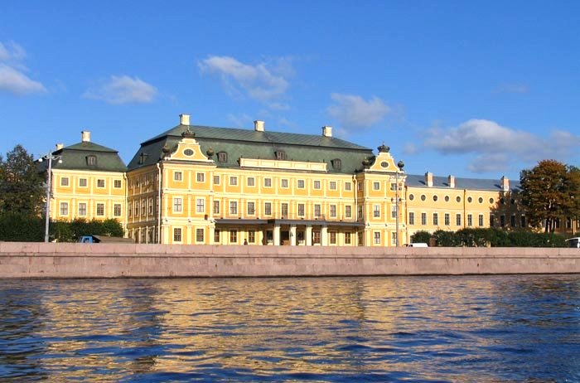
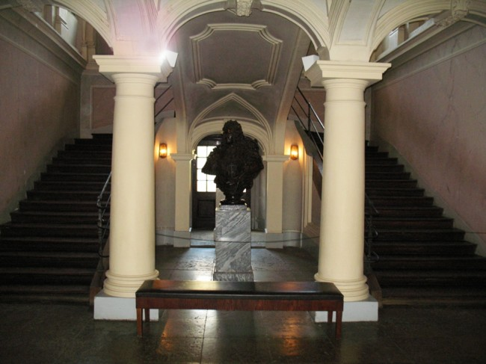
The Menshikov Palace

Slide 9
Express the same in English
Александр Меншиков был ближайшим другом и помощником Петра Великого.
Alexander Menshikov was Peter the Great’s closest associate and friend.
2. Главной обязанностью Меншикова было осуществлять все проекты Петра I.
Menshikov’s main duty was to realize all Peter’s projects .
3. Петр I подарил Меншикову Васильевский остров.
Menshikov was given Vasilievsky Island as a present by Peter I.
4. Когда Меншиков владел островом, он сумел построить для себя роскошный дворец.
When Menshikov owned the island, he managed to built luxurious palace for himself .
5. В 1727 году Меншиков проиграл борьбу за власть и был сослан в Сибирь, где умер через два года.
In 1727 Menshikov lost the struggle for power and was sent to Siberia where he died two years later .
6. В конце XX века дворец был восстановлен, и сейчас там находится музей.
At the end of the 20th century the palace was restored, and now it houses a museum.

Slide 10
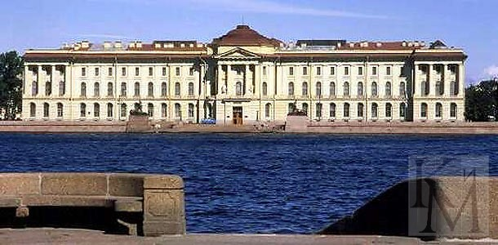
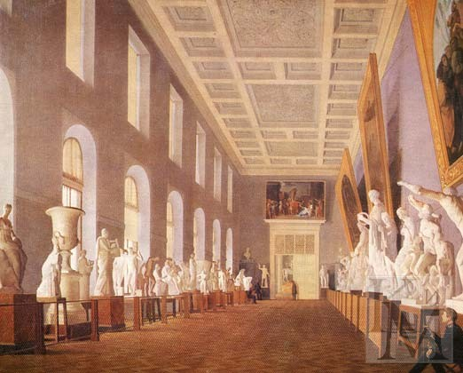
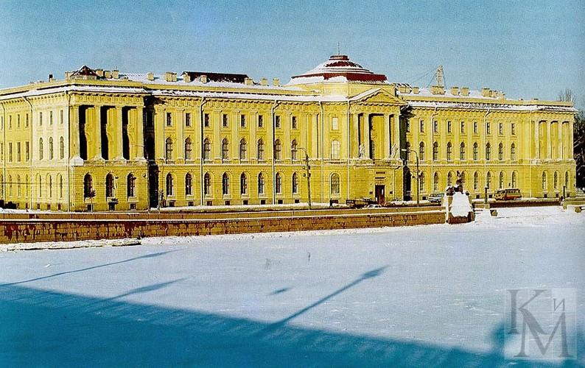
The Academy of Arts

Slide 11
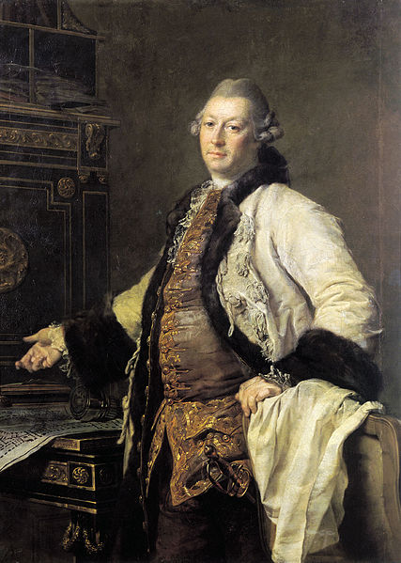
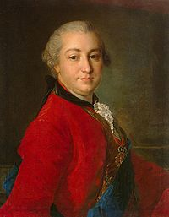
Alexander Kokorinov
Ivan Shuvalov

Slide 12
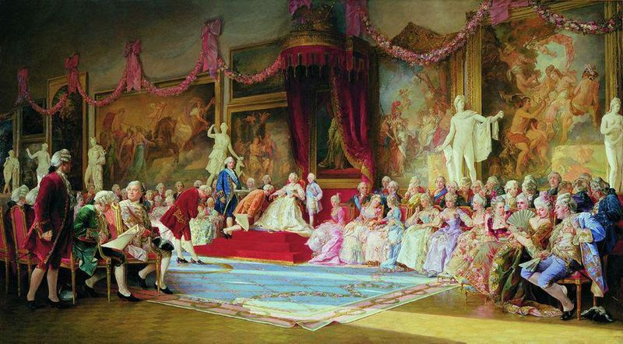
The Inauguration of the Academy of Arts, a painting by Valery Jacobi.

Slide 13
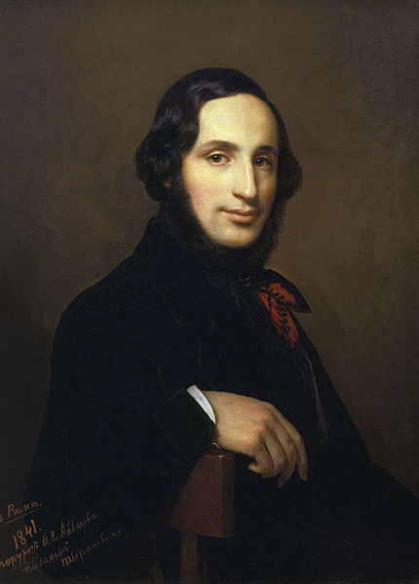
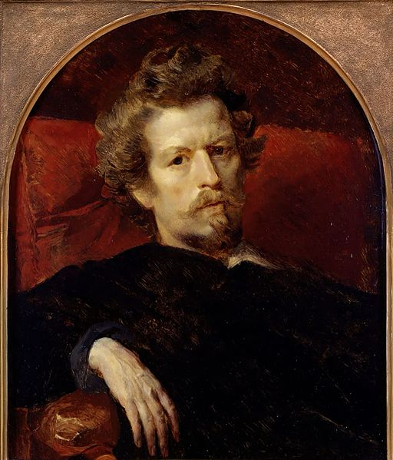
Ivan Ayvazovsky
Karl Bryullov

Slide 14
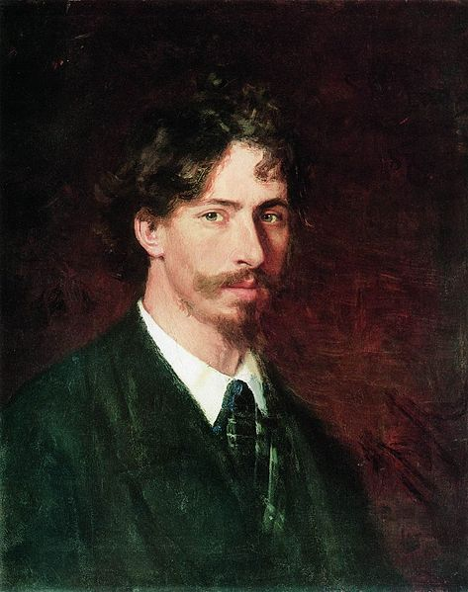
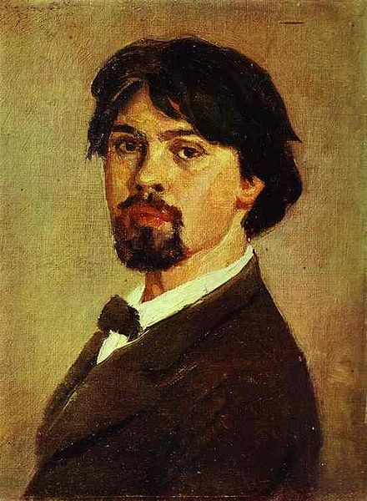
Ilya Repin
Vasily Surikov

Slide 15
http://myworldshots.com/ru/Russia/St-Petersburg/Kunstkamera-Museum/Vasilevsky-Island-Kunstkamera-Building-95.html
http://spbfotos.ru/postcard.img500.htm
http://hellopiter.ru/Building_of_twelve_boards.html
http://welcomespb.com/menshikovpalace.html
http://tochek.net/lofiversion/index.php/t26023.html
http://travel-live.ru/dvorec-menshikova-v-sankt-peterburge.html
http://www.megabook.ru/MediaViewer.asp?AID=608870
http://commons.wikimedia.org/wiki/File:Levitsky_kokrinov.jpg?uselang=ru
Автор презентации: Дмитрук Л.Е., учитель английского языка ГБОУ № 180

