Slide 1
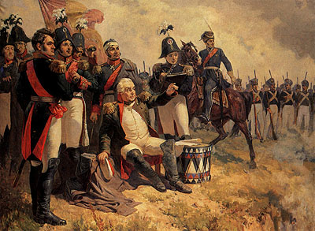
Borodino

Slide 2
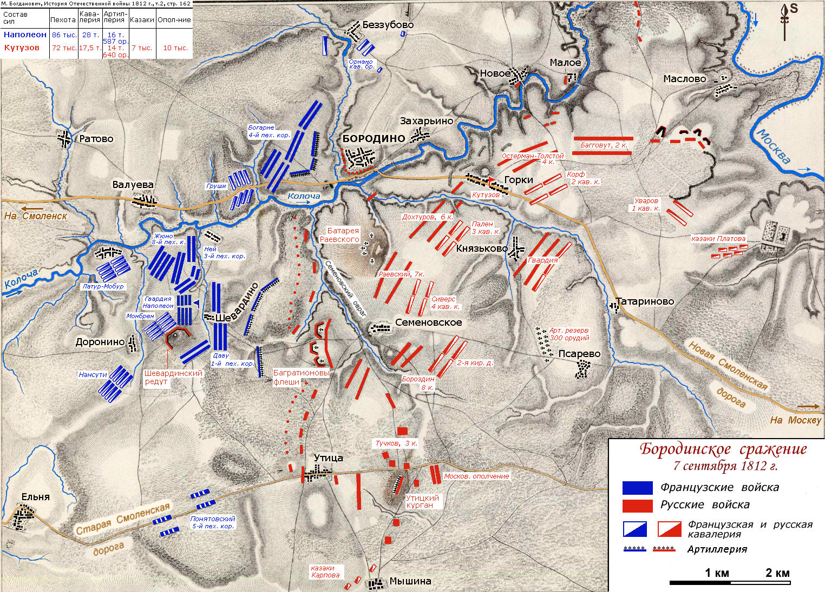
Borodino
Kutuzov
battle
18122
Napoleon
fight
army

Slide 3
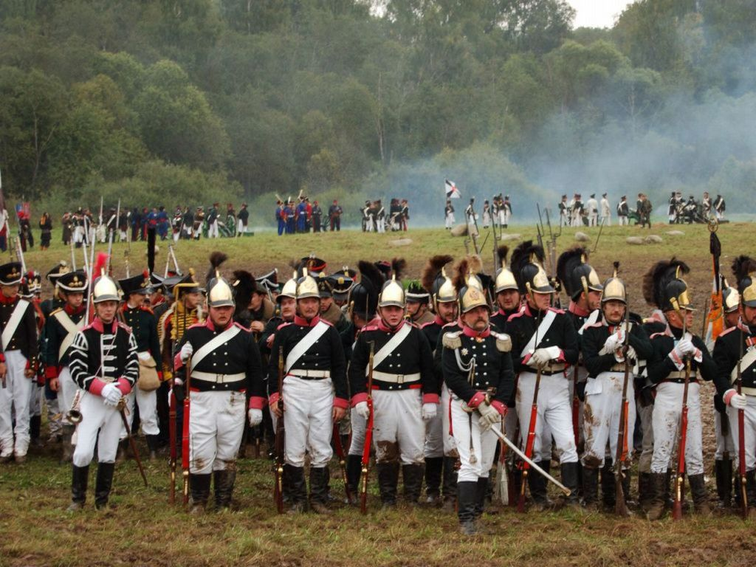
Borodino
Emperor Napoleon
Mikhail Kutuzov
Battle
Battlfield
Involving
Casualties
Wounded
Campaign
Invasion
wounded

Slide 4
Fill in the gaps. Use words: Napoleon, Borodino, wounded, Kutuzov, battlefield, battle, campaign.
In the fall of 1812, invading French troops under ... sought to capture Moscow.
The French and Russian armies fought a major battle .... , just outside Moscow.
The French army won the ..... and entered Moscow without a struggle.
The French Army attacked the Imperial Russian Army under General …
The battle of Borodino was a pivotal point in the ….
One of the famous Russian writers visited …. of Borodino by writing his novels.
Millions solders were killed or ….. During this war.

Slide 5
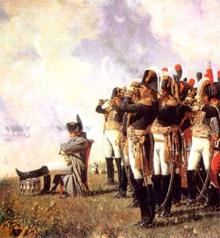
Questions
1. When takes place the battle of Borodino?
2. Who takes place in the battle?
3. Could you tell me the result of this campaign?
4.How is honourd the memory of the battle?

Slide 6
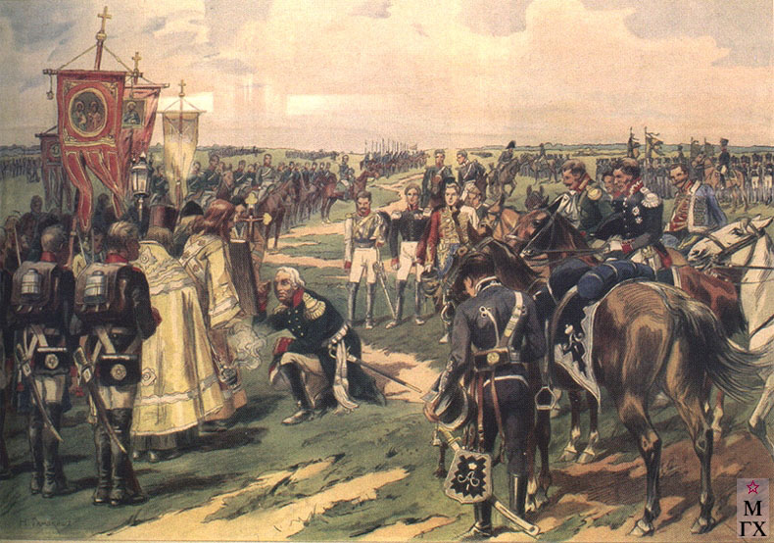
Reflection
Do you like the lesson?
What was new for you?
Was the lesson interesting (not interesting)? Why?

Slide 7
Истоники
http://www.youtube.com/watch?v=CPYTF1WVqIY музыкальный отрывок
http://viki.rdf.ru/media/upload/preview/879.jpg картинка 1
http://schkola1.files.wordpress.com/2012/02/battle_of_borodino_1812_map.jpg карта
http://www.1812w.ru/img/19vek/napoli_leto.jpg картинка 2
http://www.mostransavto.ru/mp/borodino/027.jpg картинка 3
http://maslovka.info/images/555/SAMOKISH-41.jpg картинка 4
http://www.reedline.com/Workout/0907.htm текст Приложение 1

