Slide 1
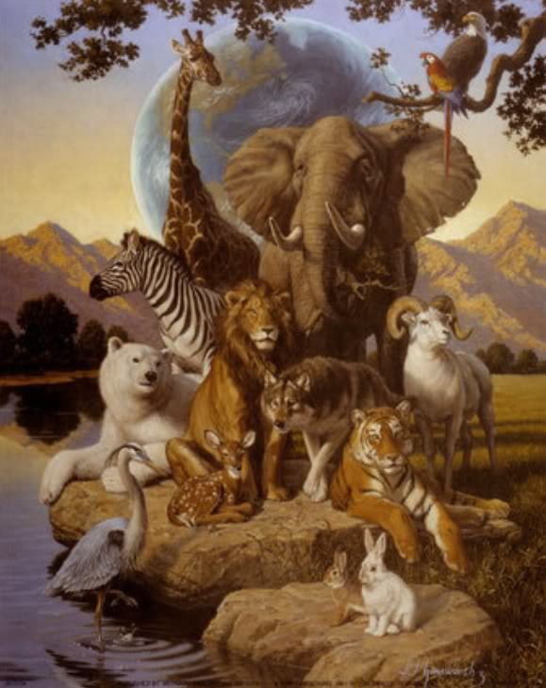
Animals

Slide 3
B_a_
_i_d
Ra_b_t
Ch_m_
_le_ha_t
S_ide_
K_ngaro_
_ort_ise

Slide 4
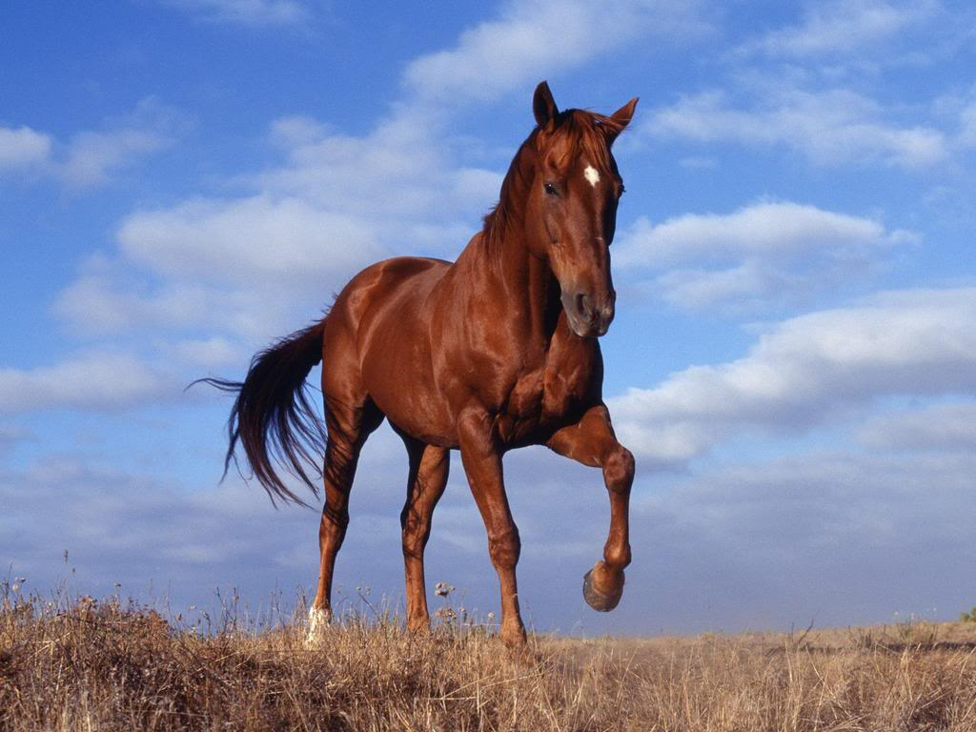
torpar - parrot
gofr - frog
hckic - chick
aksne - snack
acmle - camel

Slide 7
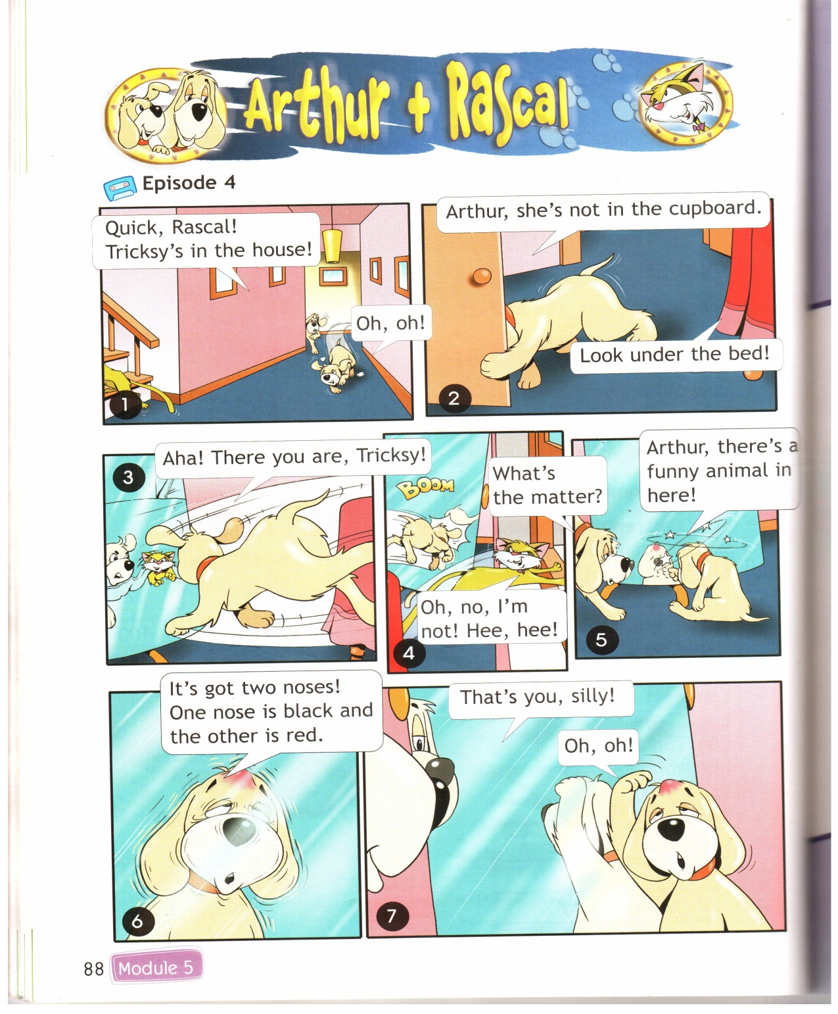

Slide 8
The Can Can Song
Can, can you dance
Like I can?
Can you sing like I can?
Can you run
And can you jump
Like me?
Can, can you walk
Like Can you talk like I can?
Can you swim
And can you climb
Like me?

Slide 9
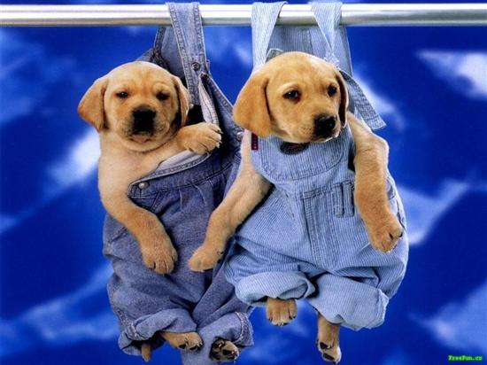
Good bye!

