Slide 1
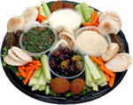
The FOOD for the Olympic Champion

Slide 2
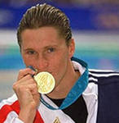
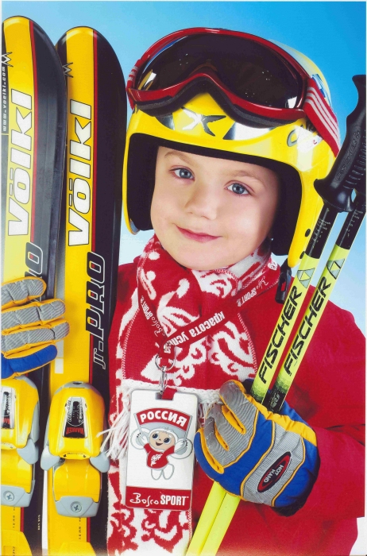

Slide 3
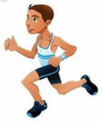
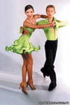
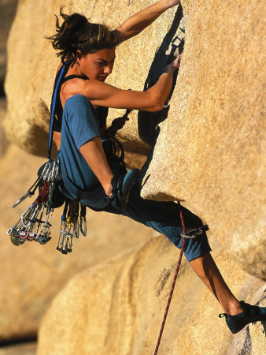
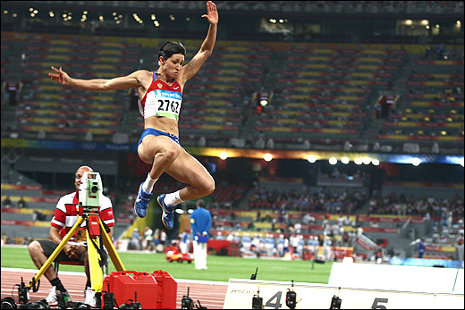
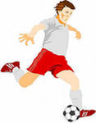
What can you do?

Slide 4
FOODLAND

Slide 5
Let’s read together
1,2,3 Let me see
Who likes coffee, who likes tea
1,2,3 Oh, I see
You like coffee, I like tea
****************************************
Mary, Max! take your seat.
Drink your tea and eat your sweat

Slide 6
a | b | k | v | w | m | s | o | c | q
n | d | l | r | e | t | s | c | h | i
a | k | m | i | l | k | w | p | e | k
n | s | a | c | a | e | e | t | e | a
a | b | f | e | n | j | e | h | s | p
b | u | r | g | e | r | t | d | e | p
z | m | k | d | g | l | s | s | x | l
o | r | a | n | g | e | a | l | p | e

Slide 7
What do you like to eat?
I like…
I don’t like…

Slide 8
d,o,F,o
e, a, b, l, e, g, V, t, e
g, g, E
p, A , l, e, p
d, m, o, n, L, e, a, e

Slide 9
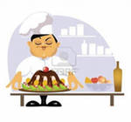
Find the shop
Dairy’s
Butcher’s
Greengrocer's
Сonfectioner's

Slide 10
Name the food you eat.
I eat … but
I don’t eat

Slide 12
MENU FOR THE WHITE BEAR
For breakfast
For dinner
For supper

Slide 13
Thank you for attention!

