Slide 1
BOOKS IN OUR LIFE
Form 8,«English», by O.Afanasyeva, I.Mikheeva, Prosveshchenie Publishing House

Slide 2
Plan of the Lesson
Tongue-twister (ppt)
Books. How can they look like? What spheres of our life can books touch upon (genres – [‘ʒα:nιə])? (www)
Reading for Information and answering questions (ppt)
Grammar. Matching (ppt)
An entertainment Break (ppt)
Listening (glog)
Listening & Reading (textbook)
Vocabulary - Grammar Test (ppt)
How can they deal with books? Reading & singing (ppt)
Conclusion

Slide 3
Tongue-twister There was an old lady
Free Novels, Free Children's Books, Free Short Story Collections, and Free Poetry Books
250+ Places for Free Books Online

Slide 4
Reading for Information. Watch the presentation & look for the answers to the questions given. Write down the answers & hand in the papers - Fairy Tales
Grammar. Matching (either/neither/none; substantivized adjectives). Legends & Ballads. Watch a presentation & fill in the gaps - Robin Hood

Slide 5
A Minute Break for some Exercise. Listen to a song, sing it marching – Yankee Doodle

Slide 6
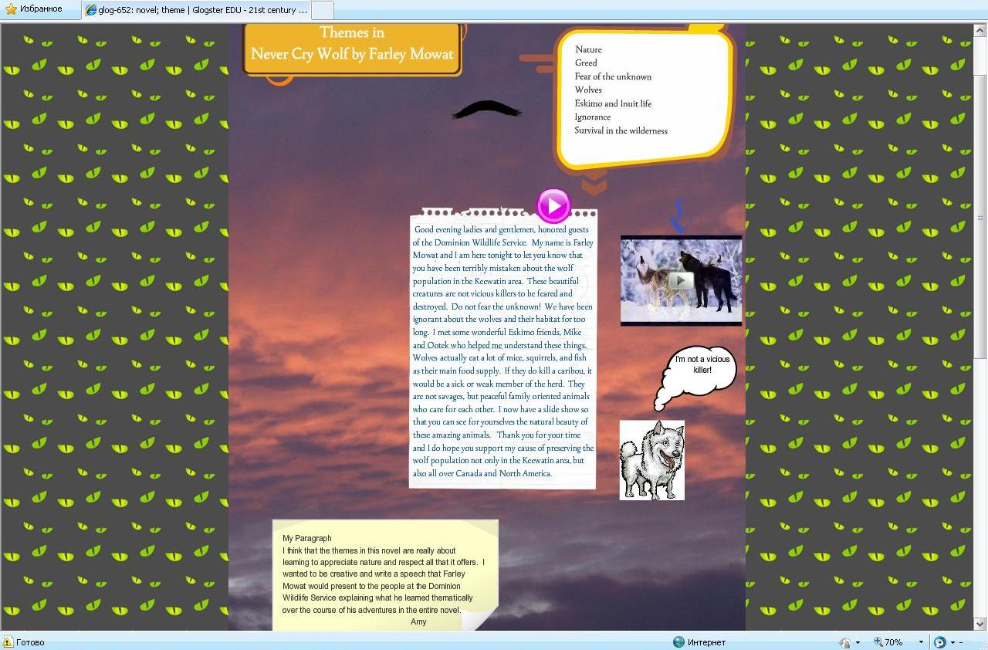
Listening for Information. Watch a teenager’s glog & answer the questions

Slide 7
The teenager’s glog
answer the questions
What is the girl’s name?
Where does she live?
What is the topic of her project?
Who helped her learn the information?
Good evening ladies and gentlemen, honored guests of the Dominion Wildlife Service. My name is Farley Mowat and I am here tonight to let you know that you have been terribly mistaken about the wolf population in the Keewatin area. These beautiful creatures are not vicious killers to be feared and destroyed. Do not fear the unknown! We have been ignorant about the wolves and their habitat for too long. I met some wonderful Eskimo friends, Mike and Ootek who helped me understand these things. Wolves actually eat a lot of mice, squirrels, and fish as their main food supply. If they do kill a caribou, it would be a sick or weak member of the herd. They are not savages, but peaceful family oriented animals who care for each other. I now have a slide show so that you can see for yourselves the natural beauty of these amazing animals. Thank you for your time and I do hope you support my cause of preserving the wolf population not only in the Keewatin area, but also all over Canada and North America.

Slide 8
1) Listening & Reading.
Open your textbooks at p.174, ex.62. Listen to the text “The Surgeon” (05_-_No_26,_Ex._62.mp3) & try to read it artistically.
2) Now let’s answer the questions of ex.63, p.174.

Slide 9
Grammar Test. Expressions with do, make, have, get. Тест по глаголам «do, make, get, have» [предлагаемый тестовый материал разработан с использованием шаблона Комаровского А.Н. (http://www.rosinka.vrn.ru/pp/)] - http://metodisty.ru/m/files/view/didaktichekii_material_Make_do

Slide 10
Genre - Geography Books.
Let’s listen to a story about Canada &
join the author – Trees and rocks
We should give our book recommendations for children & teenagers abroad. I mean our country – Russia.
While watching the presentation do the tasks given - Russia (summary)

Slide 11
Some activity in store - Riddles & Jokes
H/t: to write your own story about any event at school or at home, or somewhere else (a short publication for our school newspaper). I want you to use Adverbs of Time & Frequency in your stories. Do the task for the next Friday.
And for the next lesson: practice your imagination & speak about the events described in the story “The Surgeon” as a medical engineer (Ex.65, p.174).

Slide 12
Grammar Test. Expressions with do, make, have, get. Тест по глаголам «do, make, get, have» [предлагаемый тестовый материал разработан с использованием шаблона Комаровского А.Н. (http://www.rosinka.vrn.ru/pp/)] - http://metodisty.ru/m/files/view/didaktichekii_material_Make_do

Slide 13
Thank you for the Time!

