Slide 1
Tell me about the past
New Millennium UNIT 7 Lesson 4

Slide 2
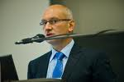
Speech (Речь)
Direct speech
(Прямая речь)
Indirect speech (Косвенная речь)

Slide 3
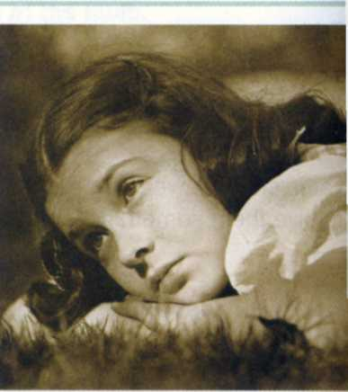
"It was a difficult time for me."
She said
(that)
it was a difficult time for
her.

Slide 4
2. Read and report what Nancy said.
"I heard it on the radio.“
She said
(that)
she heard it on the radio.

Slide 5
2. Read and report what Nancy said.
"I worked in a hospital in Boston.“
She said
(that)
she worked in a hospital in Boston.

Slide 6
2. Read and report what Nancy said.
"I didn't know there was so much pain in the world.“
She said
(that)
she didn't know there was so much pain in the world.

Slide 7
2. Read and report what Nancy said.
"We met people from different parts of the country.“
She said
(that)
they met people from different parts of the country.

Slide 8
2. Read and report what Nancy said.
"I had friends who were in the services.“
She said
(that)
she had friends who were in the services.

Slide 9
2. Read and report what Nancy said.
"We grew up quickly because of the war.“
She said
(that)
they grew up quickly because of the war.

Slide 10
2. Read and report what Nancy said.
"I thought about the war every day.“
She said
(that)
she thought about the war every day.

Slide 11
2. Read and report what Nancy said.
"We were very serious about life.“
She said
(that)
they were very serious about life.

Slide 12
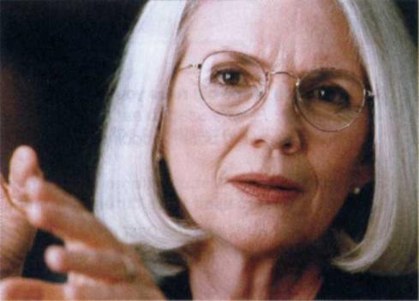
In 1939 Tina was in junior high school.
"In 1939 I was in junior high school."

Slide 13
Many boys from her сlass left school and joined the army.
" Many boys from my сlass left school and joined the army."

Slide 14
She said she wanted to join the army, too.
" I wanted to join the army, too."

Slide 15
She even wrote to the President and said she just wanted to go, but she didn't get any answer.
" I even wrote to the President and said I just wanted to go, but I didn't get any answer."

Slide 16
The end.

